Slide 1
City of Spokane Valley
Shoreline Master Program Update
2013 Spokane River Conference
March 26, 2013

Slide 2
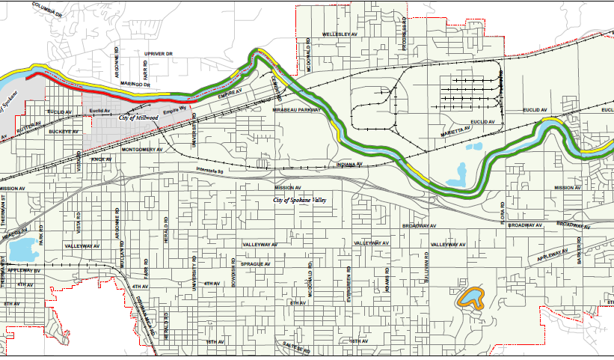
Spokane Valley’s Shorelines
Spokane River
Gravel Pit
Shelley Lake
Gravel Pit

Slide 3
SMP Update Team
Staff
Van Ness Feldman GordonDerr Special Legal Counsel
URS, Corp.
Technical Consultants

Slide 4
Development of Each Element
Legal Review
Preliminary Draft Developed
Public Review Draft Completed
SAG Issues
Inventory Report
Law/Guidelines
Research and Review
Technical Advisory Group Review
REVISED

Slide 5
SMP Update Elements
Inventory and Characterization Report/Analysis
Goals and Policies
Address Cumulative Impacts
Shoreline Environment Designations
Develop Regulations
Restoration Plan
Administrative Procedures
Local Adoption
Public Review Process
Public Access Plan

Slide 6
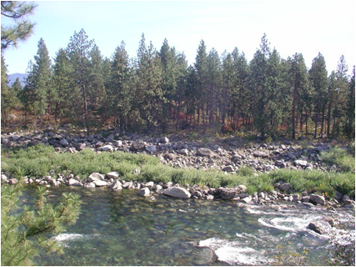
Environment Designations
Residential
Upland Residential
Public Lands /Zoned for Developm’t
Urban Conservancy
High Quality Env. - Designated Conservat’n
Urban Conservancy - High Quality
Waterfront Residential
Land Below OHWM
Aquatic

Slide 7
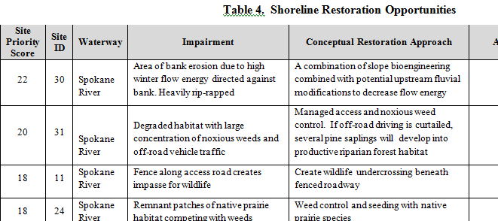
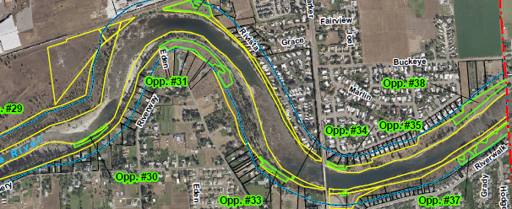
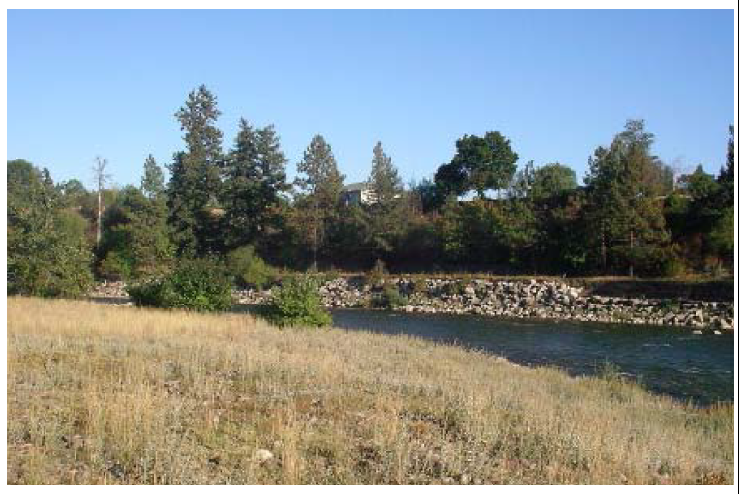
Restoration
Opportunities
Table of Restoration Opportunities
Conceptual Restoration Approaches
    Riparian Plantings
    Streambank Stabilization
    Noxious Weed Control
Maps and representative photos

Slide 8
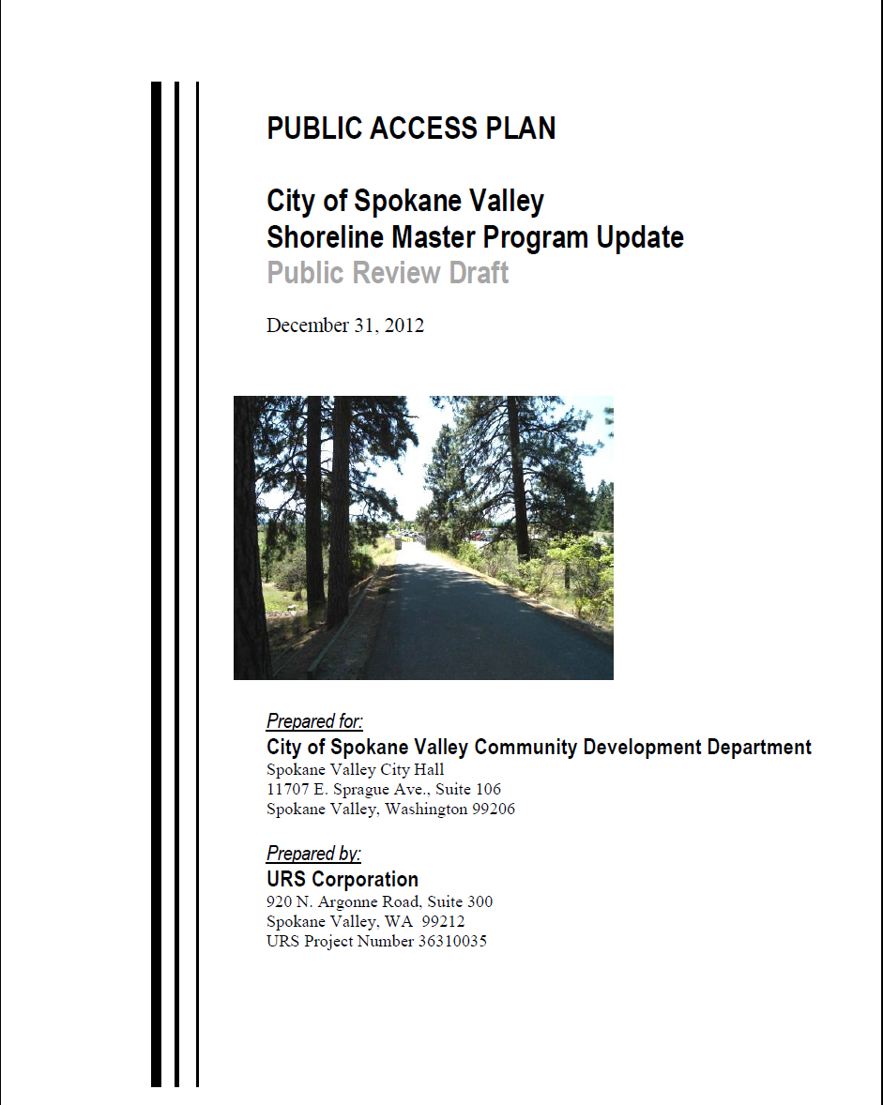
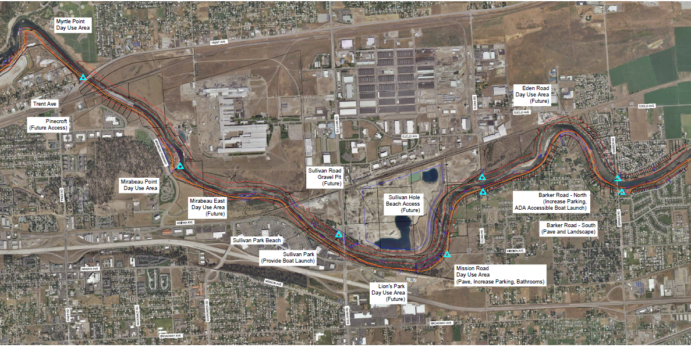
Public Access Plan
Integration with other Community Plans
Public Access and Public Uses
Shoreline Conditions
Public Access Plan
Implementation Strategy

Slide 9
Development Regulations – Under Construction

Slide 10
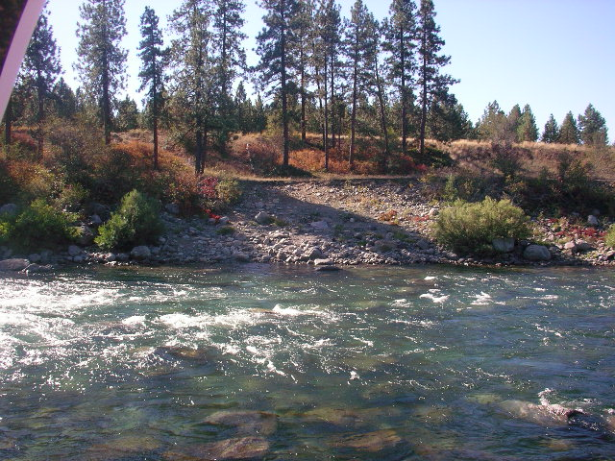
What are the Critical Issues?
Buffers
Land Uses Allowed
Docks
Public Access
Restoration
Balancing Private Property Rights
Vegetation management (public and private)
Shoreline Modification

Slide 11
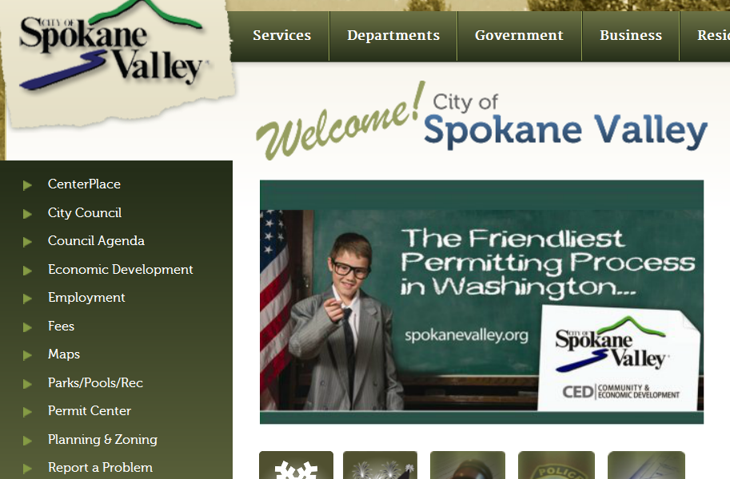
www.spokanevalley.org
Planning and Zoning
Long Range Planning
Shoreline Master Program

