Slide 2
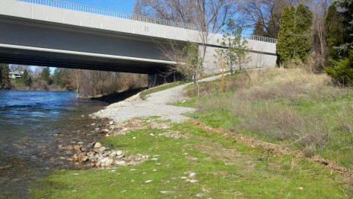
Barker Road

Slide 3
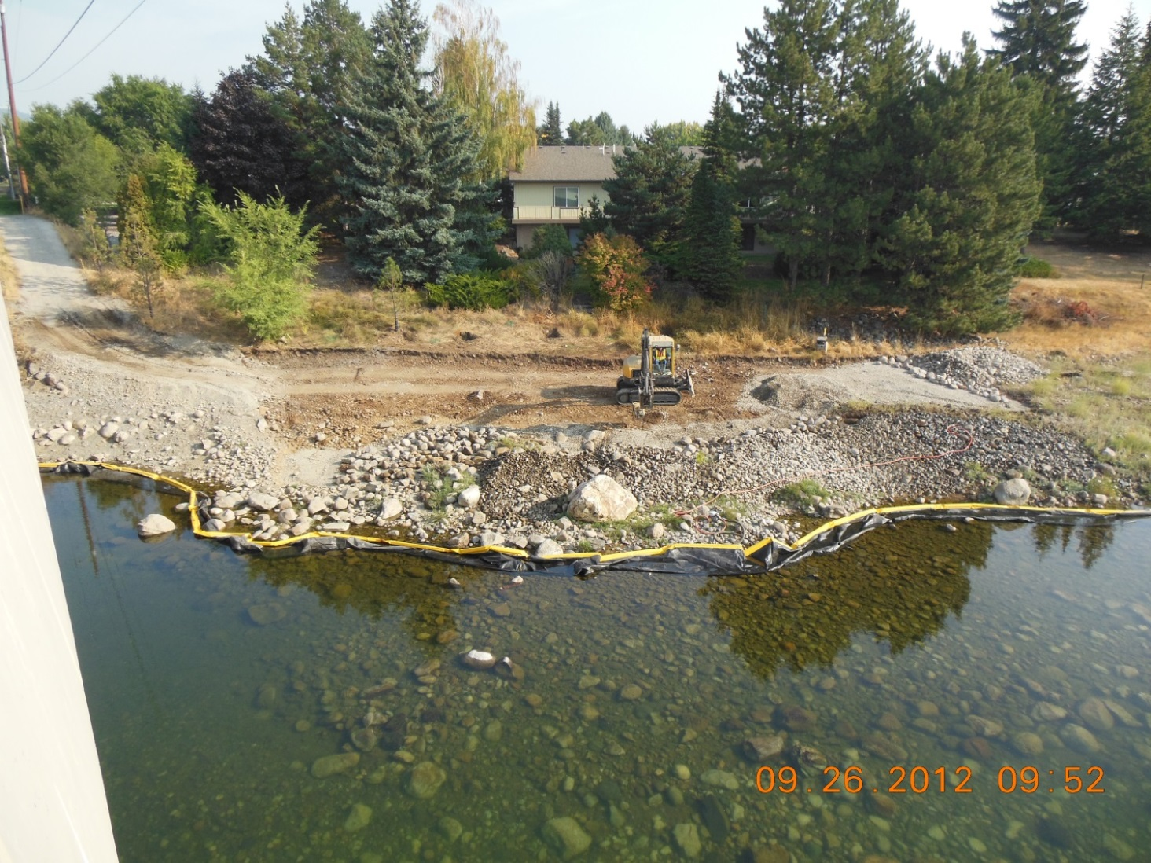
Barker Road

Slide 4
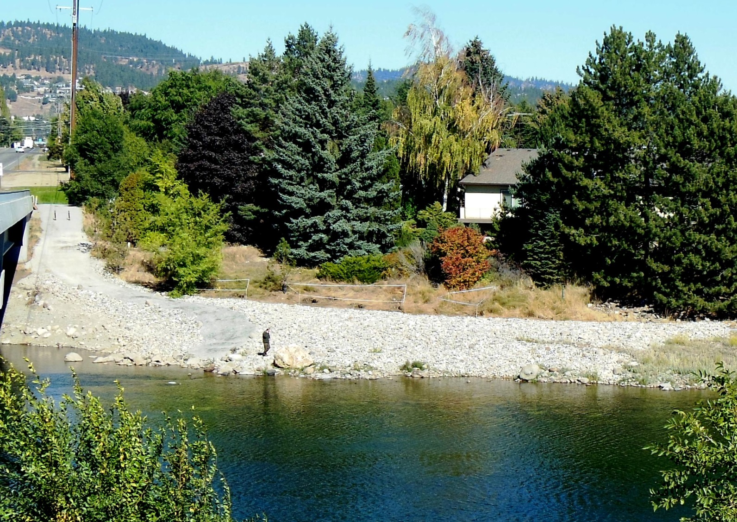
Barker Road

Slide 5
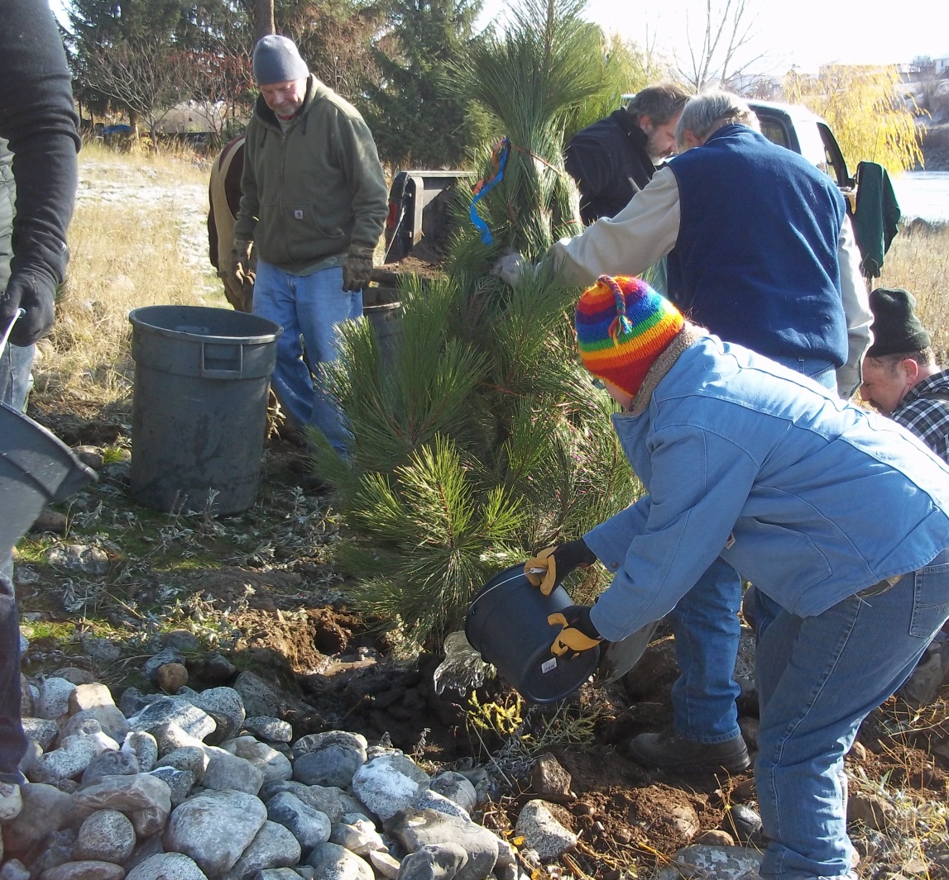
Barker Road

Slide 6
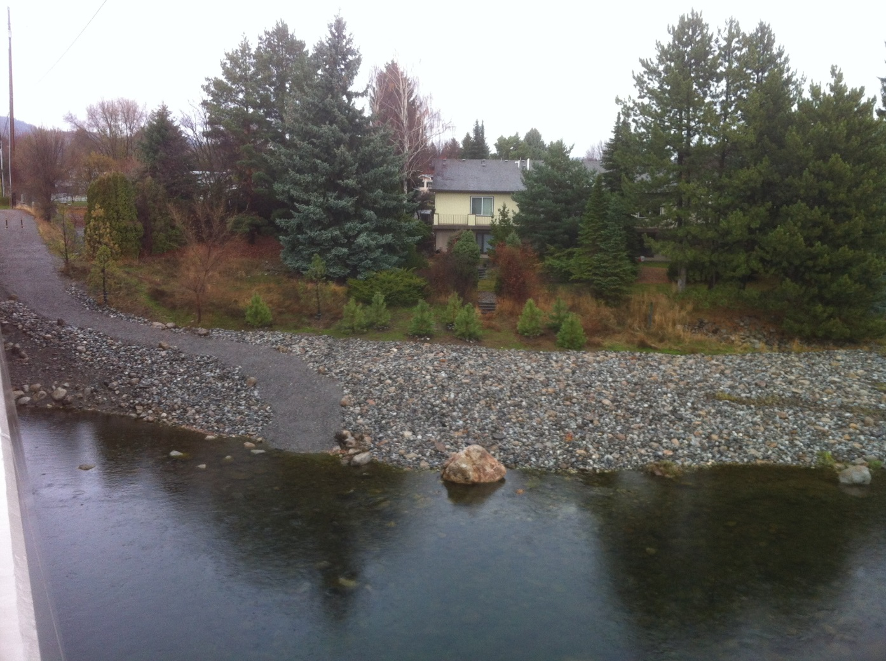
Barker Road

Slide 7
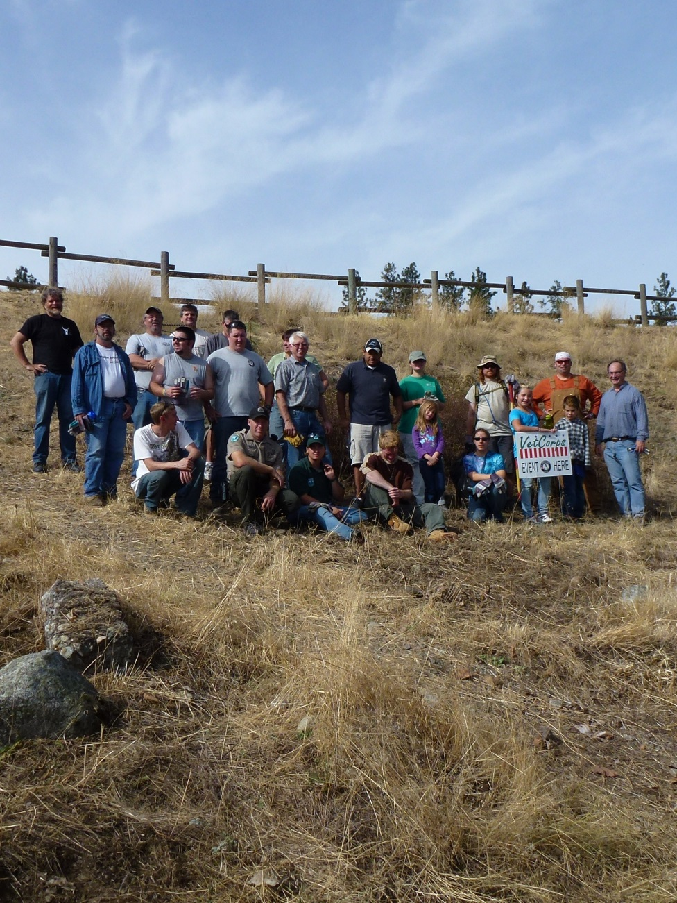
Mirabeau

Slide 8
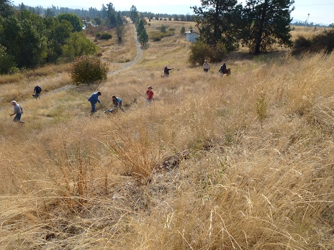
Mirabeau

Slide 9
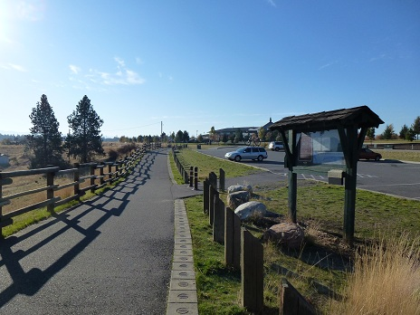
Mirabeau

Slide 10
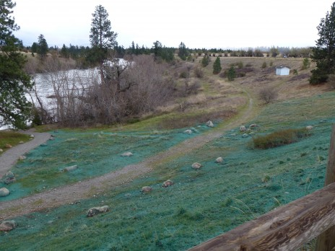
Mirabeau

Slide 11
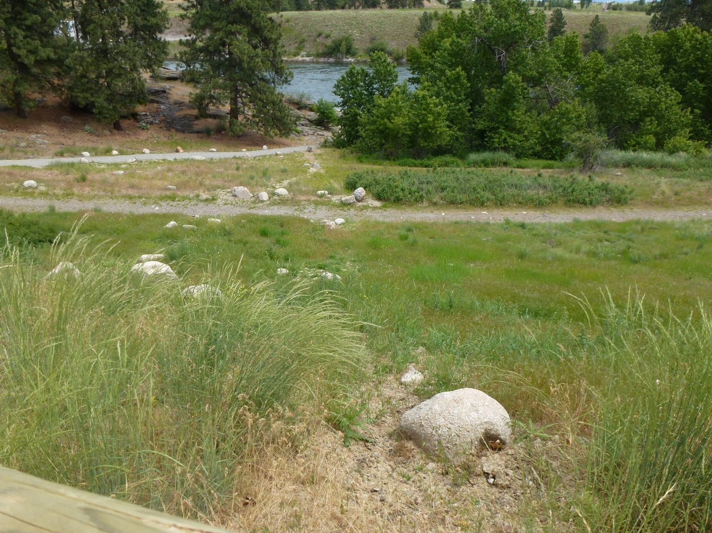
Mirabeau

Slide 12
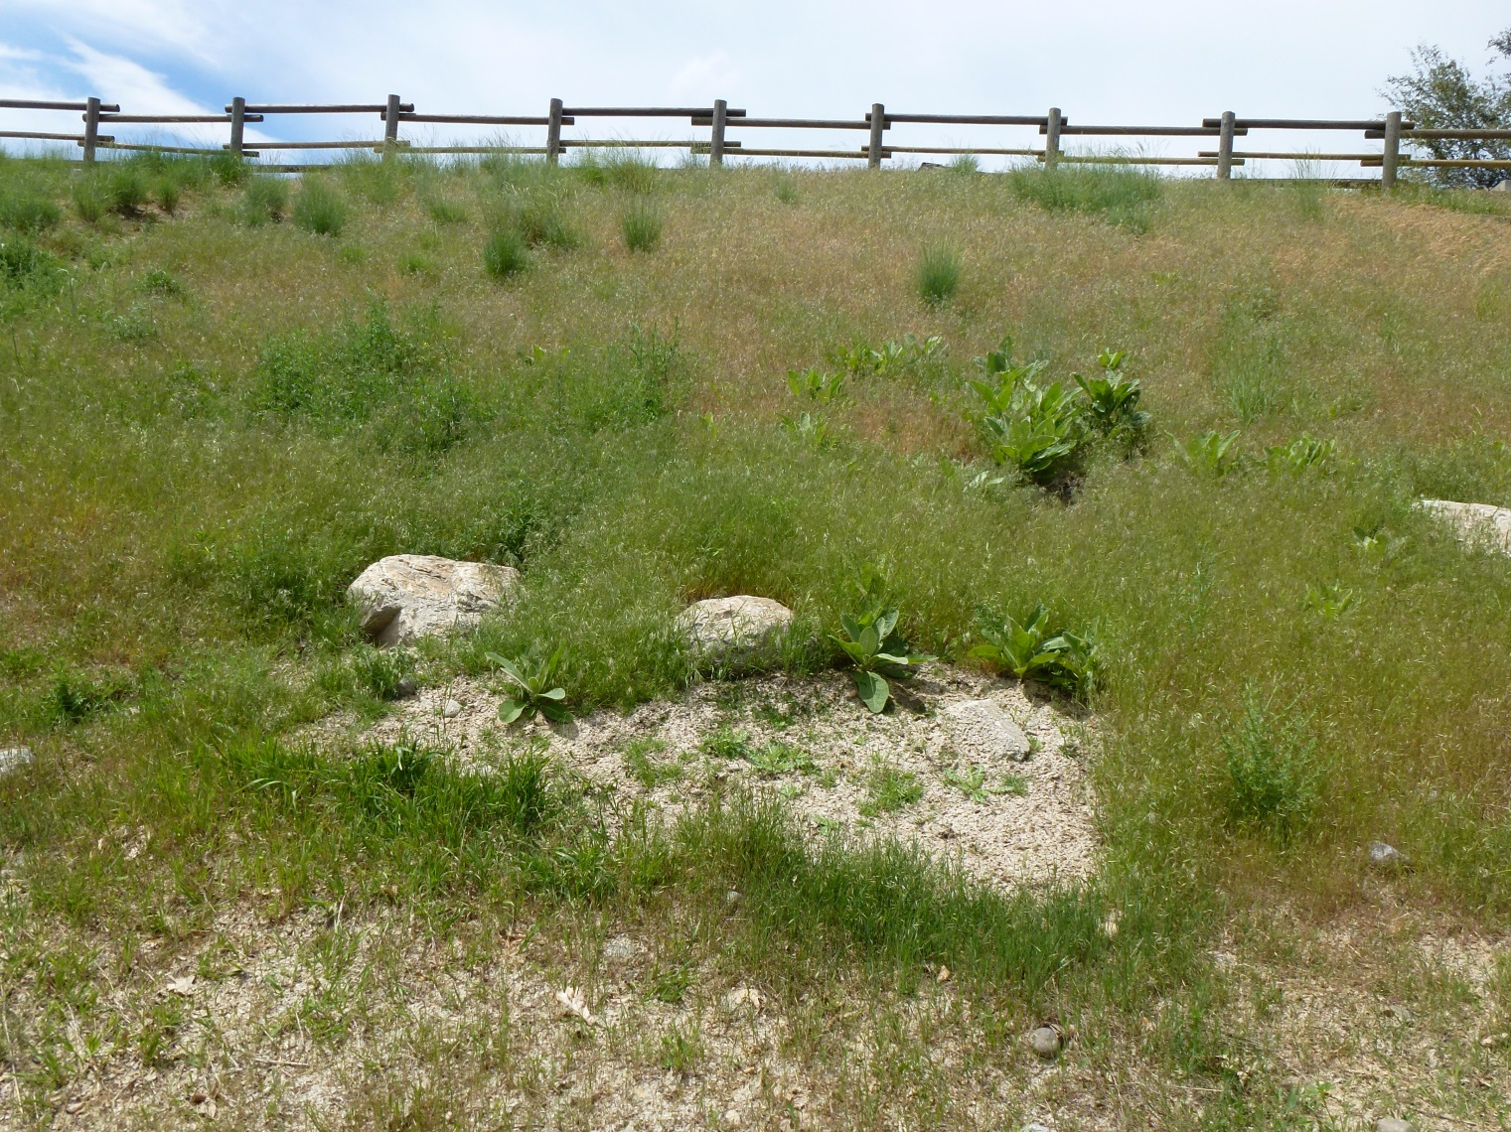
Mirabeau

Slide 13
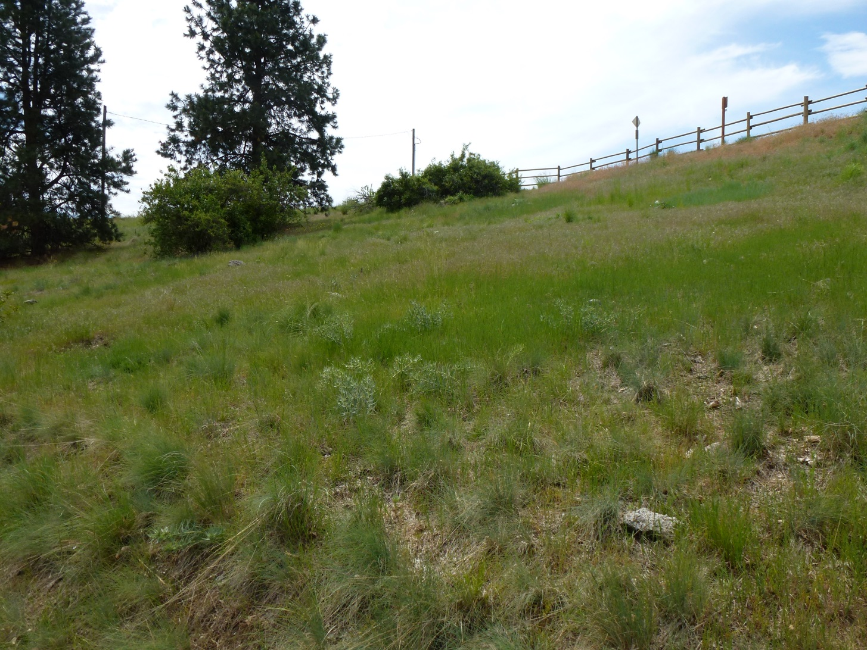
Mirabeau

Slide 14
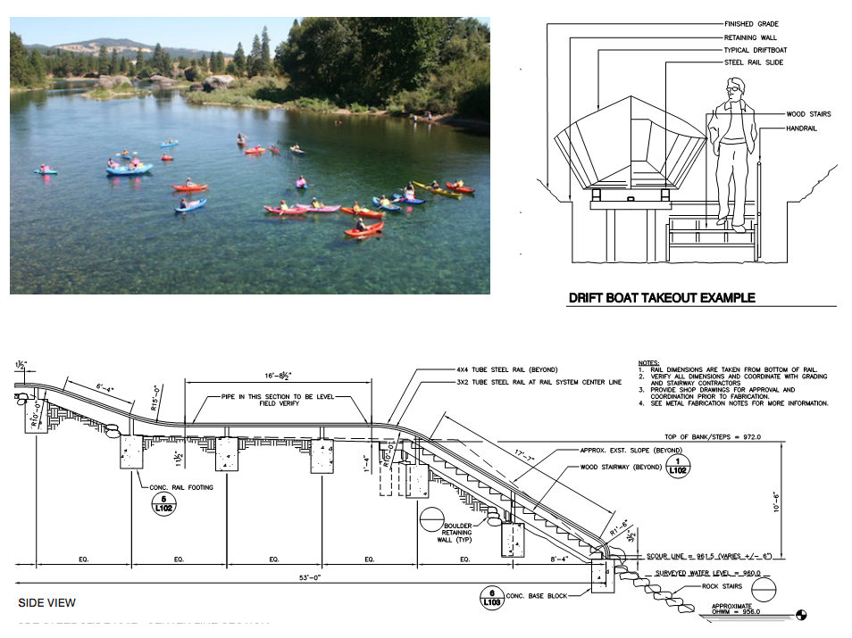
Coyote Rock/Islands Trailhead

Slide 15
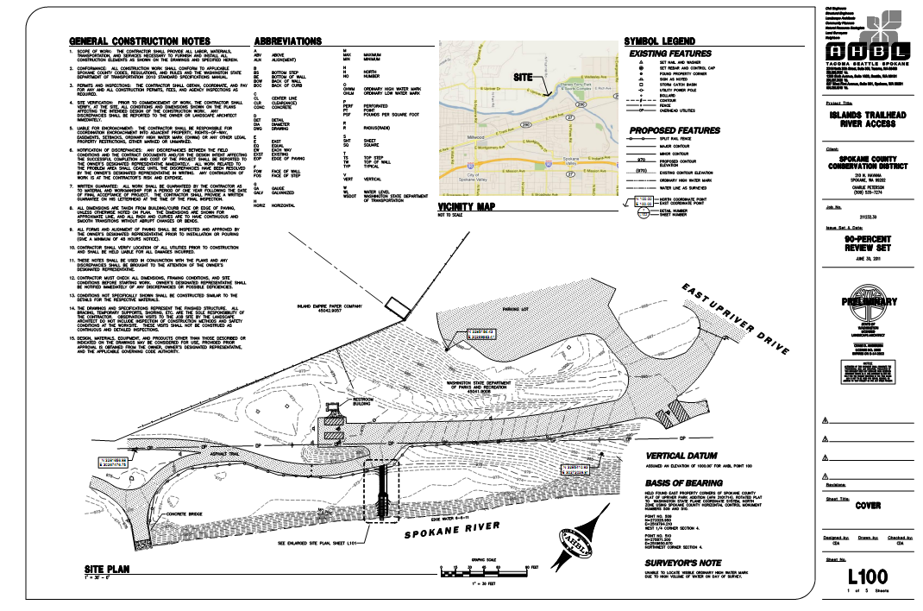
Coyote Rock/Islands Trailhead

Slide 16
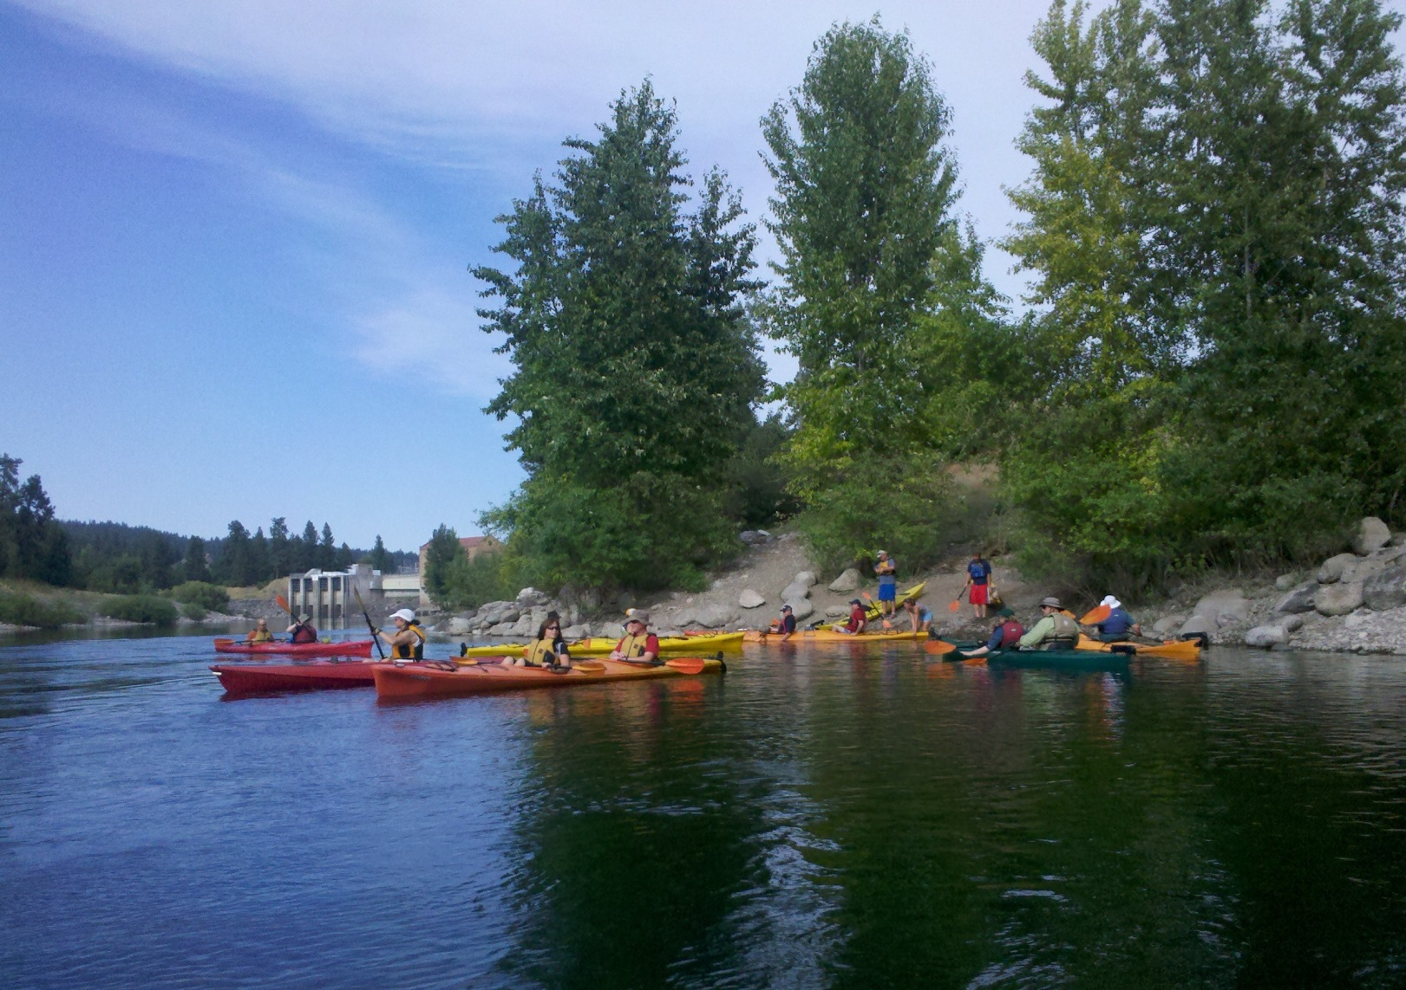
Upriver Dam

Slide 17
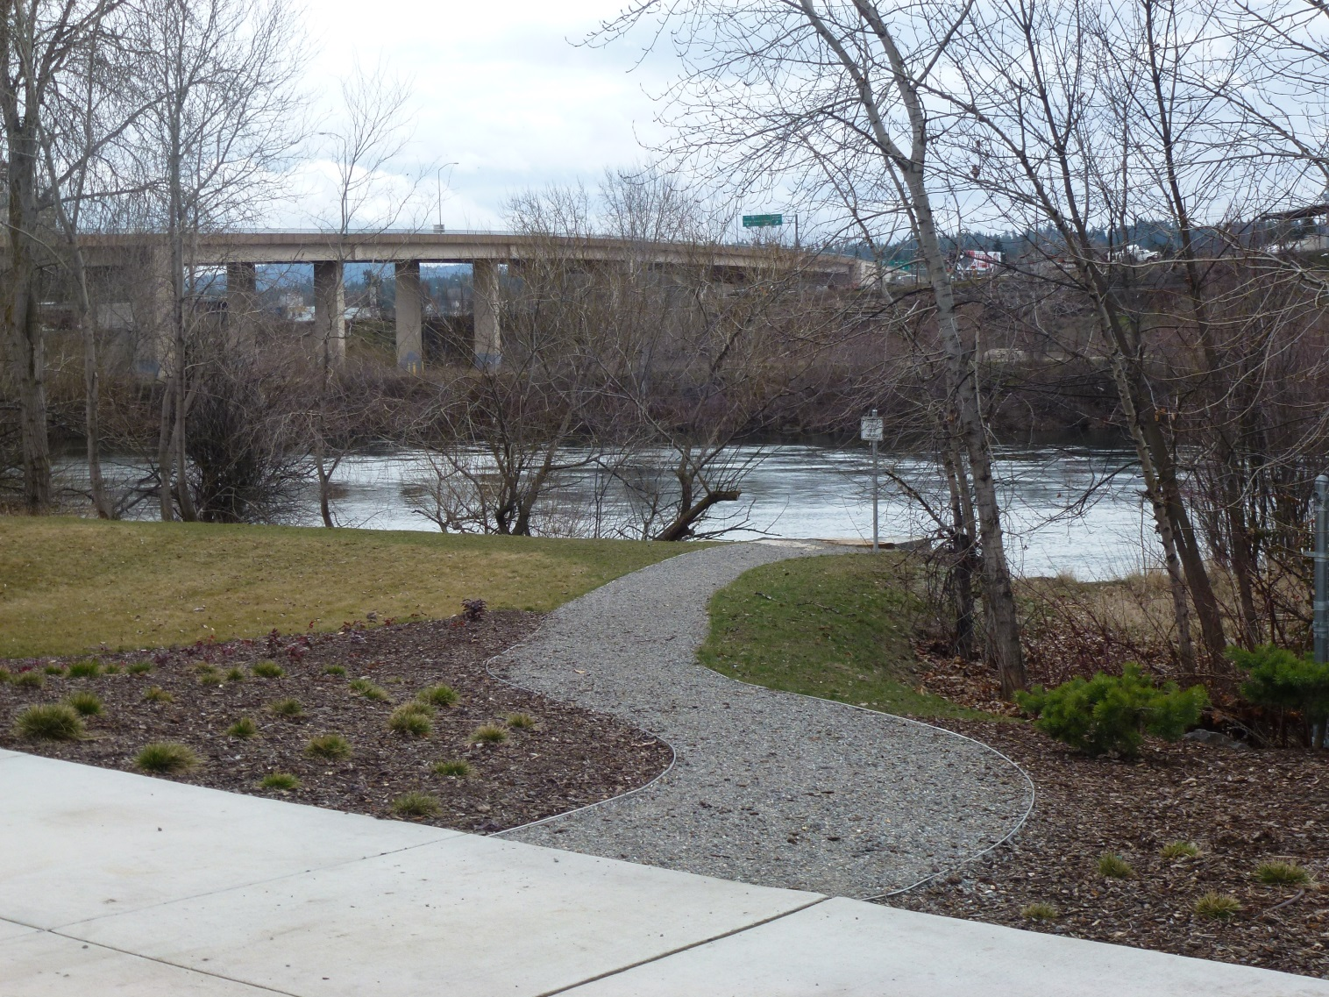
McKinstry at Gonzaga

Slide 18
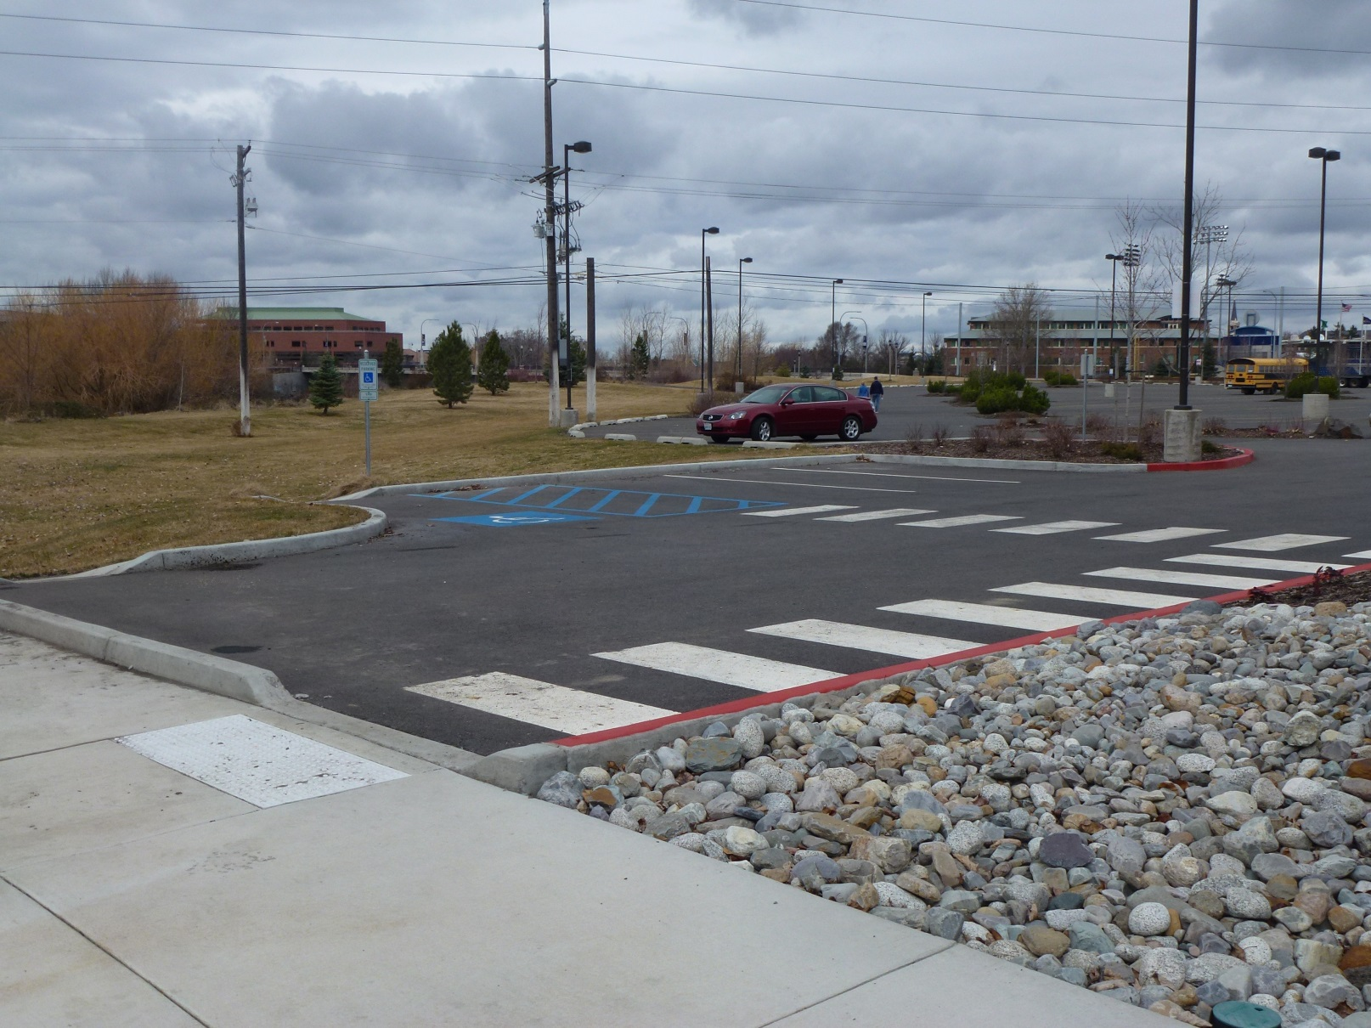
McKinstry at Gonzaga

Slide 19
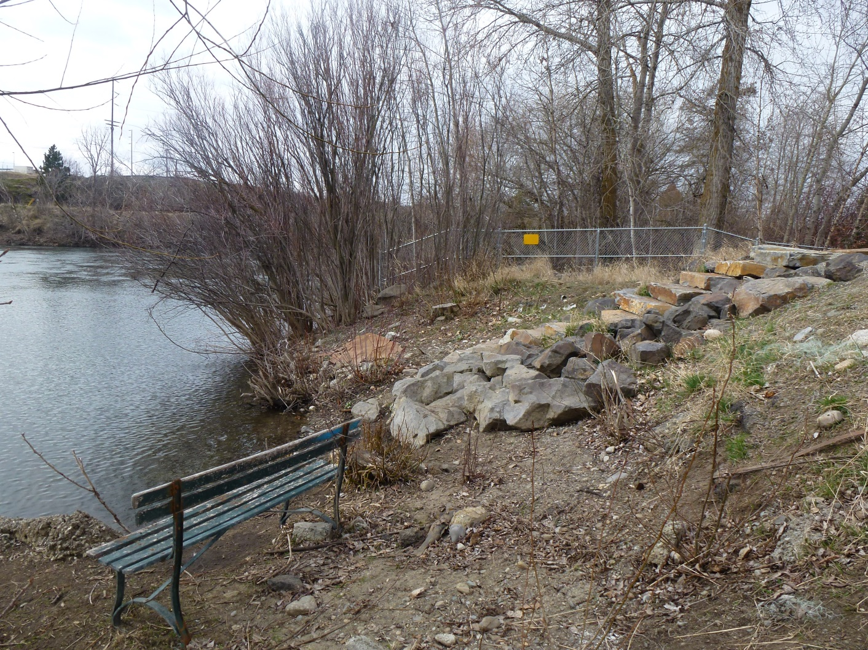
McKinstry at Gonzaga

Slide 20
Where are the holes ?

