Slide 1
Spokane River Urban Waters Progress
By Arianne Fernandez
WA Dept of Ecology
March 2013

Slide 2
Urban Waters Objectives
Find and eliminate sources of contaminants of concern
Polychlorinated Biphenyls (PCB): 303(d) listed
Polybrominated Diphenyl Ethers (PBDE)
Dioxin/Furan
Lead
Cadmium
Zinc

Slide 3
Resources
HWTR
Research
Prevention
Regulation
WQ
Research
Prevention
Regulation
Local Source Control Specialist Partnership
Urban Waters Initiative
TCP
Research
Cleanup
Spokane Regional Health District
Notes:
Increase efforts to clean up what we know about.
Find and prevent point and nonpoint source contamination to prevent recontamination as they had happen in the Duwamish Waterway.

Slide 4
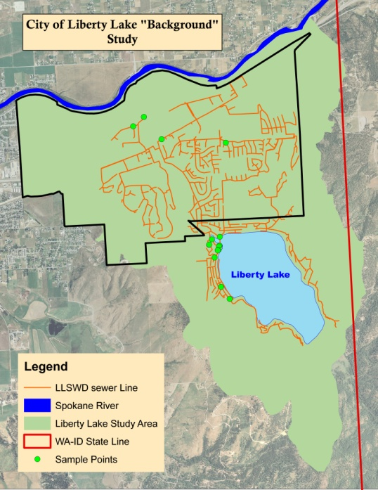
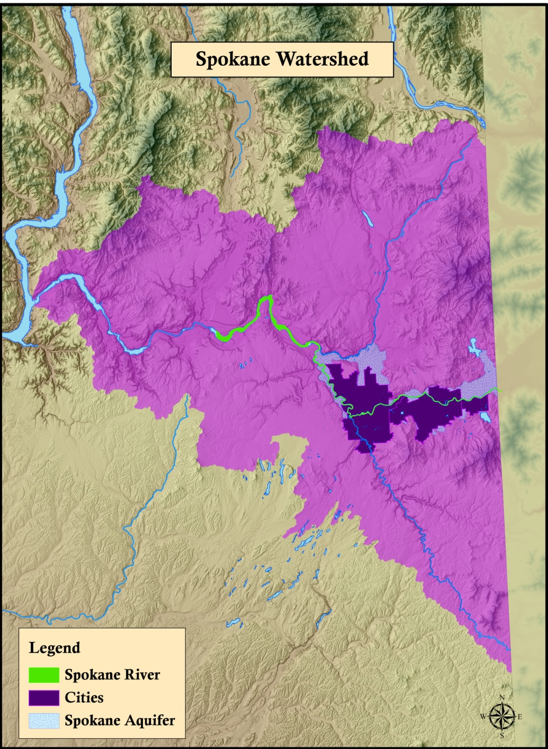
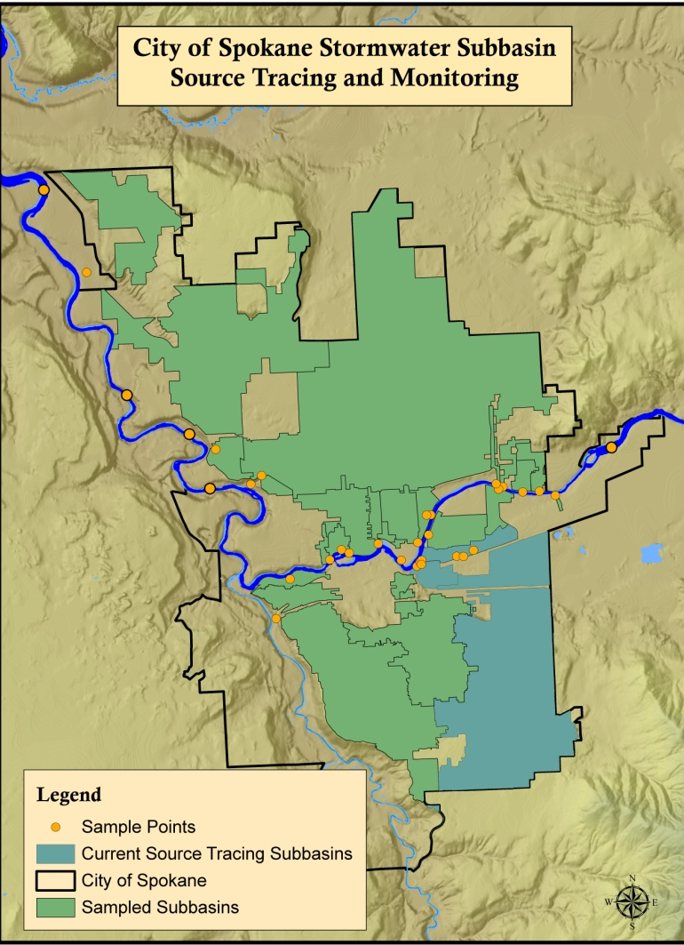
Spokane Urban Waters

Slide 5
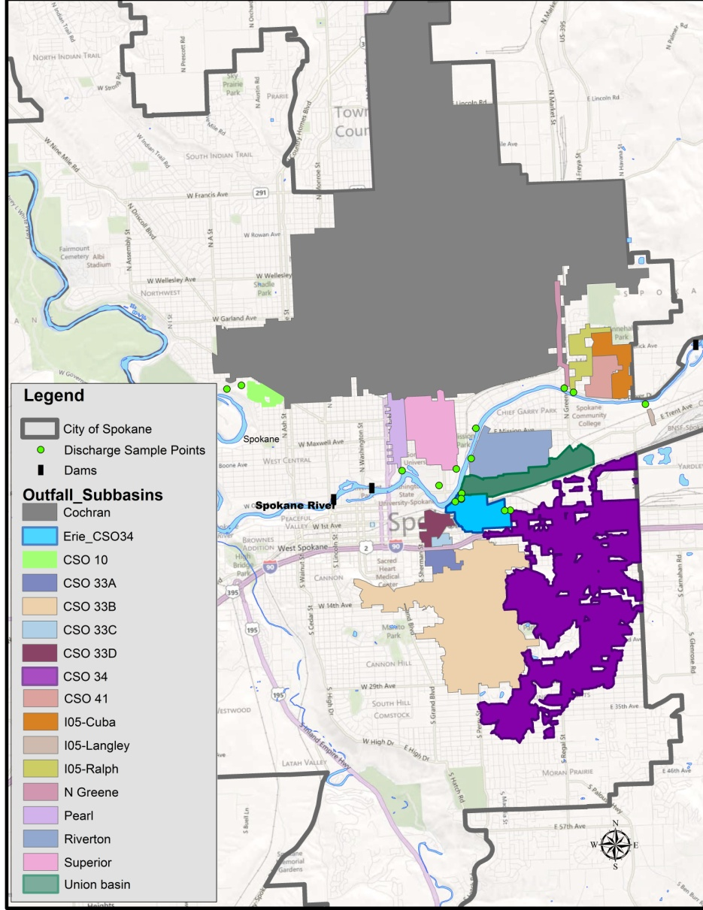
Source Tracking Plan
Start in city of Spokane
Up-the-pipe stormwater and CSO tracing.
Union basin
Combined sewer overflow #34
Erie basin
Business visits by SRHD Local Source Control Specialist, Sandy Phillips.
Historical analysis
Outfall sampling
Sewer tracing
Road data provided by Bing Maps

Slide 6
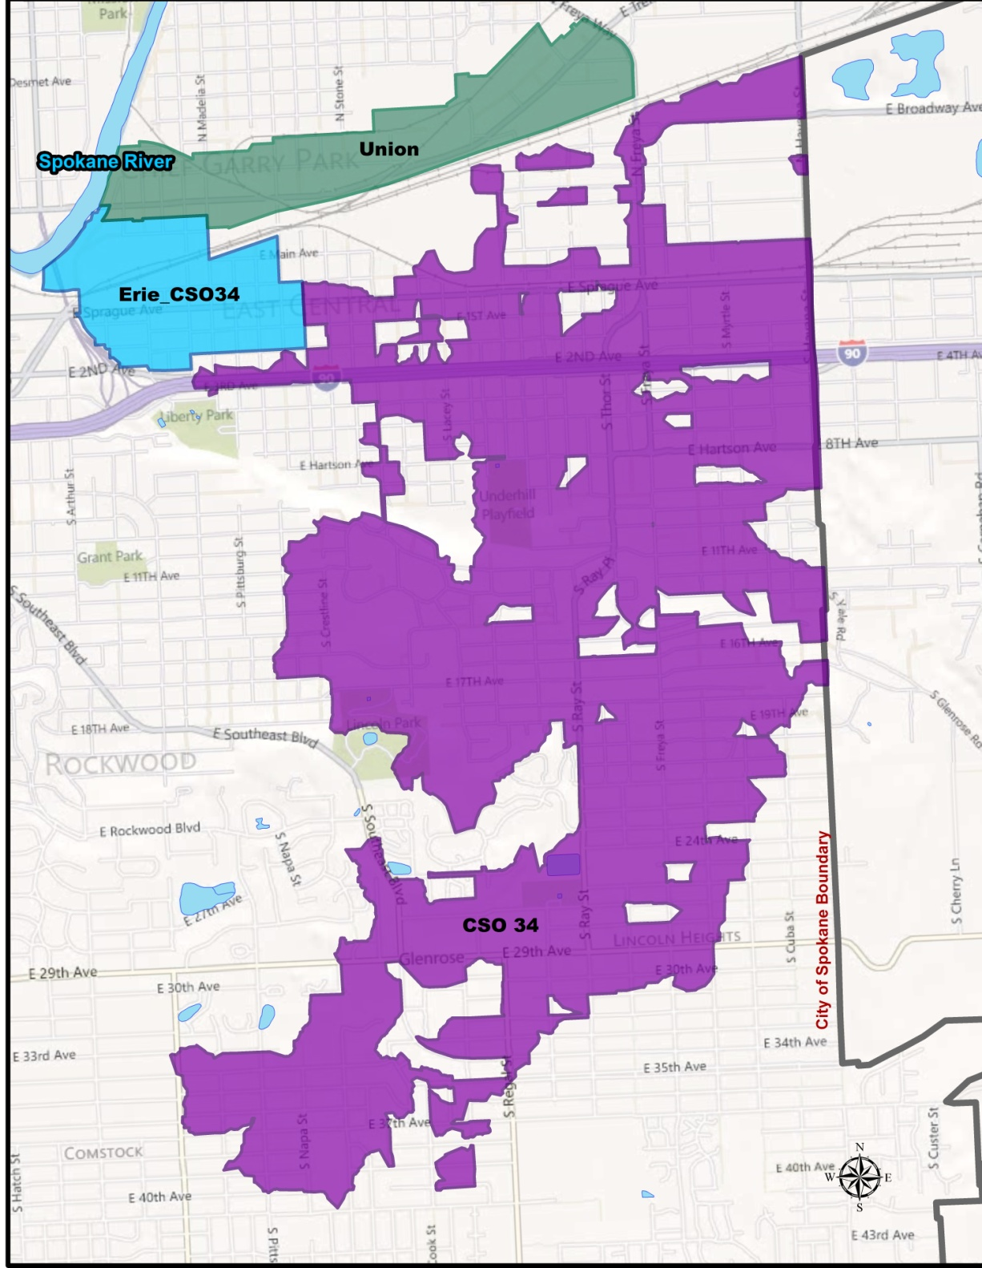
Stormwater Source Tracking
Union Basin
Erie Basin
CSO 34
Cochran

Slide 7
PCB Problem Factors
Low-level tracing
Small sources
Historical contamination
Not all data is comparable
Air deposition
“PCB-free” myth
Contaminant in everyday products
Regulatory limits
Stormwater
Human dimension
ppq (pg/L) X 1000 = ppt (ng/L) X 1000 = ppb (ug/L) X 1000 = ppm (mg/L)

Slide 8
Union Basin
Sample ID | Collection Date | Matrix | Total PCB-8082 (ng/Kg or ng/L) | Total PCB-1668 (ng/L) | Season | Storm event Precip. from Felts Field (in) | Sample Type
Upstream Trent Ave Branch
Trent_ 1384910ST | 1/24/2011 | sw | -- | 188 | WINTER | 0.49 | Grab
 | 5/16/2011 | sw | -- | 86.5 | SPRING | 0.29 | Grab
Crestline-Springfield Ave Branch
COOK - SPRG | 6/25/2009 | sed | 980,000 | -- | SUMMER | na | Comp. scoop
CR/ADM | 8/12/2009 | sw | -- | 226 | SUMMER | 0.27 | Grab
CRSPADM | 2/16/2010 | sw | 324.7 | -- | WINTER | No data | Grab
 | 6/4/2010 | sw | 14.1 | -- | SPRING | 0.56 | Grab
 | 7/2/2010 | sw | 114 | 223 | SUMMER | 0.28 | Grab
 | 1/13/2011 | sw | 33.4 | -- | WINTER | 0.33 | Grab
 | 3/28/2011 | sw | -- | QA/QC in progress | SPRING | No data | Grab
Napa St-Springfield Ave. Branch
NAPA-SPRG | 9/9/2010 | sw | -- | 285 | FALL | 0.06 | Grab
 | 1/24/2011 | sw | -- | 103 | WINTER | 0.49 | Grab
 | 5/16/2011 | sw | -- | 745 | SPRING | 0.29 | Grab
 | 7/29/2011 | sed | 17,000 | -- | SUMMER | na | Grab
Union Outfall
UNIONLPT | 6/8/2009 | sw | -- | 73.0 | SPRING | 0.29 | Grab
 | 10/2/2009 | sw | -- | 58.2 | FALL | 0.11 | Grab
 | 2/16/2010 | sw | -- | 460 | WINTER | 0.12 | Grab
 | 4/29/2010 | sw | -- | 60.6 | SPRING | 0.48 | Grab
 | 9/9/2010 | sw | -- | 255 | FALL | 0.06 | Grab
 | 1/7/2011 | sw | -- | 55.3 | WINTER | 0.19 | Grab
 | 7/13/2011 | sw | -- | QA/QC in progress | SUMMER | 0.42 | Grab
Sample Locations
Parameter | Stormwater (ng/L) |  | Storm-drain Sediment (ng/Kg)
 | Min | Max | Min | Max
PCB (ppt) | 0.4582 | 8.415 | 4.78 | 13.6

Slide 9
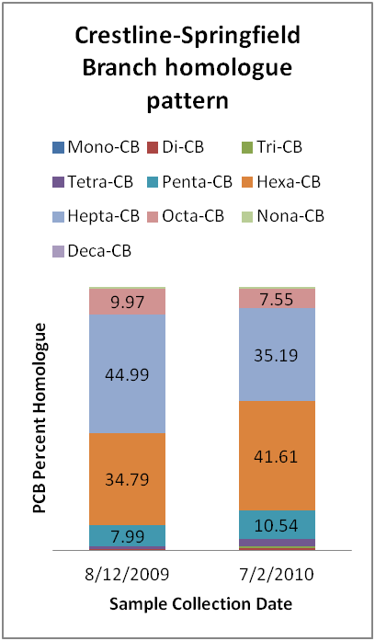
PCB Hot Spots
Aroclor 1260:
Transformers
Hydraulic fluid
Synthetic resin
Dedusting agent
Notes:
Also metals and dioxin/furan sources

Slide 10
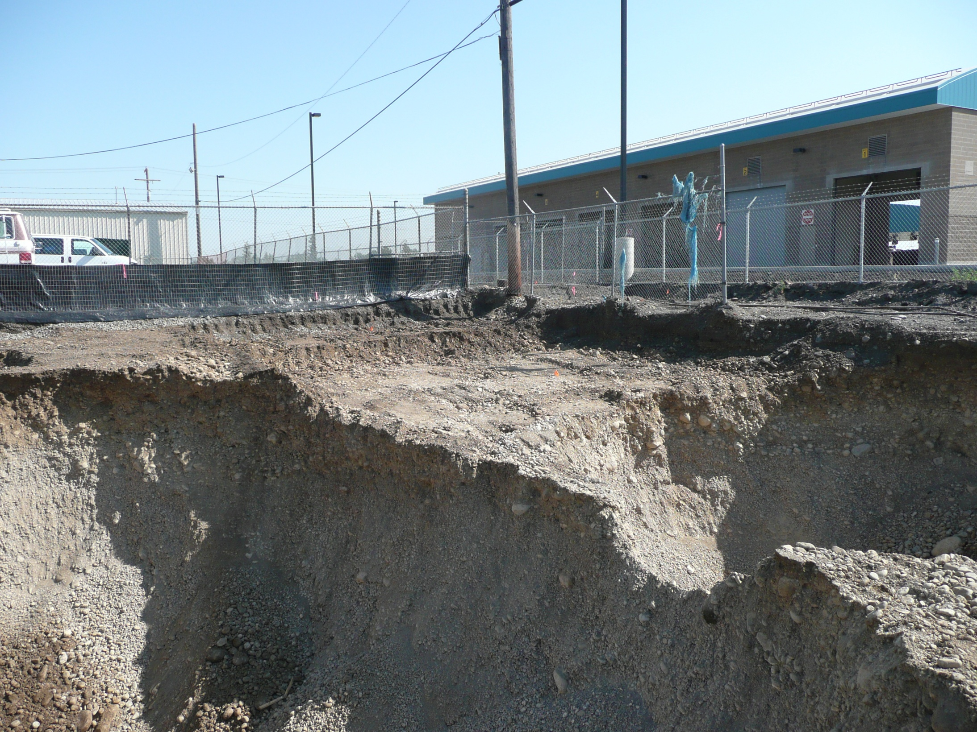
City Parcel Area Progress
Notes:
Over 8,000 tons of heavily PCB-contaminated soils and waste materials were dug up and removed from this site. The cleanup action is now complete at this property.

Slide 11
Additional Work and Findings
Mapping tool enhanced source tracing and spatial analysis.
Inadvertent production in everyday products significantly above local limits (ug/L and mg/L vs. pg/L).
Air Deposition Literature Review – Air deposition may contribute to local stormwater load.
NE Lakes Background Study - Refined knowledge of air deposition influence to sediment and fish.
ppq (pg/L) X 1000 = ppt (ng/L) X 1000 = ppb (ug/L) X 1000 = ppm (mg/L)

Slide 12
General Conclusions
Business visits have limited effectiveness for finding most CoC sources, but good for metals.
Source tracing contamination at low concentrations presented unforeseen challenges for regulators and the regulated community. These include:
Lack of knowledge for clean, ultra trace sampling techniques.
Lack of knowledge regarding how to perform quality control on results.
Current regulations do not recognize the low-level, full congener analytical method (1668) for compliance.

Slide 13
General Conclusions
Sources of CoC to the Spokane river are more diffuse
than originally suspected.
The Spokane River watershed is unique and may
be compounding the issue of elevated CoC in fish
tissue. Unique properties include:
Low total suspended solids to bind contaminants
Large urban watershed discharging to small waterbody
Ready aquifer exchange that modifies PCB congener behavior
Highly porous soil over fast moving aquifer

Slide 14
Urban Waters Tools
Source
Tracing
Tool Development
Collaboration is key!
Spokane River Regional Toxics Task Force
-Tribe
-Local government
-Citizen groups
-State government
-Federal government
-Industry
BMP
Implementation
Facilitation
Regulation
Training
Site Cleanups
Education
Incentives
Clean Water
Notes:
Source tracing
Data integration
Modeling – aquifer transport model
Sampling up the pipe
Multi-media source control checklist inspections based off of a similar checklist used by Seattle Public Utilities
Contamination does not compartmentalize itself into neat packets of regulations.

Slide 15
On-the-ground Next Steps
Out of the pipe and onto the ground
Follow the fish
Assist SRRTTF and other source control efforts
Cross boundary work
Air deposition
In-river work

Slide 16
Next Steps
Fate and transport model
Air deposition data
Mapping tool for faster source tracing and organizing large amounts of data for spatial analysis
Data consolidation across agencies and facilities
Long-term in-river monitoring with additional sites and techniques tailored to our unique system
Pattern identification
General product lists
Regulation and sample method updates

