Slide 1
Clean Water Integrated Plan
Spokane River Forum
March 26, 2013

Slide 2
The Next Phase
Water Quality
+
Innovation
+
Regulation
+
Finances
=
Opportunity

Slide 3
The Opportunity
Largest infrastructure investment in City’s history
Balance environmental & financial constraints
Responsible use of the public’s money
Add stormwater
Allow innovation
Leverage our investment into better neighborhoods, a better City, a healthier economy

Slide 4
Integrated Plan
WET WEATHER
Discharges to the River
Stormwater and CSO
COMPREHENSIVE SOLUTION
Regulatory requirement
Stakeholder engagement
Best value for our investment

Slide 5
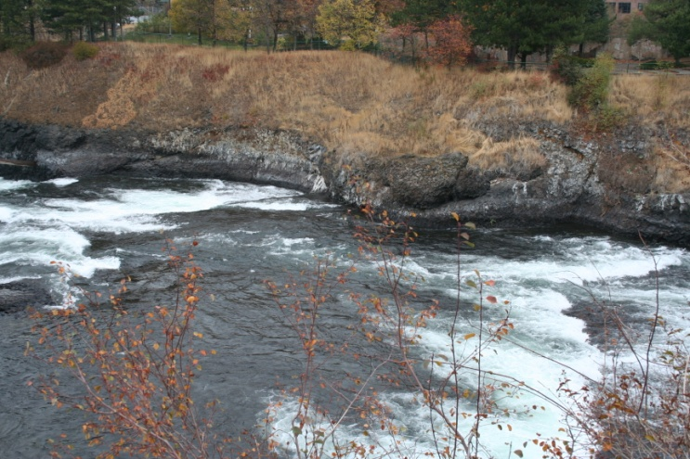
The Plan’s Goals
We want a cleaner River faster.
Prioritize work that has a greater
impact on pollutants.
We want to implement cost-effective and innovative technologies.
Add “green” technologies.
We want holistic integration with other critical infrastructure.
Solve multiple problems
Better streets, new water mains, better parks…

Slide 6
Cleaner River Faster
Prioritize by greatest reduction of pollutants
Volume versus frequency
Adding Stormwater
Initial look:
Removing prioritizing stormwater greater pollutant reduction over smaller CSO basin for:
TSS
Heavy metals
Even phosphorus

Slide 14
The Method
Design Criteria
Basin Prioritization
Right-sizing CSO storage
Green solutions
Alternatives strategies

Slide 15
Structured Decision Criteria
Methodical selection process
Ranking based on goals
Policy maker and project team interface
Communication with stakeholders
MODA
Multiple objective decision analysis

Slide 16
Decision Criteria
GOAL:
Decide upon the best mix of CSO and stormwater projects that will remove as many pollutant as rapidly as possible with the highest additional public benefit at the lowest long-term life cycle cost.
Criteria:
System benefits and risks
Environmental outcomes
Community outcomes
Operations & maintenance considerations
Life cycle costs

Slide 17
Basin Prioritization
Accelerate work in 3 basins that have the greatest impact.
THE BIG 3
CSO Basin 26
CSO Basin 34
COCHRAN STORMWATER BASIN

Slide 18
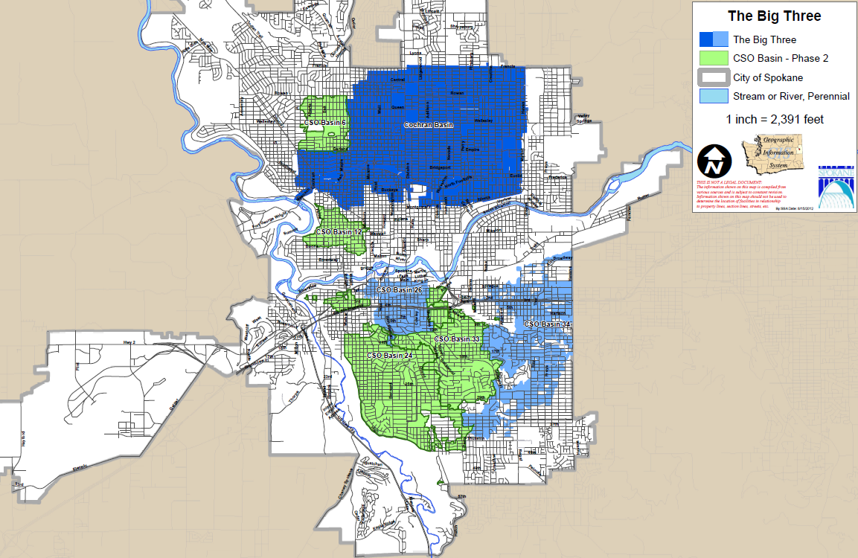
Next Steps--Prioritize:
Remaining CSO Basins
Large Stormwater Basins

Slide 19
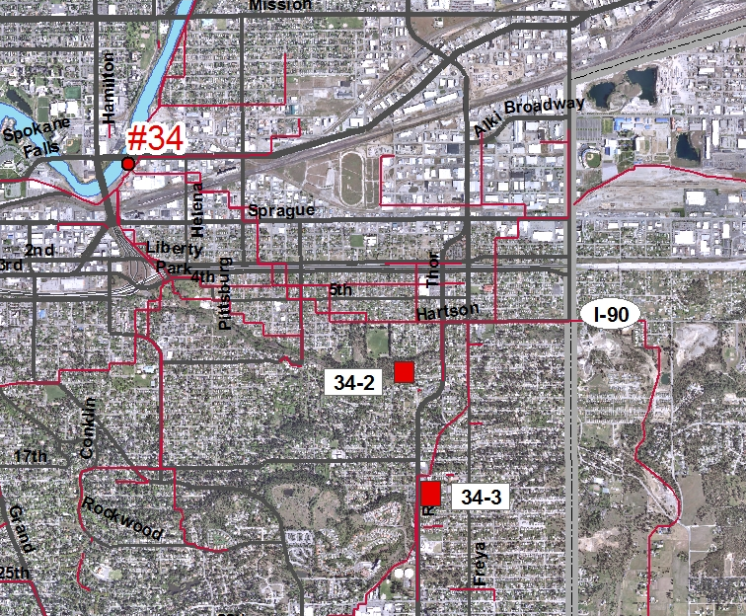
Status-BIG 3: CSO Basin 34
Constructing two tanks in 2013
Evaluating remaining storage needs

Slide 20
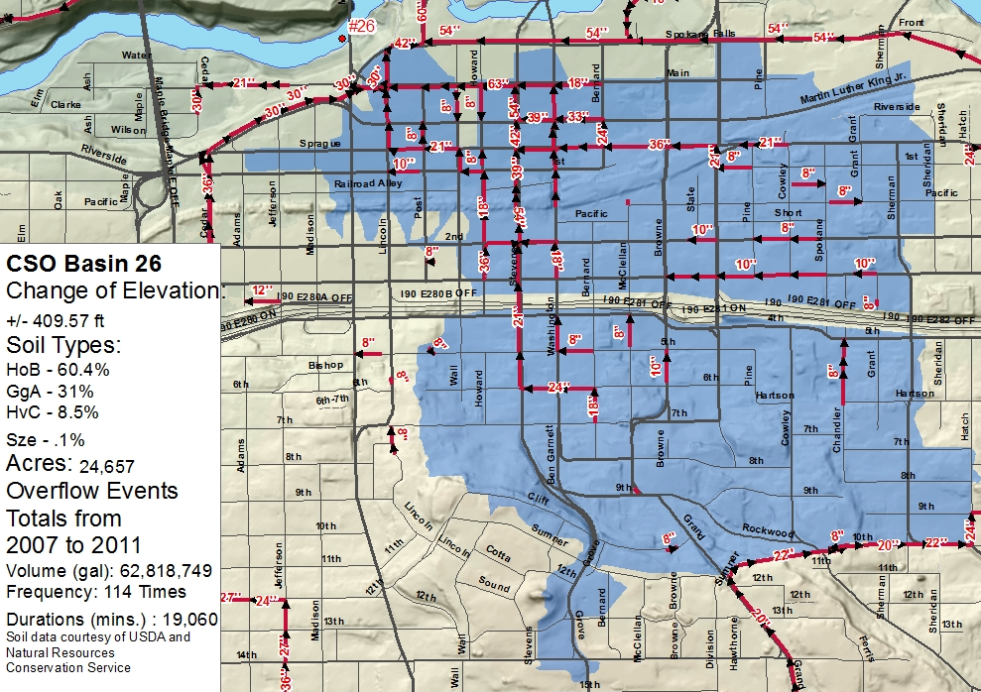
Status-BIG 3: CSO Basin 26
Preliminary design
Evaluating sites

Slide 21
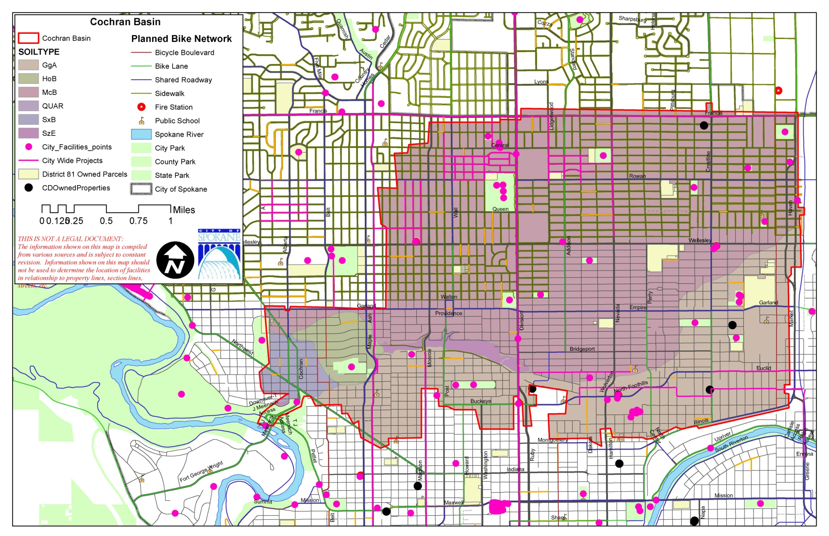
Status-BIG : Cochran Basin
Evaluating projects
Analyzing flow

Slide 23
Right-sizing CSO Storage
One overflow per year
based on a 20-year moving average

Slide 24
Innovative & Holistic
We want to implement cost-effective and innovative technologies.
We want holistic integration with other critical infrastructure
Integrate:
Streets
Parks
Water
Wastewater
Sidewalks
Ped / Bike
Golf Courses
Greenways
Street Trees

Slide 26
Timeline
Deliver plan by December 2013
Construct BIG 3 by 2017
AND as many more basins as we can
Today
2017
Deliver Integrated Plan
Dec. 2013

Slide 27
More to come
Thank you!

