Slide 1
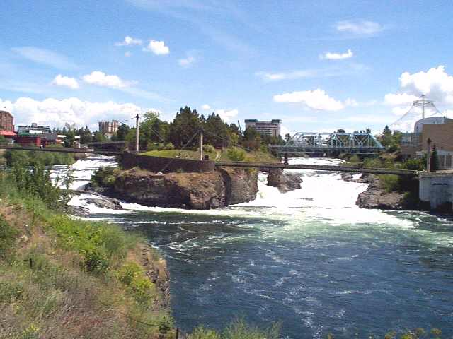

Spokane’s CSO Reduction Status
Spokane River Forum 26 May 2013

Slide 2
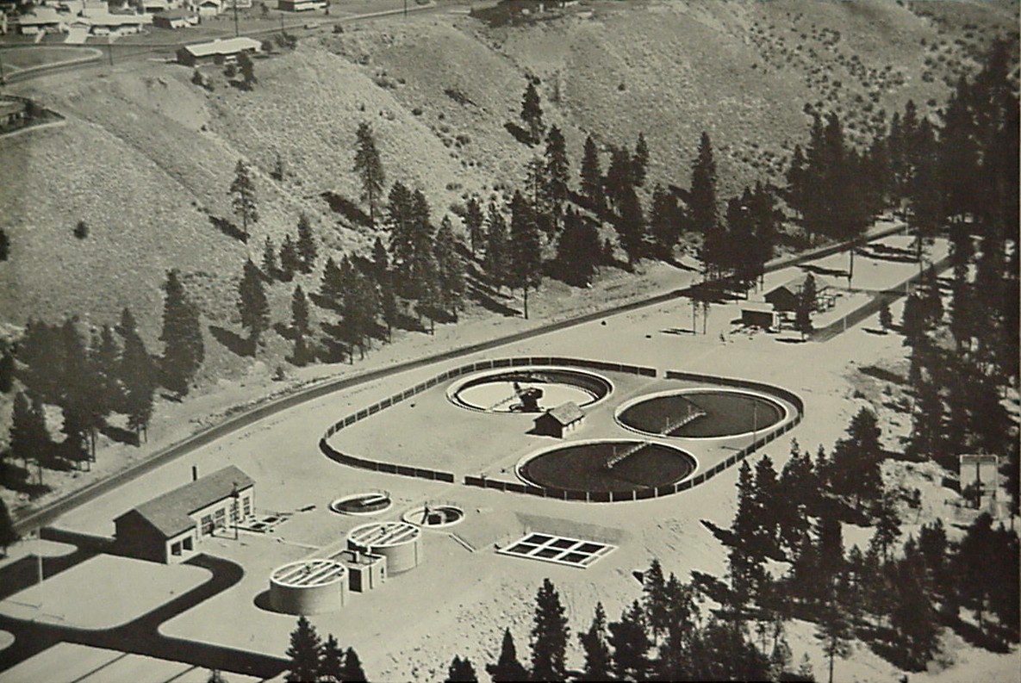
Spokane’s Primary Treatment Plant

Slide 3
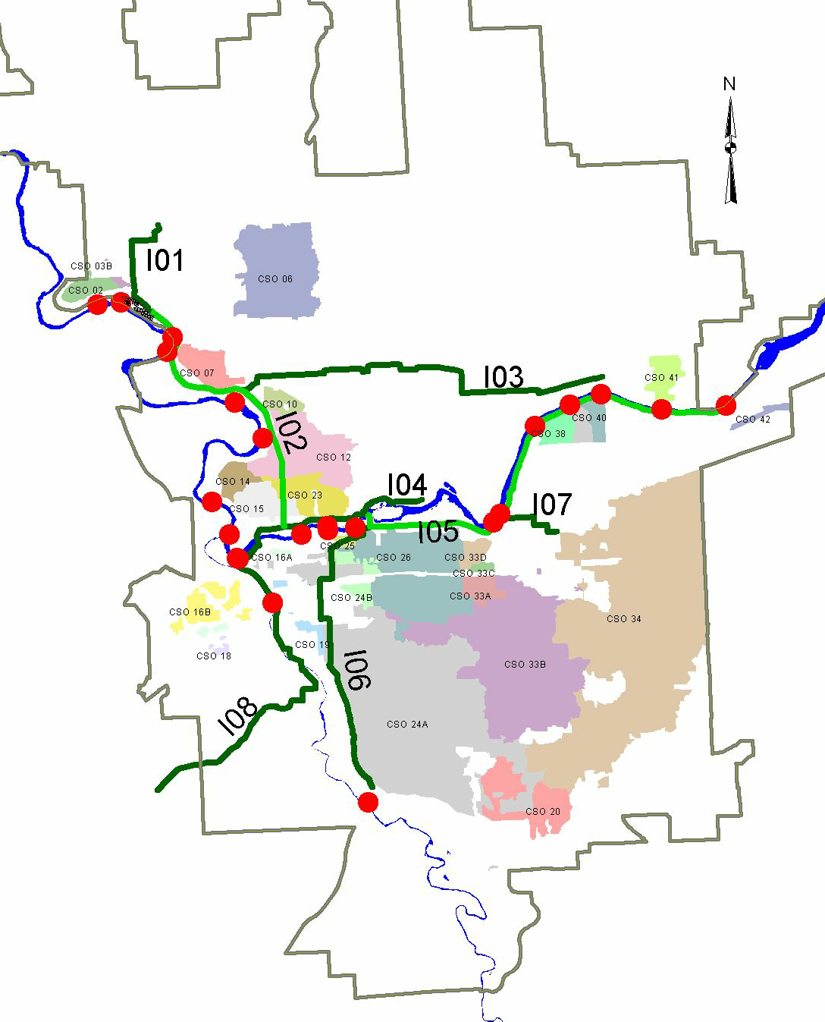
Interceptor Sewers for Dry Weather Flows
CSO
RPWRF

Slide 4
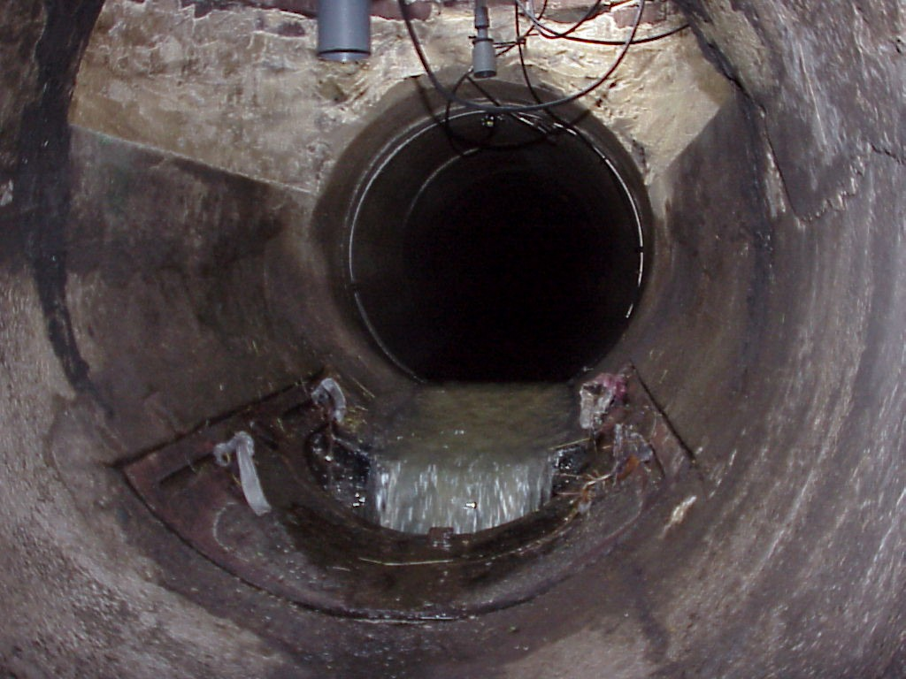
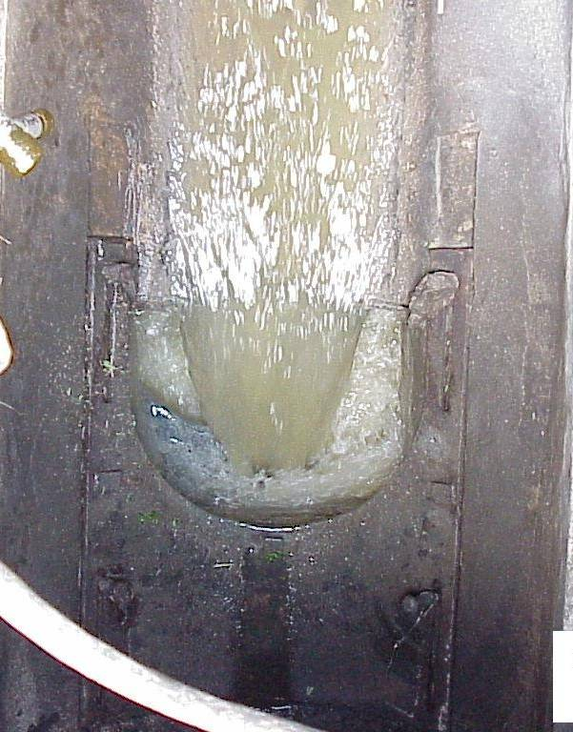
CSO Regulator is an Overflow Threshold – e.g. “Leaping Weir”

Slide 5
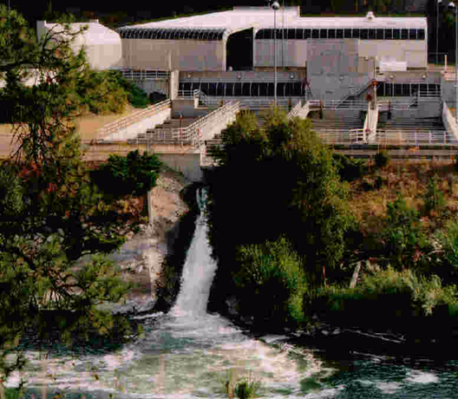
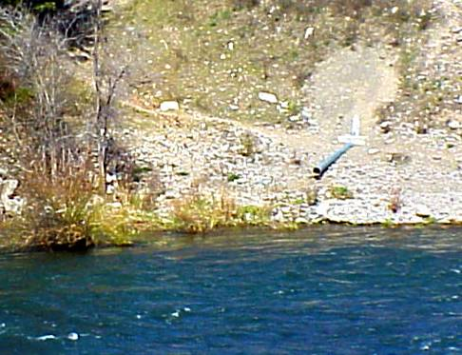

How do combined sewers work?
wastewater
stormwater
CSO Regulator
Treatment Plant

Slide 6
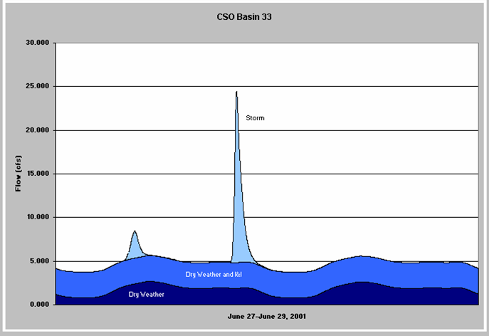
Annually, most combined sewage gets treated
Flow
Combined Sewage
Overflows to River
Treated at RPWRF
Overflow Threshold
Wastewater Flow
Time

Slide 7
CSO Reduction History
Baseline as of 1980
33 outfalls
1000 average CSOs / year
550 avg million gallons / yr

Slide 8
CSO Reduction History
Phase 1
1980s storm separation 86% volume reduction
24 outfalls
450 average CSOs / year
80 avg million gallons / yr

Slide 9
CSO Regulations
Chapter 173-245 WAC:
Frequency:
“… control of each CSO such that an average
of one untreated discharge may occur per year.”
– Applied to each outfall
Water Quality:
“CSOs shall not violate water quality standards
in receiving waters (numeric standards or the
beneficial uses).”

Slide 10
CSO Reduction History
Phase 2
Storage Tanks by 2012 for overflow frequency
20 outfalls
280 average CSOs / year
70 avg million gallons / yr

Slide 11
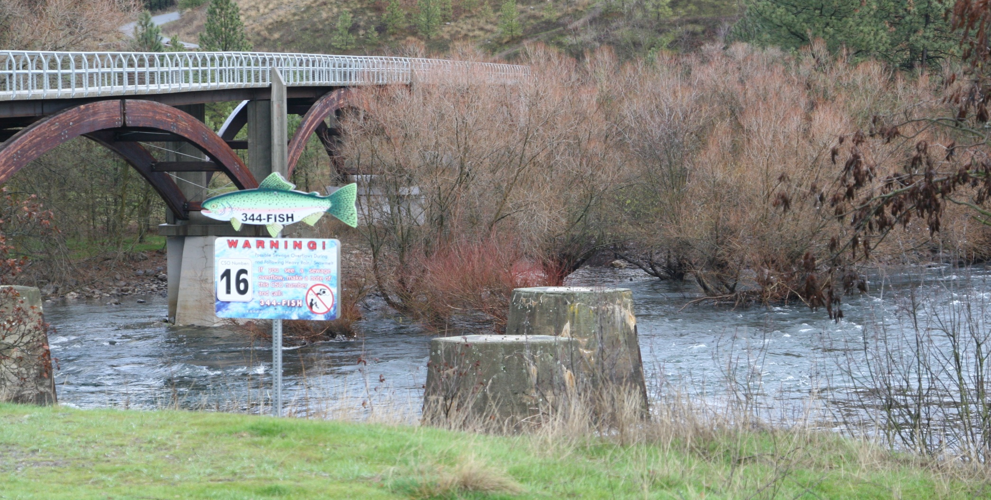
CSO 16

Slide 12
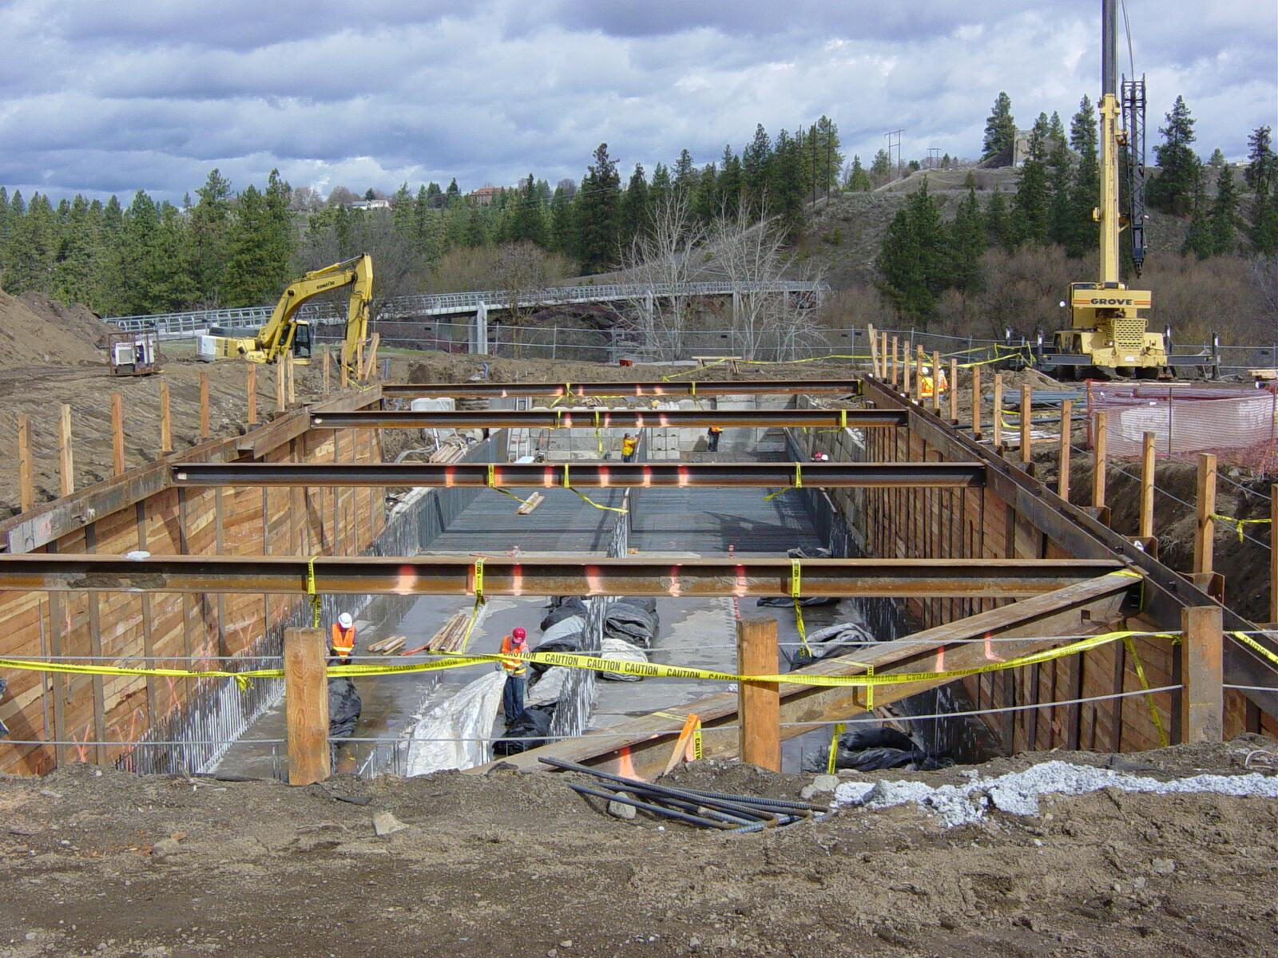
Control Facility Construction

Slide 13
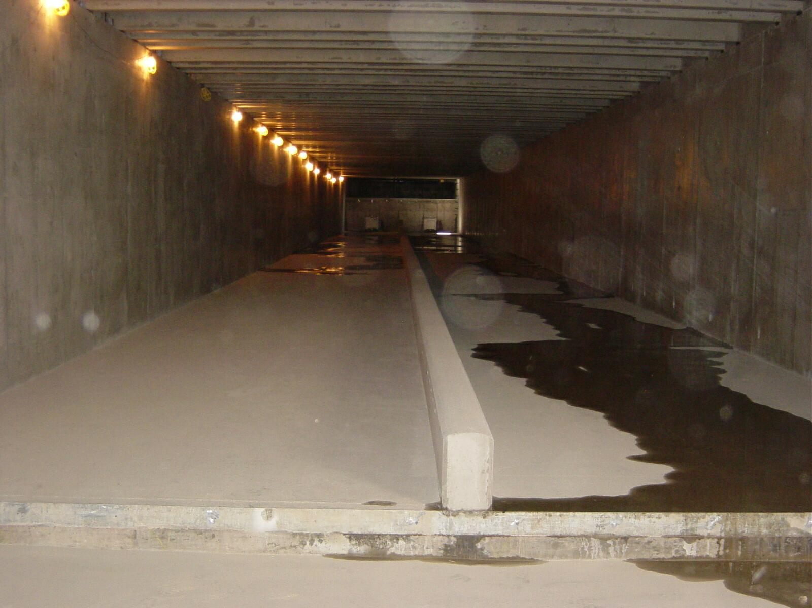
Underground Storage Tank

Slide 14
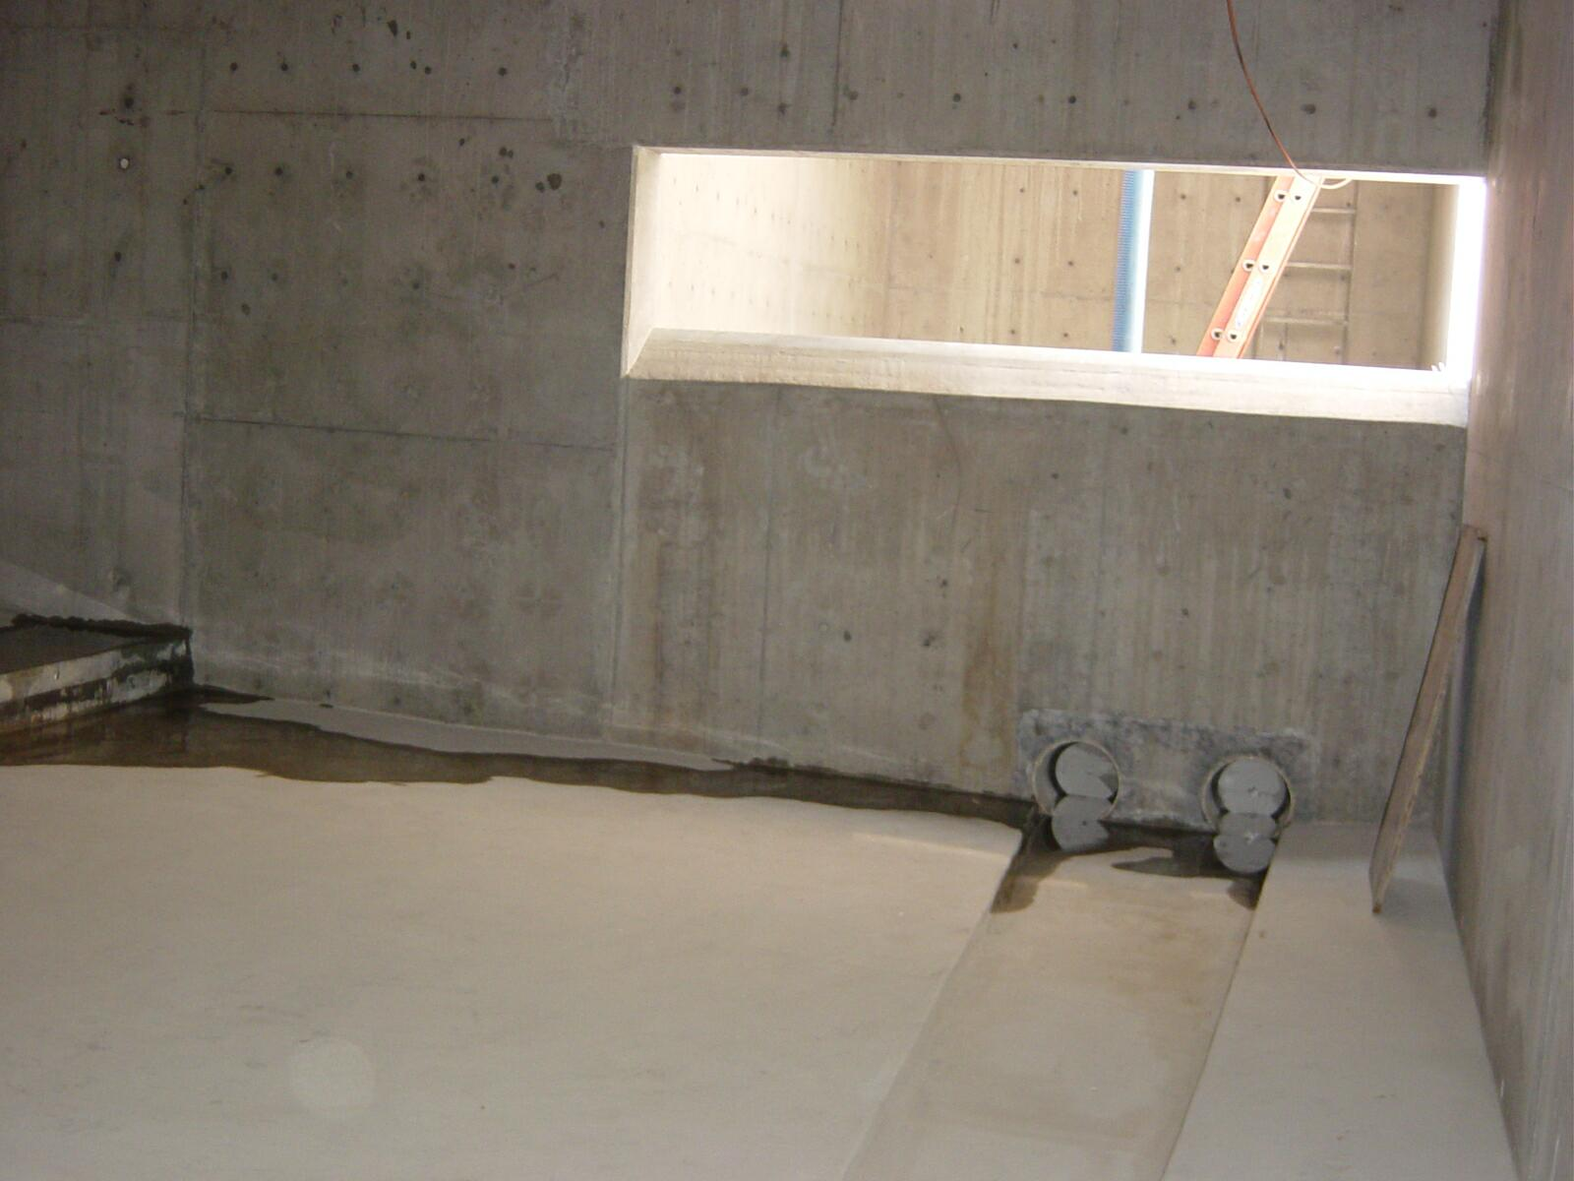
Fill Weir and Sump Drain
Tank Fills During Storm...
... Tank Drains to Sewer After Storm

Slide 15
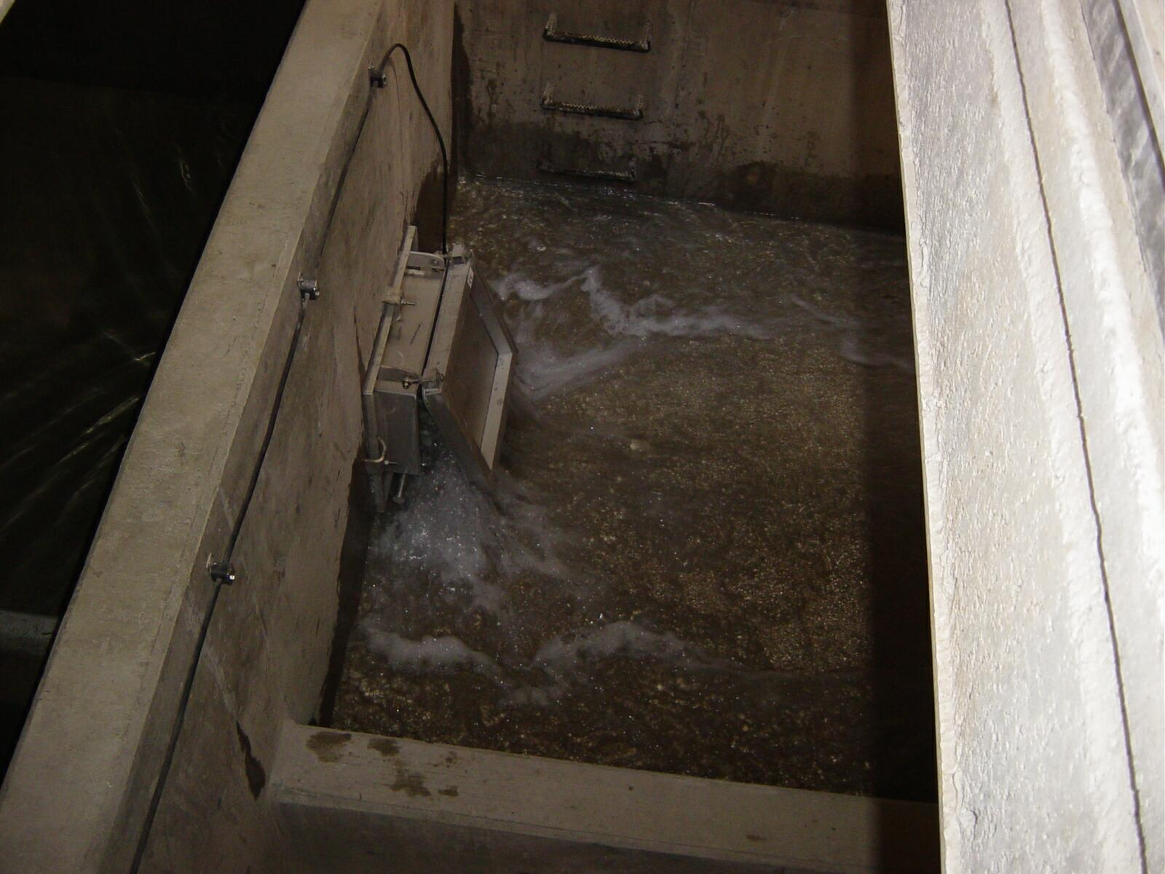
Self-Cleans After Tank Drains

Slide 16
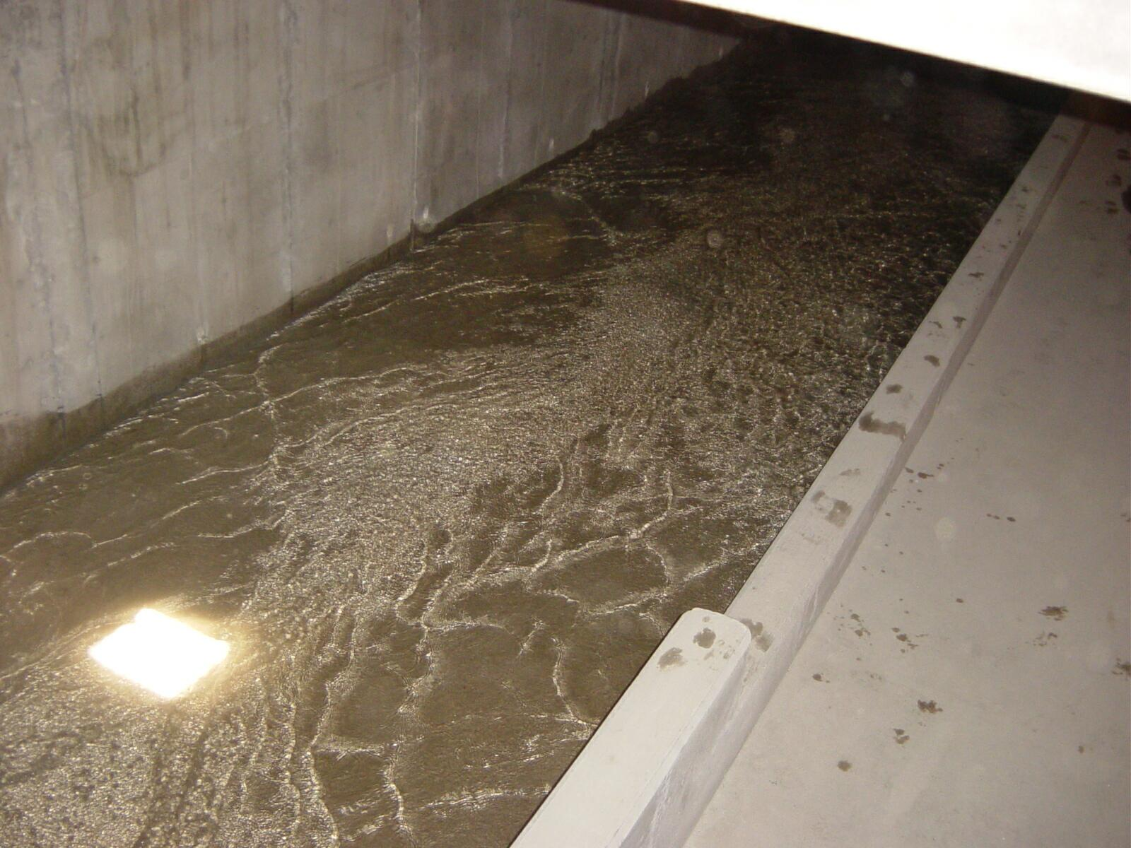
Self-Cleans After Tank Drains

Slide 17
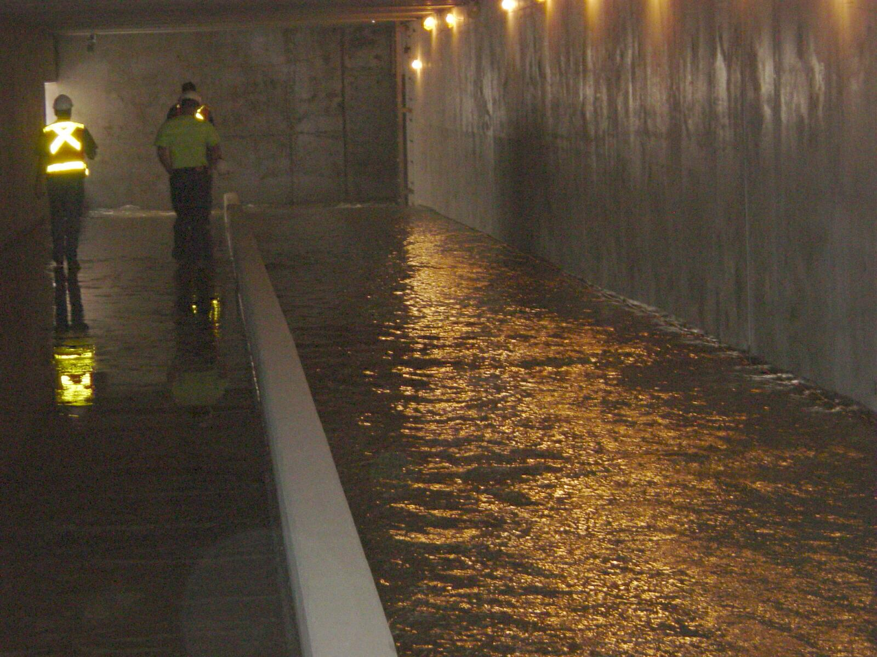
Self-Cleans After Tank Drains

Slide 18
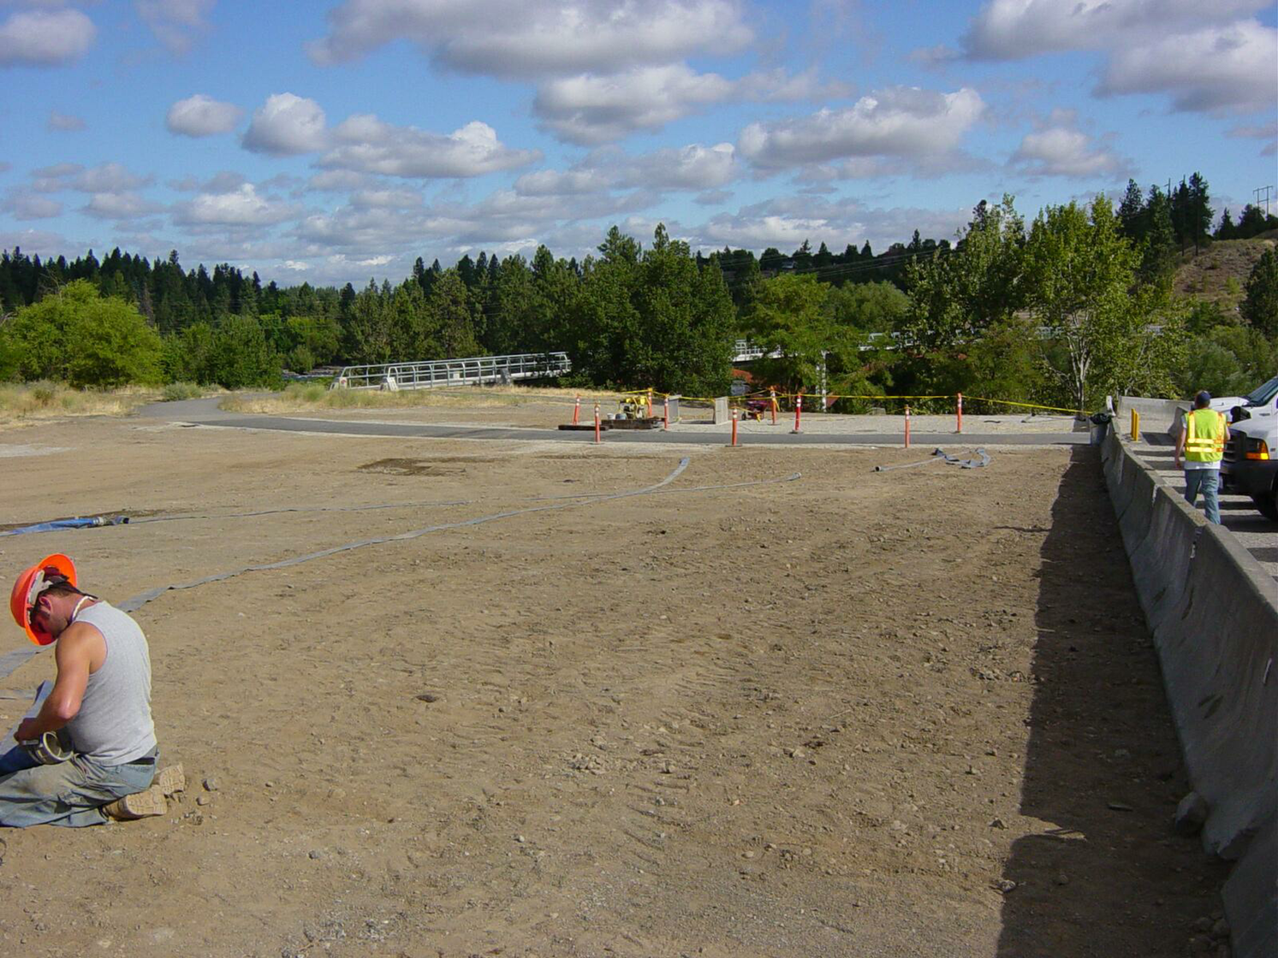
Site Restoration

Slide 19
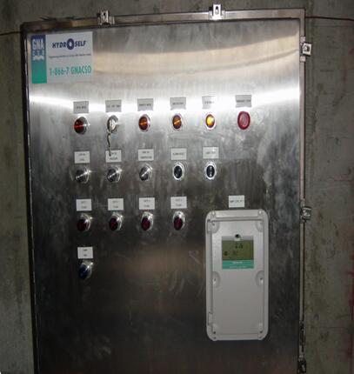
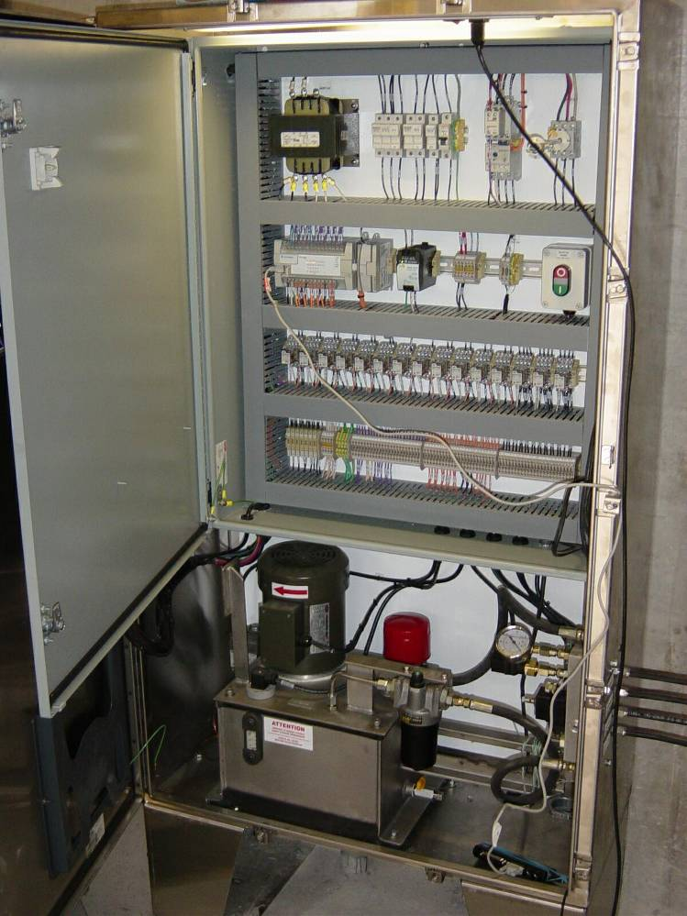
Monitoring & Cleaning Controls

Slide 20
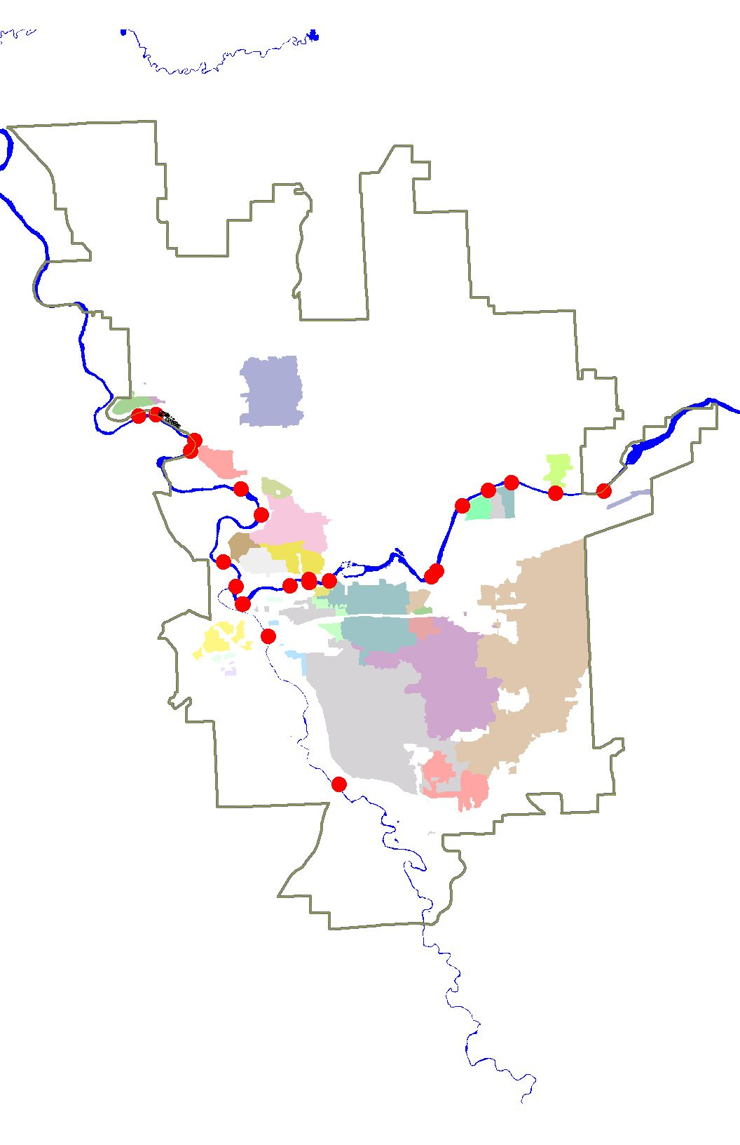
CSO Facilities Constructed
8
CSO 2/3
CSO 10
CSO 42
CSO 16/18
CSO 40
CSO 19
CSO 39
CSO 38

Slide 21
CSO Outfalls Eliminated
4
CSO 3
CSO 40
CSO 18
CSO 39

Slide 22
Facilities In Final Design
4
CSO 41
Pending Integrated Plan
CSO 33-2
CSO 34-3
Pending Integrated Plan
CSO 34-3
Up-basin Tanks

Slide 23

For better “dry weather” control:
Weir Modification... “Before”

Slide 24
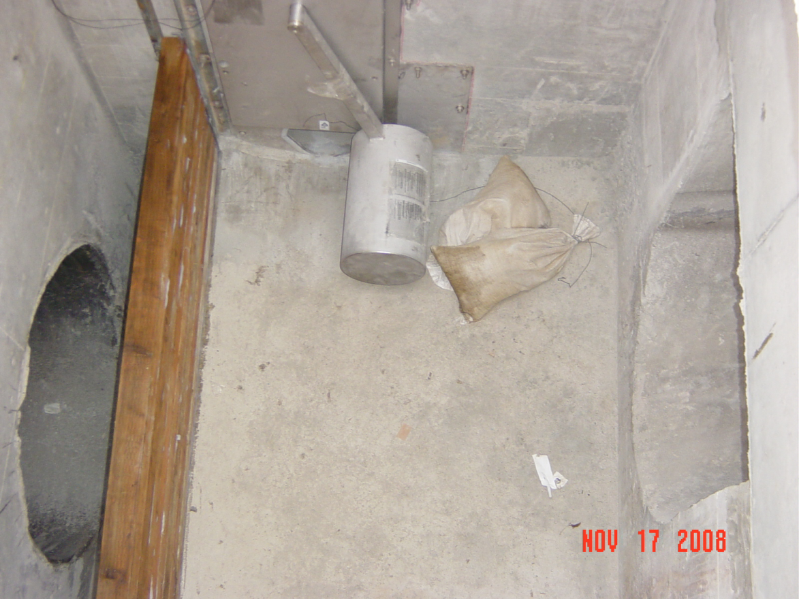
Weir Modification... “After”

Slide 25
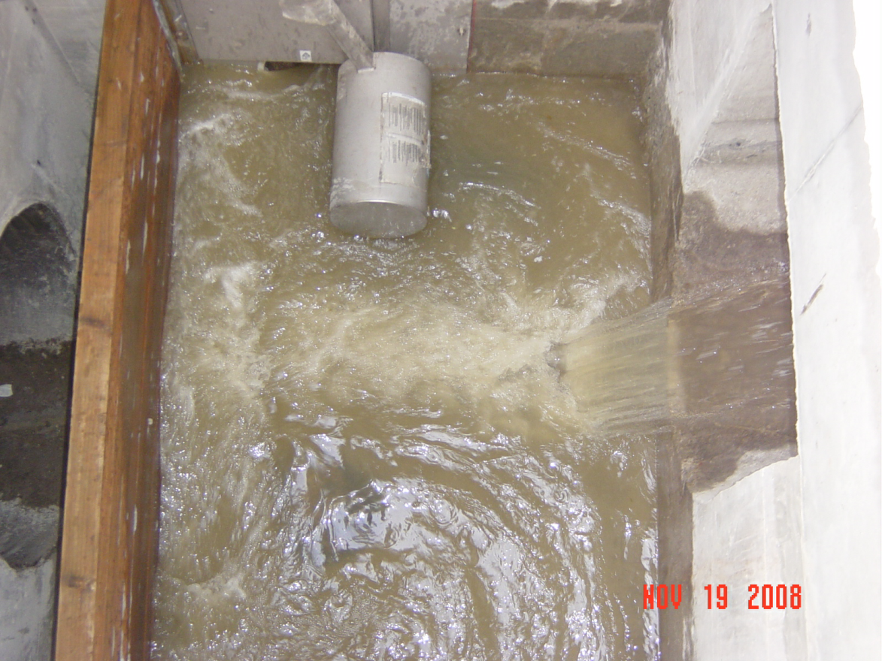
Weir Modification... “After”

Slide 26
Interim Weir Modifications
7
CSO 6
CSO 7
CSO 26
CSO 12
CSO 14
CSO 25
CSO 15

Slide 27
Weir Mods provide:
Less dry weather plugging
More response time
Improved monitoring

Slide 28
CSO Reduction History
Integrated Plan
Revised approach
Prioritize CSO volume reduction
Compliance: 20-year vs. 5-year
“Green” and “Gray” solutions

