Slide 1
Redband Trout: Cultural Past, Present and Future
Spokane Tribe of Indians
Casey Flanagan
Water and Fish Project Manager
Notes:
Good afternoon and thank you Harvey for the introduction. As Harvey stated I work for the Spokane Tribe, and although redband trout have recently become a topic of interest in this region the Spokane Tribe has had a cultural interest in the native redband trout for some time now. When the canneries overfished the salmon populations in the late 1800s and dams were built blocking salmon passage, tribal members had to rely on the native fish that remained for subsistence. So today I’m going to discuss this historical bond between redband trout and the Spokane tribe, as well as what the tribe is currently doing to understand population characteristics and our future goals for the redband trout in the Spokane River and Lake Roosevelt.

Slide 2
Redband Trout
Remnants of steelhead populations
Salmon cannery overharvest
Construction of dams
Multiple life history strategies that allow multiple spawning migrations per year
Fluvial: Resident
Fluvial-adfluvial: tributary -> river -> tributary
Lacustrine-adfluvial: tributary -> lake -> tributary
Allacustrine: Spawn in lake outlet
Notes:
Just to give a small amount of information about the redband trout before I proceed to the historical aspect, redband trout are remnants of steelhead populations that occurred in the this area before their migrations were overharvested by salmon canneries and blocked by Grand Coulee and Chief Joseph. I like to put it as a redband is related to a steelhead as a kokanee is related to a sockeye; the lack of interbreeding of the populations create distinct sub-species. There are multiple life stages that a redband can utilize: With a fluvial or resident redband staying in a stream for its entire lifespan, a fluvial-adfluvial redband hatching and growing as a juvenile in it’s natal tributary, then it out migrates into a river system to grow and mature, then returns to its natal tributary to spawn as a adult. Lacustrine-adfluvial is similar to a fluvial-adfluvial redband except that it out migrates into a lake to grow and mature. And an allacustrine redband lives its entire life in a lake and adults spawn on lake shorelines and in lake outlets.

Slide 3
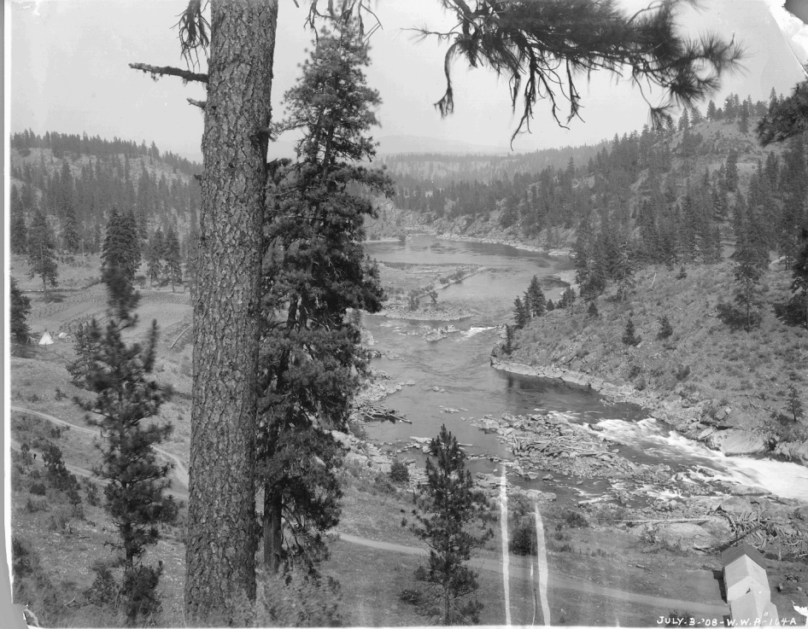
Spokane Tribe: The Salmon Eaters
At least 90% of the Spokane Tribe’s animal caloric intake was from fish.
Called themselves “salmon eaters” or “people who eat salmon”
Most eastern tribe to extensively use salmon in their diet.
Named their villages and sub-bands after a specific fishery, condition of water or a specific species of salmon
Notes:
Now I believe it is important to mention how important salmon, trout and other native fishes were to the Spokane Tribe. At least 90% of their animal caloric intake was from fish, with very little hunting going on in the area due to scarcity of wildlife and the difficulty of catching prey. The Spokane’s were one of the most easternly tribes to extensively use salmon in their diet and they even called themselves the salmon eaters or the people who eat salmon. They commonly named their villages and sub-bands after specific fishery, condition of water (such as little falls in the bottom picture), or a specific species of salmon. You can see in the top photo of tribal members fishing at Little Falls before the dam was put in and in the bottom picture is another photo of little falls before the dam was put in and you can see the teepee on the left of the photo.

Slide 4
Spokane Tribe: The Salmon Eaters
At least 90% of the Spokane Tribe’s animal caloric intake was from fish.
Called themselves “salmon eaters” or “people who eat salmon”
Most eastern tribe to extensively use salmon in their diet.
Named their villages and sub-bands after a specific fishery, condition of water or a specific species of salmon
The Spokane’s “salmon” were actually salmon, steelhead and trout.
Relied heavily on salmonids and other native fish year round.
“Eleven salmon trout caught in halfdays sport on the Spokane River” - Spokesman Review Publications 1896
Notes:
Another important tidbit to mention is that in older reports and documents that described fish harvested along the Spokane River and Columbia River lumped steelhead, cutthroat and redband trout into a single category of salmon trout. So this picture put in the Spokesman Review in 1896 was labeled “Eleven salmon trout caught in halfdays sport on the Spokane River” is actually a mixture of steelhead, cutthroat and redband.
It is also important to mention that although salmon were a large portion of the Spokane Tribes diet, traps and fishing also targeted trout and other native fish year round.

Slide 5
The Spokane River
“The Spokane River was known worldwide, as one of the finest trout rivers in the world.” – Marshall McDonald 1894
Multiple weirs and basket traps on the Spokane River and its tributaries produced up to 800 fish per day
Little Spokane River was known for steelhead and resident trout
Up to 200 fish caught per day
Permanent fishing spot
Little Falls was one of the last permanent fishing stations
Fishery started in early spring for steelhead, resident trout, lamprey, suckers
At least 250 tons of dried fish in one season
Notes:
Looking specifically at redband trout and steelhead along the Spokane River, it is easy to see in past reports that the Spokane River produced a large number of salmonid migrants throughout the year. Marshal McDonald put it quite nicely in 1894 by saying “The Spokane river was known worldwide as one of the finest trout rivers in the world.” And the Spokane Tribe definitely knew that and tied to utilize this resource responsibly. The Spokane River had multiple fish weirs and basket traps set up throughout the drainage up to Spokane Falls that produced up to 800 fish per day for tribal members. The Little Spokane river in particular was popular for its steelhead and redband trout spawning runs and tribal members created a permanent fishing spot there that could catch up to 200 fish per day. They set up weirs across the river like the photo shown and put the fish weir at an angle so the fish would congregate into the upstream corner for them to spear and net. On the Little Spokane River the weir would be used year round: as the summer and fall they would catch salmon and in the winter and spring they would steelhead and trout.
Little Falls was also a major fishing area and was actually one of the last permanent fishing stations during the decline of salmon and steelhead spawning runs. This fishing station started in early spring to target steelhead, redbands, lamprey and suckers. At least 250 tons of dried fish were recorded in one fishing season, and the tribal members that captured all of these fish relied on the dried meat throughout the year.
Now contrary to the belief of white settlers, tribal members specifically set up fish weirs to allow fish to escape through them to migrate upstream to spawn the next generation. Holes and large gaps were purposely made or left unfixed so a portion of the migrating salmonids could get through and spawn upstream. So historically tribal members made sure that salmon and trout populations remained intact by managing the amount of fish that were able to get passed their weirs. But today we don’t even know what streams contain native redband trout, let alone the spawning characteristics, the survival or the sustainable harvest of the redband population.

Slide 6
Redband Trout Stock Assessment
Understand population characteristics for individual stocks
Genetic Integrity
Recruitment
Mortality
Escapement
Harvest
Evaluate negative interactions with redband trout
Hatchery-stocked coastal rainbow trout
Non-native fish
Identify critical spawning and juvenile rearing habitat
Alder
Orapaken
Blue
Spring
Spokane
Notes:
So currently the Spokane Tribe is conducting a redband trout stock assessment in Lake Roosevelt and the Spokane arm of Lake Roosevelt. We are currently working on four tributaries labeled on the map including Alder, Orapaken, Blue and Spring Creek. These streams are just the beginning of many streams that need to be assessed and so we are currently working cooperatively with the Coville Tribe (who is conducting stock assessments on the Sanpoil River Drainage that is in the Lower end of Lake Roosevelt) and WDFW (who is conducting stock assessments on the Kettle River and Big Sheep Creek in the Upper end of Lake Roosevelt). Together we are trying to assess basic questions about indiviual redband stocks in Lake Roosevelt and it’s tributaries such as:
-Understand population characteristics for individuals stocks of redband, primarily understanding the genetic integrity, recruitment, mortality, escapement, and harvest of each population on each tributary.
-Evaluate negative interactions of hatchery stocked rainbow and non-native fish with redband trout and how it effects individual populations.
-And identify critical spawning and juvenile rearing habitat because if the stream habitat is falling apart, then the redband population will be doing the same thing.

Slide 7
Redband Trout Stock Assessment
Summer Habitat Surveys
Pool/riffle ratios
Large woody debris
Vegetative cover
Wolman pebble counts
Temperature loggers
Water depth and flow
Invertebrate surveys
Fall Electrofishing
Population density
Age
Genetics
PIT tag
Notes:
So on the four streams I had just mentioned, we do summer habitat surveys that evaluate the water quality, riparian vegetation, stream complexity and macroinvertebrate densities. These are just some of the habitat parameters we collect. In the fall and winter we backpack electrofish the streams to collect juveniles so we can collect data on population density, age, genetic integrity and it implant a PIT tag in them before the migrate to Lake Roosevelt in the Spring. I will discuss what a PIT tag is and its use in one moment.

Slide 8
Redband Trout Stock Assessment
Spring Trapping
Adult Spawning Migration
Sex ratios
Maturity
Age
Genetics
PIT tag
Juvenile Out-Migration
Ratio of out-migrants to residential population
Distance of out-migration
Growth
Age
Genetics
PIT tag
Notes:
In the spring we use a modern day weir to collect adult redbands as they migrate into the stream to spawn and collect juveniles as they migrate out of the stream and into the reservoir. Using adult redbands we can collect data on sex ratios migrating into the stream to spawn, age and stage of maturity, genetic integrity of spawners and using a PIT tag we can record how many times they migrate into the stream to spawn over their lifespan. Using juveniles that we capture outmigrating into the reservior we can evaluate the number migrating redbands compared to the number of resident redbands. We can also look at the distances they travel in the stream until they reach the reservior, the growth of the juveniles from the fall shocking to the spring outmigration, the age of outmigrants, their genetic integrity and we can implant a PIT tag to track their movements and captures over time.

Slide 9
Redband Trout Stock Assessment
PIT (Passive Integrated Transponder) Tag
Locations
Body Cavity
Pelvic Girdle (between pelvic fins)
Unique 15 digit code for each fish
Notes:
Now in order to understand our project I have to explain what a PIT tag is and what it can do. A PIT tag or Passive Integrative Transponder tag, is a small glass or plastic tag that is inserted into the fish and contains a unique 15 digit code. It’s like a social security number for a fish. No two tags have the same number, so when it is implanted into the fish it makes the fish easier to track and collect information on. There are multiple locations that biologists can implant a PIT tag, but our study implants PIT tags in the body cavity of juveniles and in the pelvic girdle of adults. Once the initial body measurements, maturity, genetics and age are taken, a PIT tag can aid in many ways. If the fish is found again and the Pit tag is recorded, growth, age of spawning return, number of times returned, natal origin, and straying can be collected. Also if the fish is caught by a fisherman, the tag can show natal origin and what percentage of the tributaries redbands are being taken through harvest.

Slide 10
Redband Trout Stock Assessment
PIT (Passive Integrated Transponder) Tag
Locations
Body Cavity
Pelvic Girdle (between pelvic fins)
Unique 15 digit code for each fish
Allows biologists to track fish without being in the field
PIT tag antennas
PIT tag handheld readers
Biologists
Creel Clerks
Notes:
The best thing about PIT tags is that biologists do not have to be in the field to collect data. PIT tag antennaes running on batteries and solar panels are installed in streams to pick up fish that are migrating in and out of the stream while we are not actively catching fish. Handheld PIT tag readers are used by biologists during fish surveys, trapping and netting so multiple studies can benefit from fish surveys. Creel clerks also use handheld readers so data can be collected at boat launches as fisherman come in with their catch.

Slide 11
Future Goals
Identify streams that contain redband trout
Classify genetically pure redband trout populations
Prioritize streams that contain native redband trout for habitat improvement projects
Understand movement of redband trout in the reservoir and tributaries
Evaluate if native redband trout populations are in decline or maintaining stable recruitment
Notes:
So using the information we are currently collecting and will be collecting into the near future, we have created these goals. We hope to identify all streams that contain redband trout and what their population characteristics are. We plan to use genetic samples to classify the genetically pure redband trout from hybridized redband. We hope to understand the movement of redband trout in the lower Spokane arm and lake Roosevelt through tracking studies. And our overall goals is to evaluate the overall redband trout population in the upper Columbia and determine whether the redband trout is in decline or is maintaining stable population sizes that handle current harvest by fisherman.

Slide 12
Acknowledgements/Cooperative Partners
Bonneville Power Administration
Avista Corporation
Lake Roosevelt Fisheries Evaluation Program
Eastern Washington University
Colville Confederated Tribes
Washington Department of Fish and Wildlife
Kalispel Tribe
Warren Seyler
Jimbo Seyler
Questions?
Notes:
So with the end of my presentation I would like to acknowledge the following people and entities with their support and funding and hard work. Is there any questions?

