Slide 1
Exploring the Interface Between Research, Management and Policy:
Knowledge Entrepreneurialism to Knowledge Journalism
Todd Jarvis
Institute for Water and Watersheds
Oregon State University
water.oregonstate.edu

Slide 2
Overview
Explore opportunities, pitfalls, and challenges of how research and science are used to inform management and policy decisions using a series of case studies completed by my students and through personal experience:
Rivers, Sand, and Gravel: Normative Science
Groundwater: Scientists as Mediators
Coastal Watersheds: Complexity & Collaborative Learning
Exempt Wells: Hydrostitutes & the Power of the Status Quo
Greywater: Academic Tokenism
Emerging Trends: Role of Social Media, Transdisciplinarity, & Knowledge Journalism
Pitfall or Prophecy: Reading the Landscape vs. Expertise
Conclusions

Slide 3
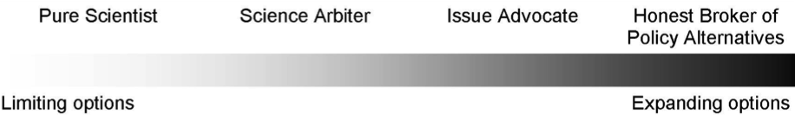
Path from Research Science to Policy
Scientific information can provide a knowledge foundation, expose risks and uncertainty, resolve conflict, and garner public favor. (Ewing, 2010)
“…little support for a limited role for scientists, strong support for an interpretive role, almost universal support for an integrated role, moderate support for an advocacy role, and little support for a complete decision making role for scientists…”

Slide 4
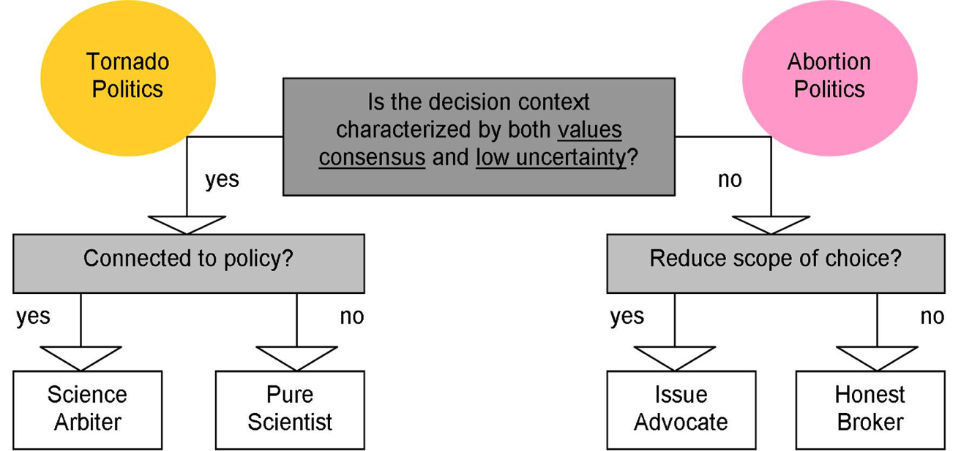
Science & Honest Brokers
From Pielke (2007)

Slide 5
Research: Conflict Cartographers
Planning
Goals
Planning
Goals
NOAA/
NMFS
Governor’s
Office
Corps of
Engineers
ESA
Review
policy
404
permit
policy
policy
Technical
Review
DEQ&WRD
AQ/Wtr Res
State Lands
DOGAMI
permit
fees
fees
permit
permit
DLCD
Policy
Gravel &
Rock
Counties
State
Forests
OCAPA
Members
Policy
Products
Gravel &
Rock
Recycle &
Reclamation
Zoning
Gravel &
Rock
Farm
Bureau
Lobby
Agriculture
Cities
Soils
Aggregate
Products
Zoning
Policy
State
Ag. Dept.
& Data
Gravel &
Rock
Habitat
Soils,
Policy
Fish
permit
Fish
Recycling
ODOT
NRCS
Gravel &
Rock
& Forests
Habitat
Protection
ODF&W
USFS &
BLM
1000 Friends
LWV
Lobby
Who is at the table, who should be at the table?

Slide 6
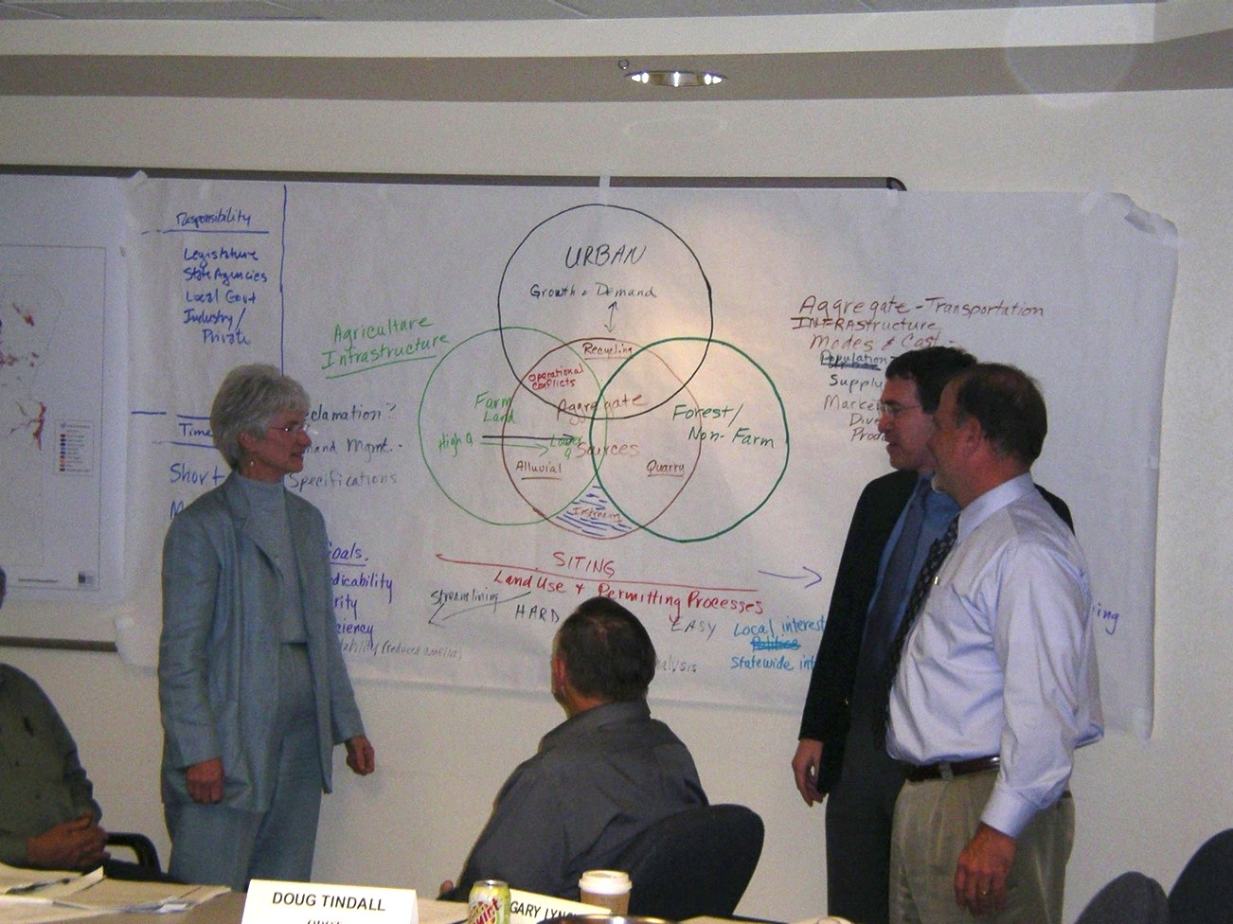

Slide 7
Exposing Risks: Aggregate Mining on Farmland Issues Map
Responsibility
Legislature
State Agencies
Local Gov’t
Industry/Private
Time/Priority
Short Term
Medium Term
Long Term
As Growth and Demand Increases
Need to protect high quality farmland
And encourage siting to move toward lower quality and non-farm
In proximity to demand if possible
Urban
Agriculture
Infrastructure
Needs
Farmland
HVF vs.
Non HVF
Forest/
Non-Farmland
Aggregate
Infrastructure
Transportation –modes &cost
Population Demand
Diversity of Product Supply
Recycling
Alluvial
Quarries
Siting
Reclamation
Demand Mgmt.
Specifications
In Streams
Aggregate
Sources
Goals of Siting Process Reform
Predictability
Clarity
Efficiency
Integration/Coordination of State/Local decisions
Siting
Land Use and Permitting Processes
Streamlining Processes
“Hard” “Medium” “Easy”
Alternatives Analysis (Scope?)
Future:
Adaptive mgmt./learning
Monitoring
Data Gathering

Slide 8
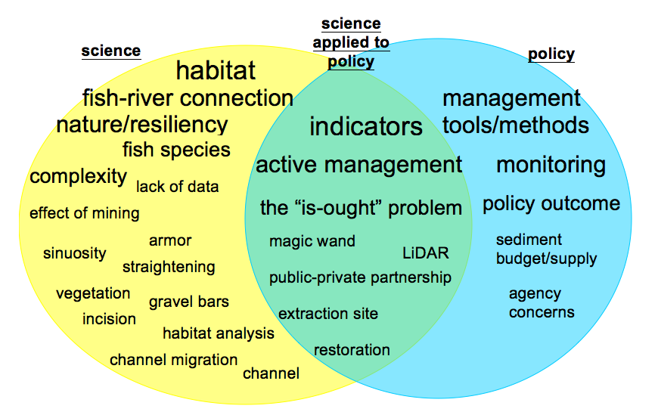
Science & Policy: Rivers, Sand & Gravel Mining
From Ewing (2010)

Slide 9
Challenges: Normative Science, Professional Opinion, or Free Speech
Geology professor that lives near a proposed sand and gravel pit testifies at public hearings as expert for land use groups about destroying high value soils and uses of crushed rock for concrete and road base
Complaint filed by Registered Geologist with Oregon State Board of Geologists Examiners regarding geology professor practicing without a license
Oregon Supreme Court finds testimony is exercise of First Amendment right to free speech

Slide 10


Scientists as
Mediators & Educators?
Science is at the core of water issues because interests and options are not easily defined without the assistance of specialists who can interpret causal chains.
Using Technical Experts
In Complex
Environmental Disputes
by Edward Scher

Slide 11
Science & Policy: Seen and Unseen Boundaries
Washington
Diagram courtesy of Confederated Tribes of the Umatilla Indian Reservation

Slide 12
Umatilla County Research Uses “Collaborative Learning”
Recent innovation-- first application by OSU
was in 1992 in a conflict over forests.
Combines concepts from systems thinking with conflict resolution, negotiation, and mediation.
Emphasizes active learning and systemic improvement.
Integrates best science with relevant traditional/local knowledge.
From Daniels and Walker (2001)

Slide 13
Some CL Tactics/Techniques
Informing and engaging citizens
Issue talks, technical & local/traditional
Newsletters, websites
Systems thinking
Situation mapping
Community mapping
Concerns & improvements
Worksheets
Group interaction
Desirable and feasible debate
Action plans
Draft improvement texts

Slide 14
Science: Take the Word On the Road

Slide 15
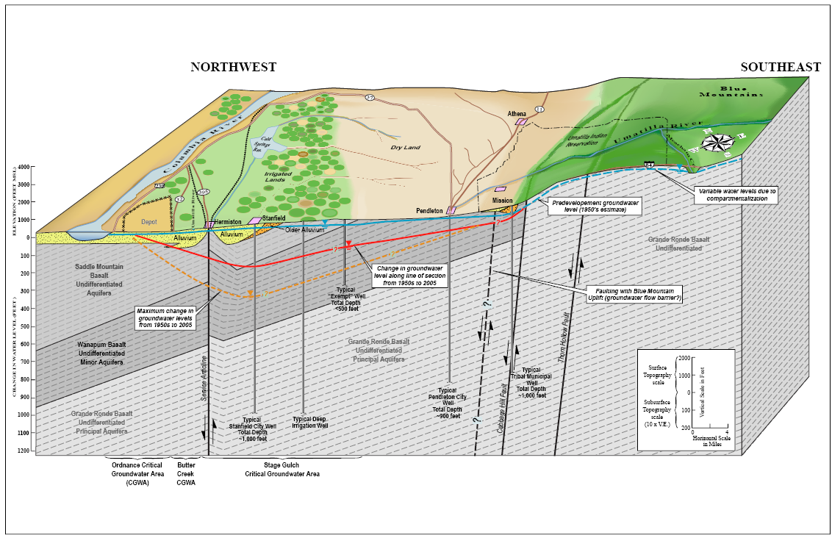
Another Scientific View of Situation

Slide 16
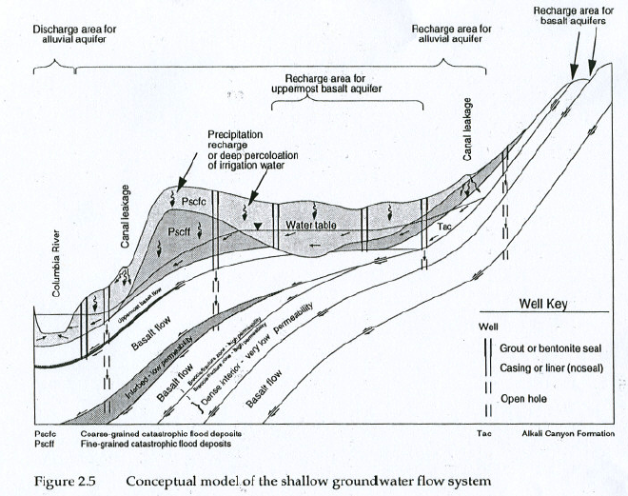
Challenge: Tension Between Political & Technical
Notes:
If we examine just the ecology of groundwater systems, the areas can be very small and short-lived to large and long lasting. Human disturbances associated with development can cause the boundaries to change very quickly. Consider, for example, a pumping well. Pumping technology has evolved greatly in the past 50 years, so the disturbance can impact the boundary from just part of an aquifer to the entire aquifer system, and we see this usually in the ages of the water that are pumped.

Slide 17
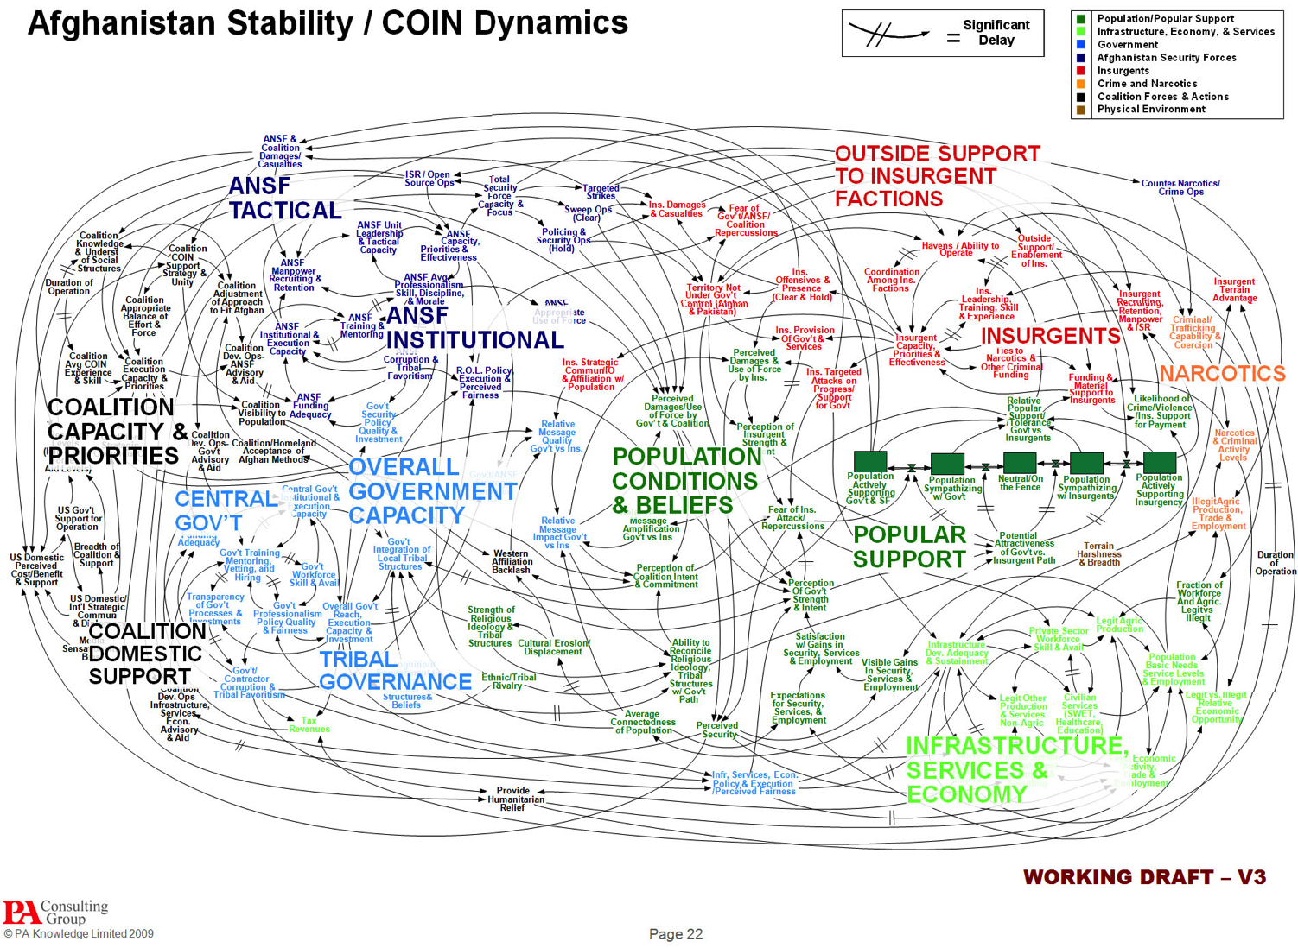
Big Projects and Complexity

Slide 18
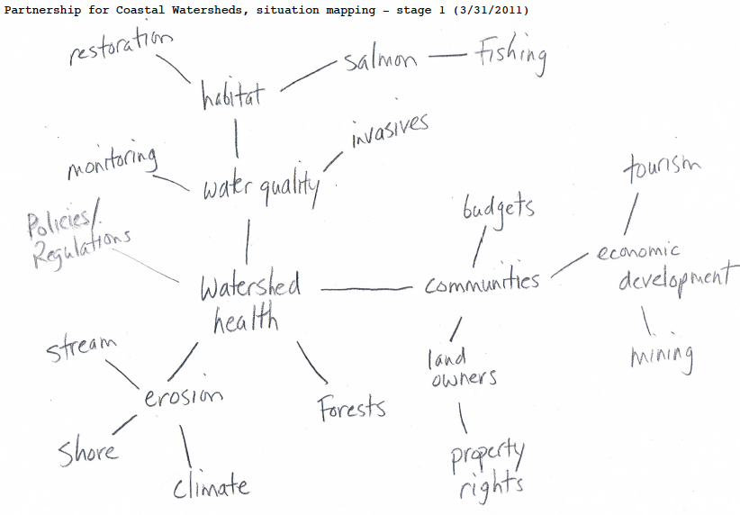
Small Projects
are Complex, too

Slide 19
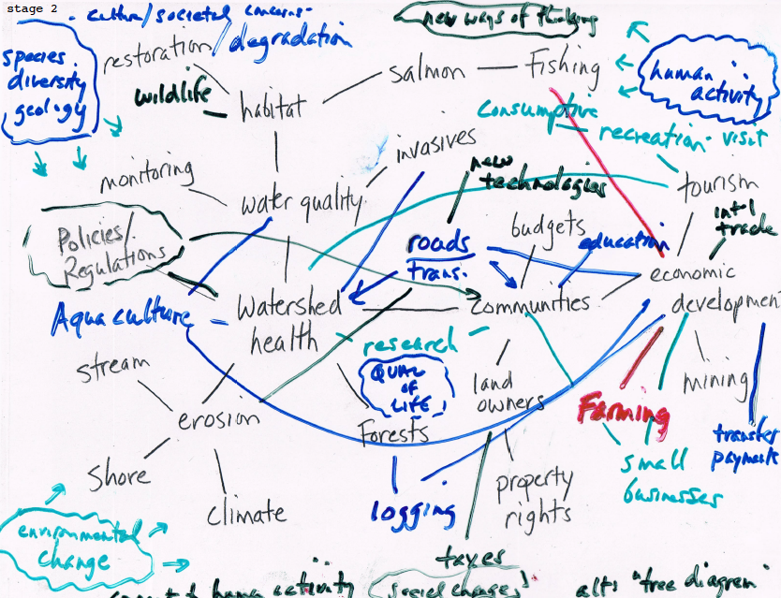

Slide 20
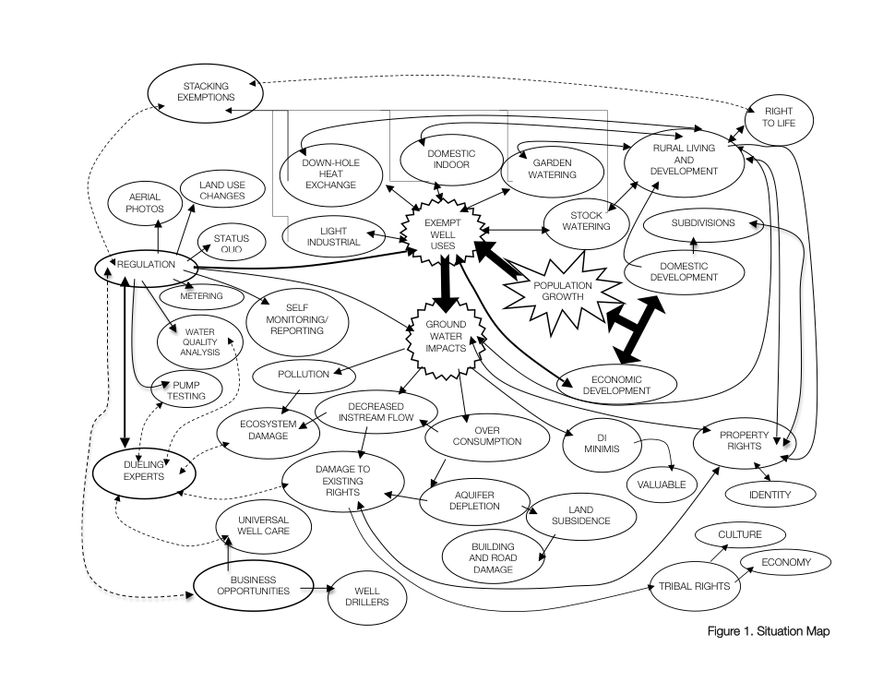
Science and Policy:
US - Canada Exempt Wells Situation Map
From Vinett (2011)
Searching for Research Opportunities…

Slide 21
Research:
Circle of Conflict - Finding Landmines
Data conflict Lack of Data
Procedures
Interpretation
Assessment
Value conflict
De Minimus
Land Use
Culture
Green Energy
Interest conflict
Property Rights
Water Rights
NIMBY
Business Opps.
Structural conflict
Power of Status Quo
County Commissions
Courts
Rural vs. Urban
Identity conflict Urban vs. Rural
Right to Life
Relationship conflict NIMBY
Developers
Dueling Experts
From Vinett and Jarvis (2012)

Slide 22
Research: Spaghetti Western Water War
From Jarvis (in progress)

Slide 23
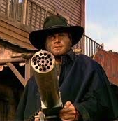
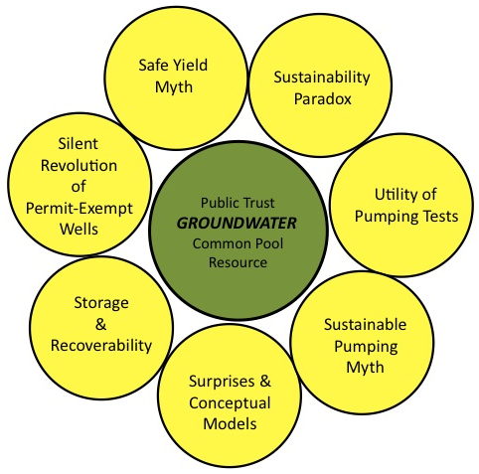
“Hydrostitutes?”
Empty Language, Empty Souls
Django (1966)
Adapted from Jarvis (2010)

Slide 24
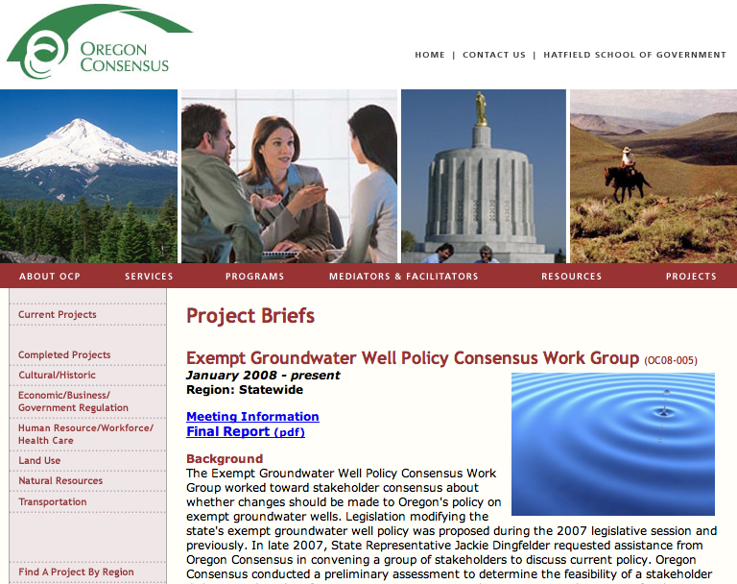
Challenge: Science & Exempt Well
Policy Work Group
Hamman (2005) states "Those individuals, communities, and institutions that benefit from the current allocation or perceive they will suffer from a change have great power to defend the status quo."

Slide 25
Academic Tokenism and Policy: Greywater & The Colors of Water
“Green versus Black & White”
"Graywater reuse is viewed by the green-leaning layperson as the panacea for water shortages, groundwater depletion, surface water contamination, and climate change"; and
"Graywater is seen by society's public health guardians (including the water utilities) as a threat to health and safety of the users themselves and their neighbors”.
"Neither of these caricatures of graywater is accurate, although an element of truth resides in each".
AWWA – White Paper on Graywater (2010)

Slide 26
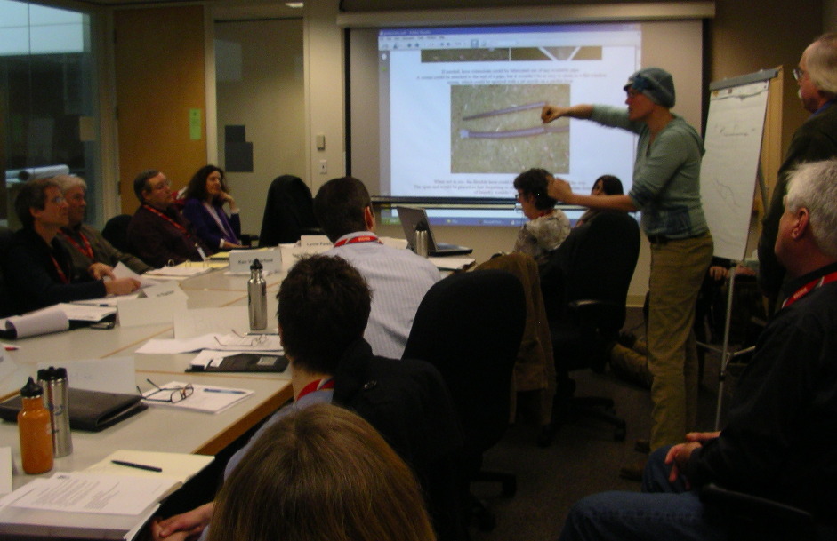
Science & Policy: Protecting the Public?
Environmental Atty./Activist
Civil/Structural Engineer
Toxicologist
Landscape Architect
Environmental Atty.
Architect
Water Quality Analyst
Plumbing Designer
Green Bldg. Coordinator
Water Quality Manager
Wastewater Managers
Urban Res. Conservationist
Engineering Geologist &
The Token Academic
Each profession has a different way of defining
this (except the lawyers who don’t mention it)

Slide 27
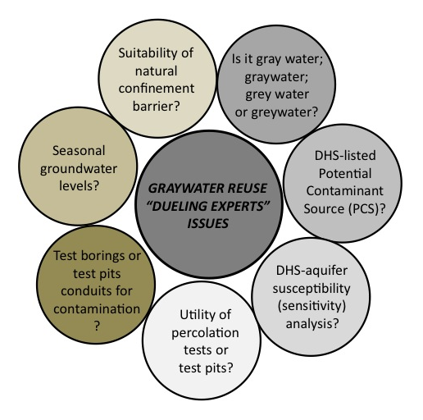
“Guerilla Well-fare”
Another Dueling Expert Situation

Slide 28
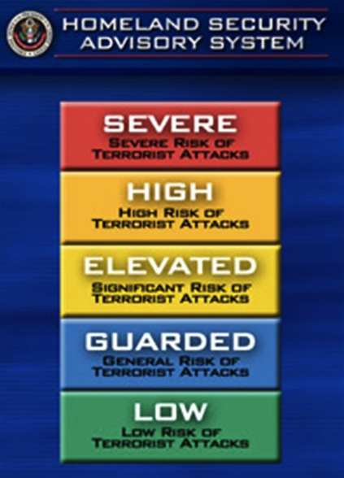
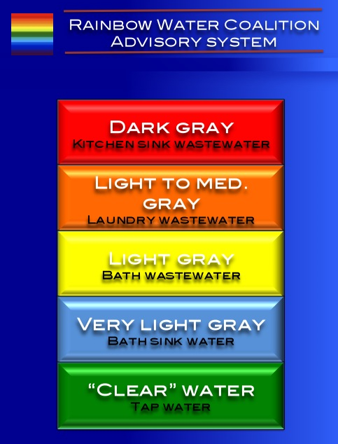
The Tragedy of Classifications
Classifications ≅ Source + Threat + Risk + Arbitrary + Capricious + Colors

Slide 29
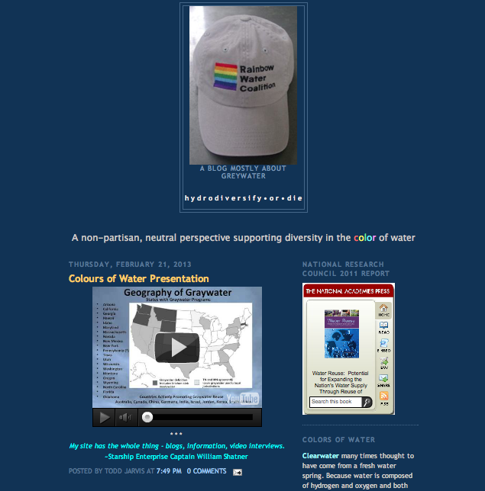
Emerging Trends: Science and Social Media

Slide 30
Emerging Trends: “Blurring the Boundaries of Disciplinary Research” and Transdisciplinarity
Negotiation Stage | Common Resource Claims | Collaborative Skills | Geographic Scope | Core Motive Influencing Decision Making | Trans-disciplinarity
Adversarial | Rights | Trust-building | Nations | Institutions | What Exists
Reflexive | Needs | Skills-building | “Basins” | Information | What We Are Capable of Doing
Integrative | Benefits | Consensus-building | “Benefit-sheds” | Incentives | What We Want to Do
Action | Equity | Capacity-building | Region | Identity | What We Must Do
From Jarvis (in progress)

Slide 31
Emerging Trends: Knowledge Journalism vs. Peer-Review Journals
Emerging power of “knowledge journalism and celebrity authors”
Special class of public intellectual who writes journalistically, but blurs the lines between journalism and activism.
Examples: Bill McKibben, Thomas Friedman, Andrew Revkin, Peter Gleick, others

Slide 32
Pitfalls or Prophecy:
Politics or Science Leading the Way?
“Understanding the political landscape into which one wants to introduce new concepts and approaches is more important than being expert in those concepts.”
2008 Stockholm Water Prize Winner Professor J. A. “Tony” Allan

Slide 33
Conclusions: Interface Between Research, Management and Policy
Irish dramatist & poet William Butler Yeats succinctly summarized the new paradigm:
“Think like a wise man but communicate in the language of the people.”
Knowledge Entrepreneurs must be aware their work is increasingly
political and will be used in many ways, some good, some not so good.
Knowledge Entrepreneurs must accept that the traditional methods of
sharing their message through peer-reviewed journals and technical reports
has little impact.
Knowledge Entrepreneurs must integrate the new modes of communication
through social media, video, and knowledge journalism.
Thank you for your invitation and attention

