Slide 1
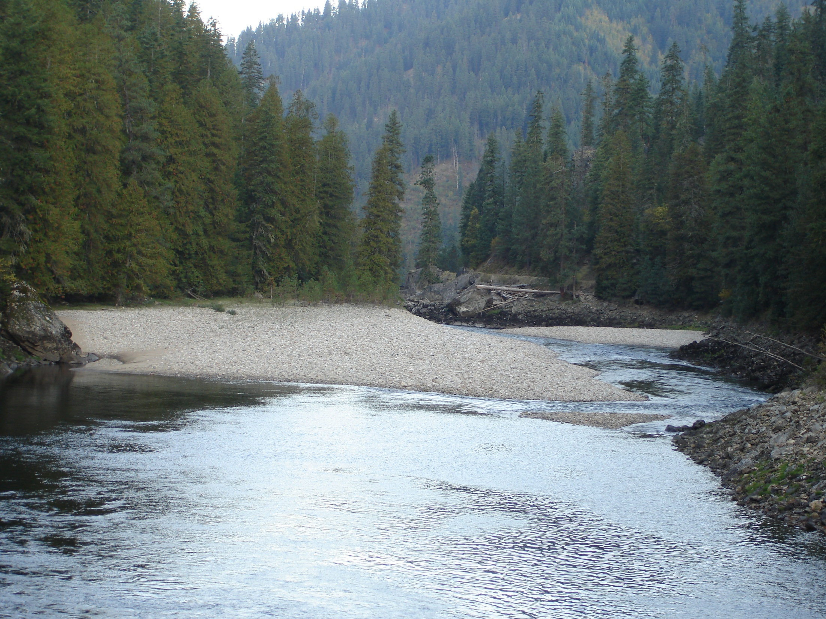
Fish Consumption
&
Water Quality
Don A. Essig, Idaho Department Of Environmental Quality
Spokane River Forum, March 27, 2013

Slide 2
Some Differences Between ID & WA
National Toxics Rule
2005 Human Health Criteria Update
Available Fish Consumption Data
Fish Resources
Rulemaking Process
Notes:
In WA human health is covered by the 1992 National Toxics Rule, with a FCR of 6.5 g/day.
Idaho adopted EPA’s NTR criteria into its WQS by reference in 1994, and fully incorporated them in 2003
In 2005 Idaho updated its human health criteria taking into account new data on toxicity and upping its FCR to 17.5 g/day as recommended by EPA’s 2000 Human Health Methodology. This update was submitted to EPA for their approval in July 2006. Not until May 12th of last year did EPA finally take action (nearly 6 years later), disapproving Idaho’s update for a FCR they said they could not determine was protective, and oddly enough putting us back to criteria based on 6.5 g/day until we come up with a new rule.
Fish consumption data for Idaho consists of EPA’s 2002 national survey, and CRITFIC’s 1994 survey of four tribes, one of which was the Nezperce in Idaho. When we looked at fish consumption data n 2005 it was the same story and we had no way to tease out the information specific to Idaho. In WA there has been much more fish consumption survey work done.
Idaho has no coast, little shellfish, and no commercial fishery to speak of (6 tons of crayfish per year).
Idaho began its consideration of a new FCR last fall, beginning its negotiated rulemaking process. Final rule must be approved by Idaho legislature before it is submitted to EPA.

Slide 3
Where is Idaho in its process?
Idaho has had 3 rulemaking meetings to date
In our second meeting we announced our decision to collect new data on fish consumption in Idaho
We want to survey two populations:
All Idahoans
Recreational anglers
We are just beginning survey design
Plan to begin surveys later this year
Spring of 2016 is the earliest we might have a new rule
Notes:
We know EPA has money to fund surveys for each of the 5 tribes in Idaho, so that is covered outside of Idaho’s efforts
General population of Idaho is biggest data gap, and while regulatory FCR is not likely to be based on a general population distribution alone, we feel it is important to:
put more focused sub-population fish consumption patterns into context
be able to communicate risk to all Idahoans
move a regulatory fish consumption rate through rulemaking process

Slide 4
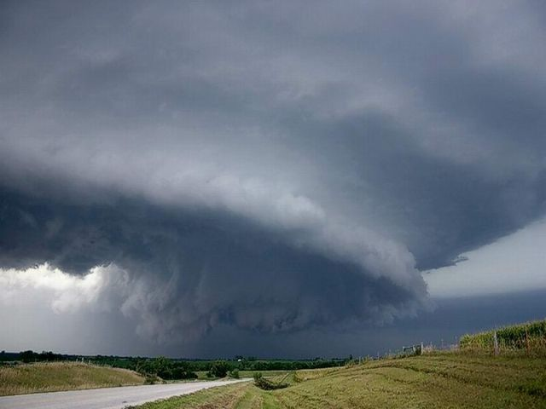
“Many of the components in the 2000 Human Health Methodology are an amalgam of science, science policy, and/or risk management.”
Notes:
Methodology for Deriving
Ambient Water Quality Criteria
for the Protection of
Human Health (2000)
EPA-822-B-00-004
October 2000

Slide 5
Science
How much fish do people eat?
What dose of a toxin elicits a harmful effect?
Science Policy
Do we treat a particular toxin as having a threshold , linear, or non-linear effect (dose-response)?
Use and choice of uncertainty factors
Risk Management
What is protective … enough? Of whom?
Notes:
Science Policy:
Use of animal data to represent human health.
What effects do we consider harmful?
Using BAFs rather than BCFs
Risk management:
What FCR do we use in criteria calculation, is a 90th percentile FCR the right choice?
Of what population of sub-populations?
Choice of cancer risk factor
Default 20% for relative source contribution.
Do we include marine fish or market fish?
Other public policy questions
Is it reasonable to expect to reduce fish contaminant levels through local water quality criteria?
How do we implement criteria we may not be able to measure reliably, or ever achieve?

Slide 6
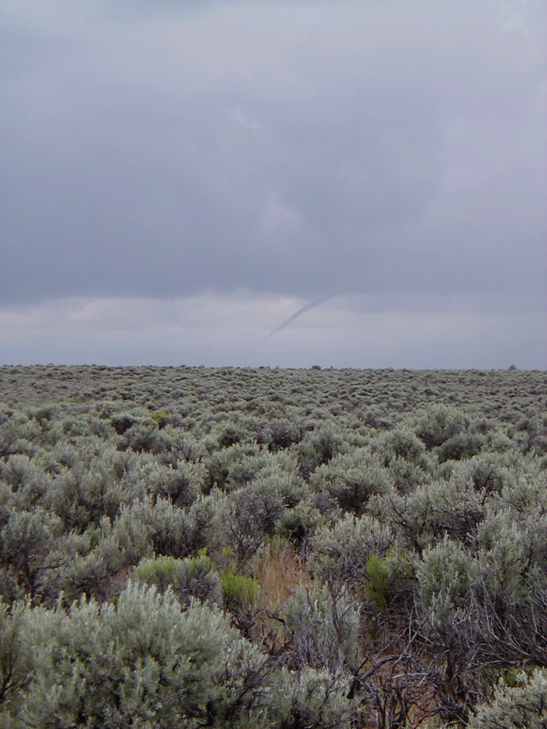
“EPA believes that ambient water quality criteria inherently require several risk management decisions that are, in many cases, better made at the State, Tribal, or regional level.”
Notes:
Idaho’s plan is to discuss and hopefully resolve some important policy decisions while our survey’s are underway.

Slide 7
Some Important Questions
How well do we know who is a fish consumer?
How do we account for market fish?
How do we account for anadromous fish?
Who are we trying to protect and what does it mean to be protected?
Is it better to calculate criteria using distributions rather than point estimates?
Notes:
The first is also a target population question – consumers or non-consumers – but we often don’t have a good handle on who is who. The EPA national data set is a good example, and miss-identification skews the statistics.
Clearly market fish provide a dose of toxins, but whose responsibility is it regulate those sources, does it make sense to do so through surface water quality criteria?
The same question arises with anadromous fish, which get most of their body burden of toxins from their time in the ocean. EPA in their national FCR excluded marine fish, but are salmon marine fish or not? In EPA 2002 “salmon was apportioned across the marine and freshwater habitats.”
Salmon Habitat Apportionments
Freshwater (Great Lakes) 0.05%
Estuarine (Aquaculture) 4.73%
Marine (Pacific) 95.22%
How far out on the risk spectrum do we go, how well do we know the spectrum?
The last one is a mouthful, and quite technical at its roots. The current approach combines a number of point estimates, like a 90th percentile FCR and mean body weight, which means at the end of the calculation we can’t say how protective we are being. Using distributions can get us on more solid ground, but it is more complicated, and we may not have or be able to generate distributions for all the inputs to the criteria calculations. So is a hybrid approach a step forward?

Slide 8
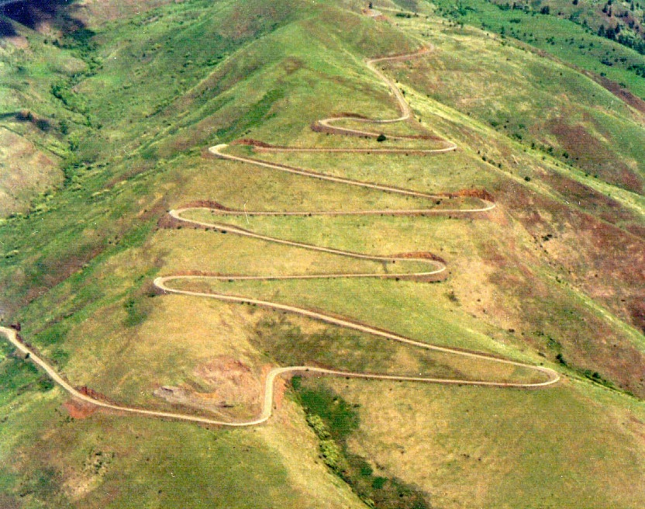
It took us a while to get here, …
and we’ve got a ways to go yet.
Notes:
It took us a while to get here, and we’ve got a ways to go yet.
And it appears we are travelling in a bus, with multiple steering wheels.

