Slide 1
Nutrient Transport in Groundwater to Lake Spokane Spokane River TMDL Implementation August 13, 2014
Llyn Doremus Steve Cox
Dept of Ecology US Geological Survey
Water Quality Program WA Water Sciences Center

Slide 2
Presentation Overview
Objectives and Approach to characterizing phosphorus discharge to Lake Spokane
Study design
Data collection
Outcomes
Notes:
Septic systems reduce the rate of phosphorus transport, do not remove phosphorus

Slide 3
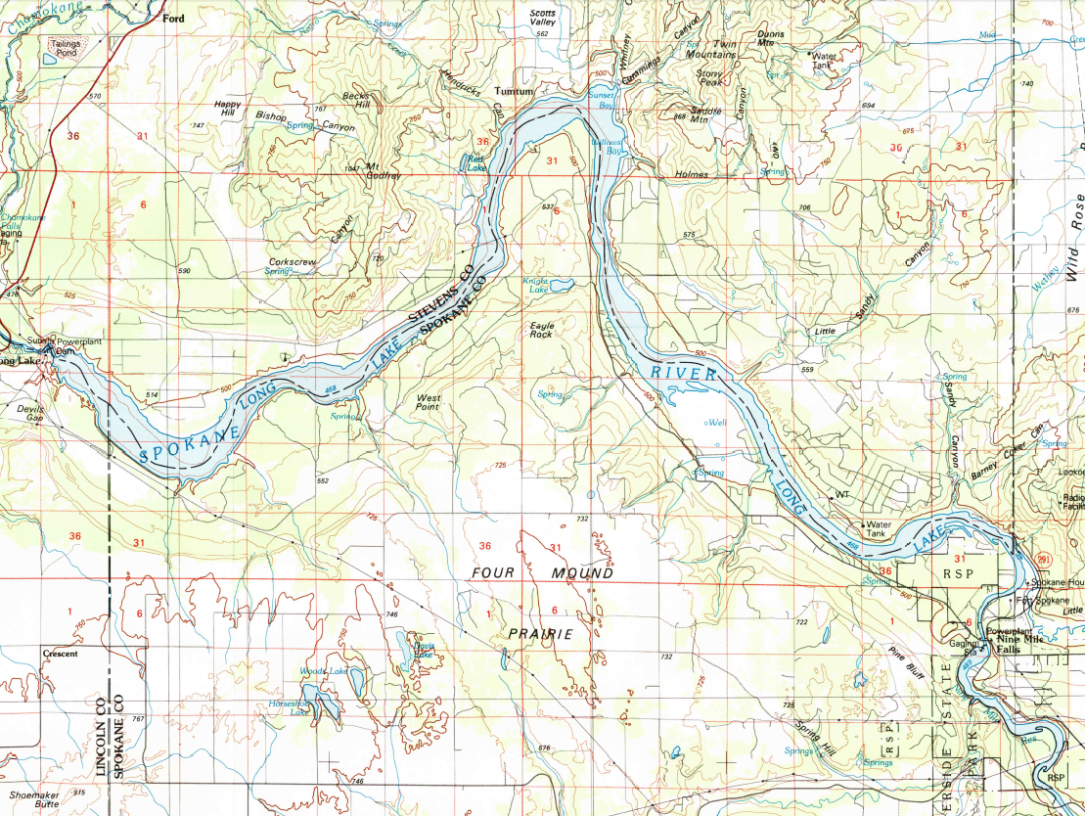
Goal: Identify locations on Lake Spokane north shoreline influenced by phosphorus from onsite septic systems
Approach: Establish and measure conditions that differentiate septic influence from non-impacted sites

Slide 4
Approach
Measure nutrients in groundwater and lakeside vegetation at various locations
Groundwater is the transport mechanism for nutrients infiltrating through OSS
Plants are receptacles for nutrients discharging from groundwater to Lake Spokane
Nutrients are the problematic constituent that we are focused on managing

Slide 5
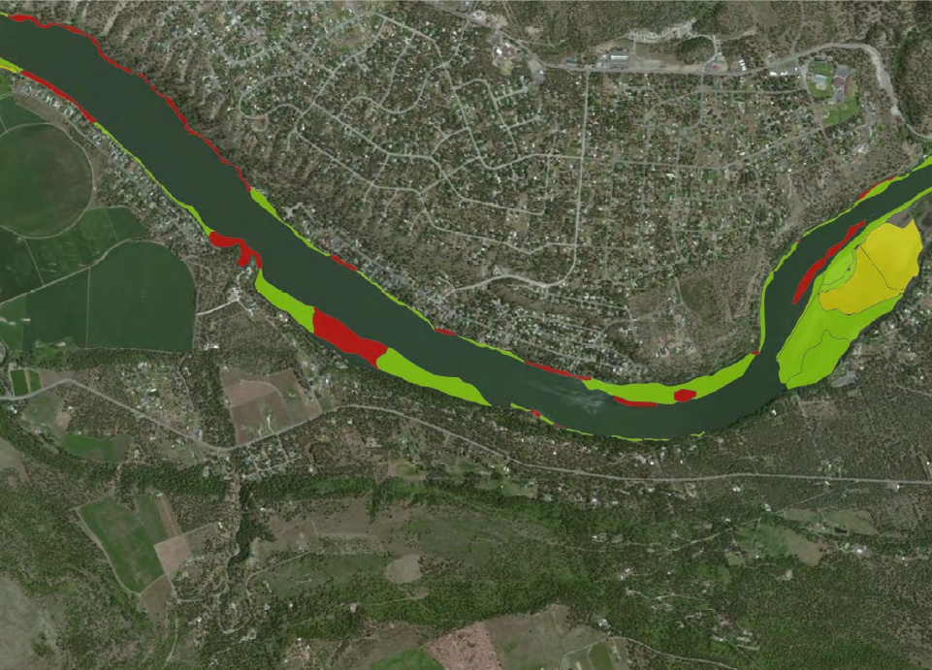
Notes:
how to distinguish OSS source of nutrients?
Lots of algae, lots of nutrients –
Nutrients derive from: vegetation and animals, surface runoff of fertilizers
Nutrient mix in lake water, which obscures source

Slide 6
Nitrogen isotope ratio as a tool for source evaluation
Nitrogen ¹⁵N to ¹⁴N isotope ratios increase with increasing trophic level (denoted as d¹⁵N)
Metabolism fractionates ¹⁵N; concentrating ¹⁵N in the metabolizing organism
d¹⁵N ratio increases by 3 for each step up the trophic level (ratio in humans is 6- 10 ppt)
d¹⁵N ratios further increased by microbial action in septic tanks (typical is 10 – 20 ppt)
Background atmospheric ratio (¹⁵N:¹⁴N) is constant, at 0 (parts per thousand)

Slide 7
Nitrogen isotopes in near shore plants
Algae (and plants) growing in water derive nitrogen from water in root zone
Plants growing in shoreline area derive nutrients from groundwater discharging in root zone
Plants uptake of N exhibits ¹⁵N : ¹⁴N in the proportions available over time – displaying a time integrated ¹⁵N ratio in plant tissue
Notes:
higher N15 concentrations in the water supply yields higher d¹⁵N in plant tissue

Slide 8
Onsite Septic Systems (OSS) Source
1,380 onsite septic systems (OSS) at Suncrest
250 OSS along Spokane County shoreline
Nitrogen and phosphorus are released through OSS drain fields & infiltrate to groundwater
Nitrogen (as nitrate) moves quickly through groundwater – it doesn’t breakdown or react
Nitrogen in OSS is enriched in ¹⁵N
OSSs do not remove phosphorus – P is absorbed to sediment & breaks through as soil absorption sites are saturated
Notes:
Ninemile/ Suncrest algae formation indicates nutrient loading from groundwater discharge

Slide 9
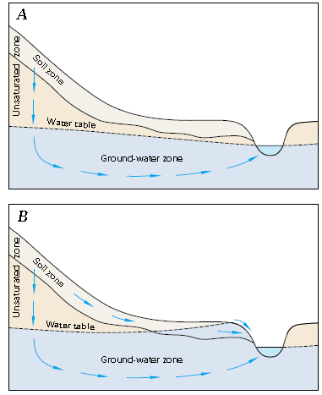
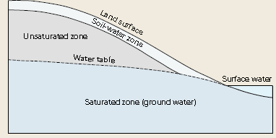
Groundwater transport pathways
Notes:
Groundwater discharges at shoreline interface, and above (Springs visible along shoreline)
Identify wells to collect samples in Suncrest area
Install “drive points” to collect groundwater in nearshore area

Slide 10
Lake level changes& groundwater
Groundwater level above lake surface causes groundwater discharge to lake
Lake levels above groundwater level causes lake discharge to groundwater
Notes:
Both of these conditions are likely – depending on the time of year and the lake management practices.
Lower lake levels cause groundwater discharge along the shoreline bluffs above the lake, as springs.

Slide 11
Groundwater Characterization
Groundwater data collection:
Upgradient wells
Shallow groundwater at shoreline locations around Lake collected from piezometers (hand-installed drive points)
Shallow groundwater in areas with septic influence as identified by d15N analyses results
Measure groundwater elevations
Groundwater analyses for:
Total phosphorus, ortho-phosphate, nitrate & nitrite, ammonia, dissolved oxygen, chloride
Example groundwater contamination plume
Notes:
Lots of samples to provide sufficient data for statistical analyses

Slide 12
Source Evaluation Study
Survey Shoreline for Eurasian Milfoil growth locations
Select shoreline sample locations representative of:
high nutrient discharge (lots of plants & upgradient houses)
low discharge (no houses, little algae & plants)
Collect plant tissue for d¹⁵N analyses
multiple sample events for statistically valid analyses
Collect groundwater at a range of locations for P & N content (& at same locations Eurasian Milfoil tissue samples)
Identify septic influenced shorelines using N isotope analyses of plant samples & groundwater
Assess groundwater pathways from OSS to shoreline discharge
Evaluate P content in groundwater at septic influenced sites

Slide 13
Analyses and Results
Assess difference in d¹⁵N ratios and groundwater pathways to distinguish
septic influence
non-septic impacted shorelines
Statistical Analyses of d¹⁵N ratios:
background (upgradient)
undeveloped
developed
Compare with data from other studies to interpret source(s)
Report - findings & mapped impacted areas

Slide 14
Example analyses results

Slide 15
d¹⁵N analyses results

Slide 16
Study Results
Study will generate information which to better understand:
Shoreline locations impacted by septage in groundwater
Suncrest OSS impact on shoreline
Lake Spokane typical d¹⁵N ratios for:
shoreline groundwater
shoreline plants
Phosphorus content of groundwater in impacted shoreline areas
Future study – measure rates of discharge & P loading

Slide 17
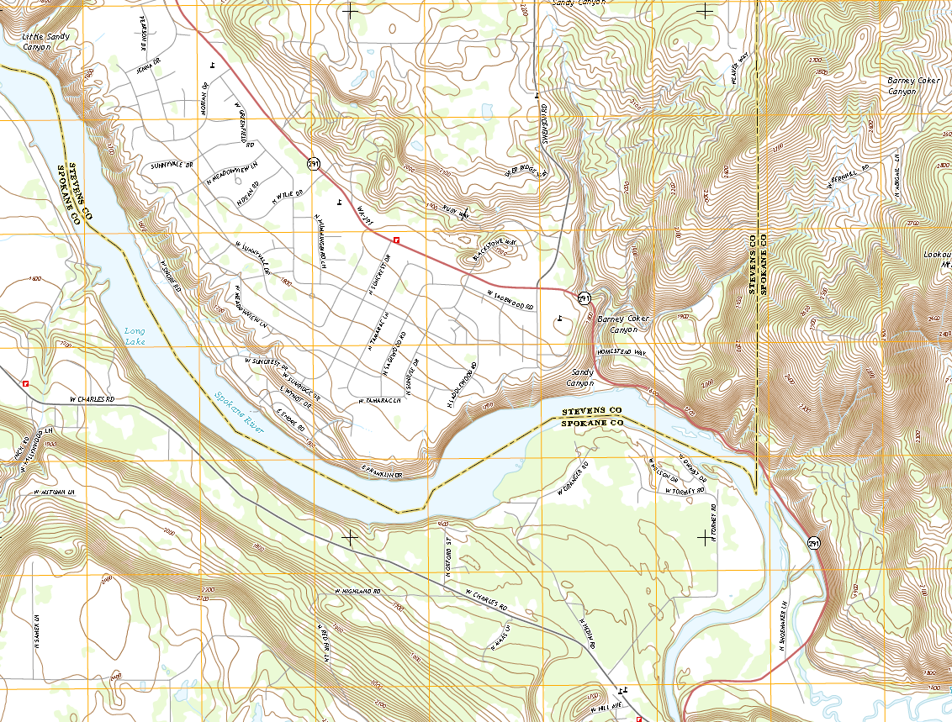

Slide 18
