Slide 1
DO TMDL Advisory Committee Mtg
October, 1, 2015
Meghan Lunney
Aquatic Resource Specialist

Slide 2
Lake Spokane Inflow
36,600 cfs
33,700 cfs
26,600 cfs
19,400 cfs
22,500 cfs
17,000 cfs
2001 Peak Streamflow = 16,800 cfs
*2001, 2010-2014 Peak Streamflows from USGS, Spokane River @ Spokane Gage
Notes:
Avista completes nutrient monitoring in Lake Spokane, May through October. We still have one monitoring event left this year.
We are still receiving and processing our data, so today will include information regarding nutrients. I think I’m here today to talk about the low flows and visual observations we have seen this year.
So lets lake at these hydrographs to talk about the flows in 2015 compared with previous flow years.
Y-axis is flows in cfs, x-axis is time showing 2010-2015
2010, 2013, 2014 and 2015 lower flow years compared with 2011 and 2012
Important to note, with respect to water quality, its not just about the amount of water, but when the water flows through the system. (peaked Feb. @ MGuire)

Slide 3

2015 NWS/NOAA Weather Observations
Very Low Snowpack
Early Snowmelt
Record Hot June (and spring/summer)
Very/Record Dry June (and spring/summer)
High Evaporation Rates

Slide 4
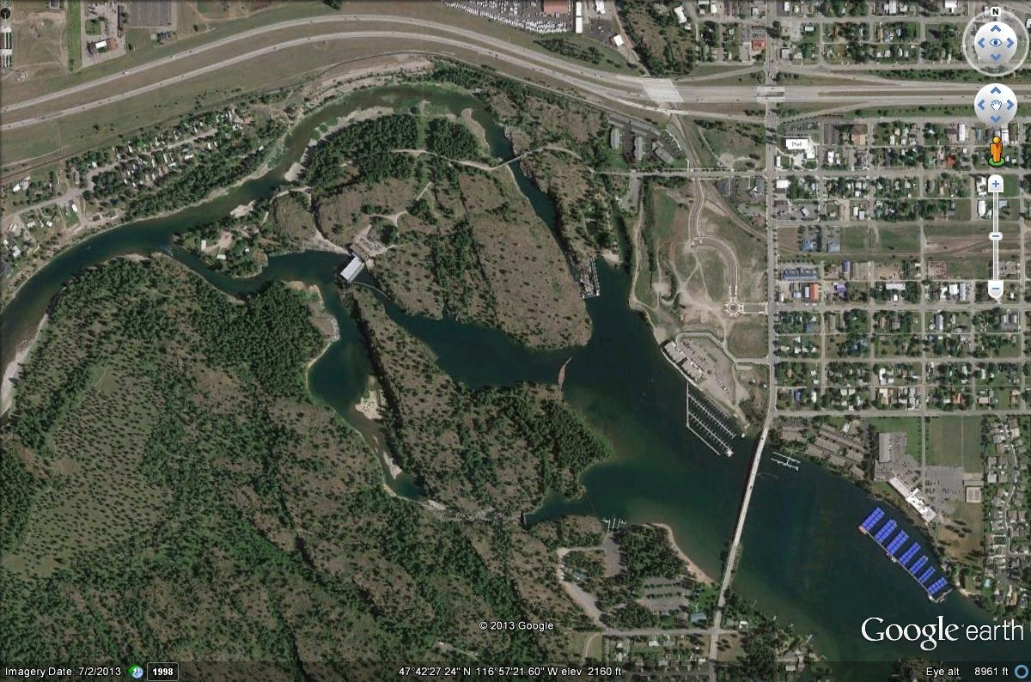
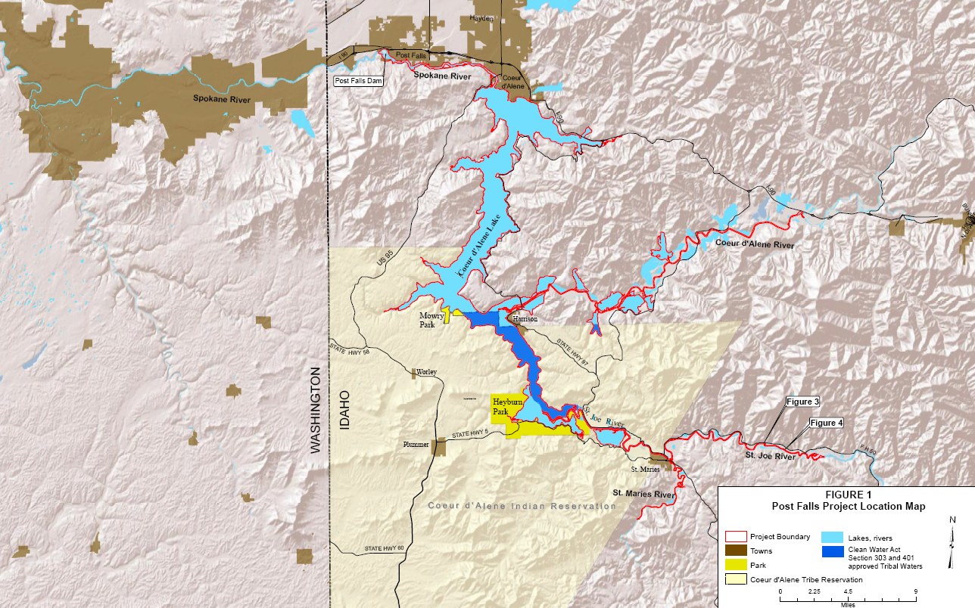
Post Falls HED
Notes:
Post Falls HED
-License requirement to maintain CDA Lake elevation at or near 2,128 ft as early as practicable each year, and maintain it until after the first Tuesday following Labor Day.
-Beginning June 7th of each year, Avista maintains a minimum discharge of 600 cfs from Post Falls.
-If the lakes elevation falls 3 inches below full pool, Avista reduces the discharge to 500 cfs until the fall drawdown

Slide 5
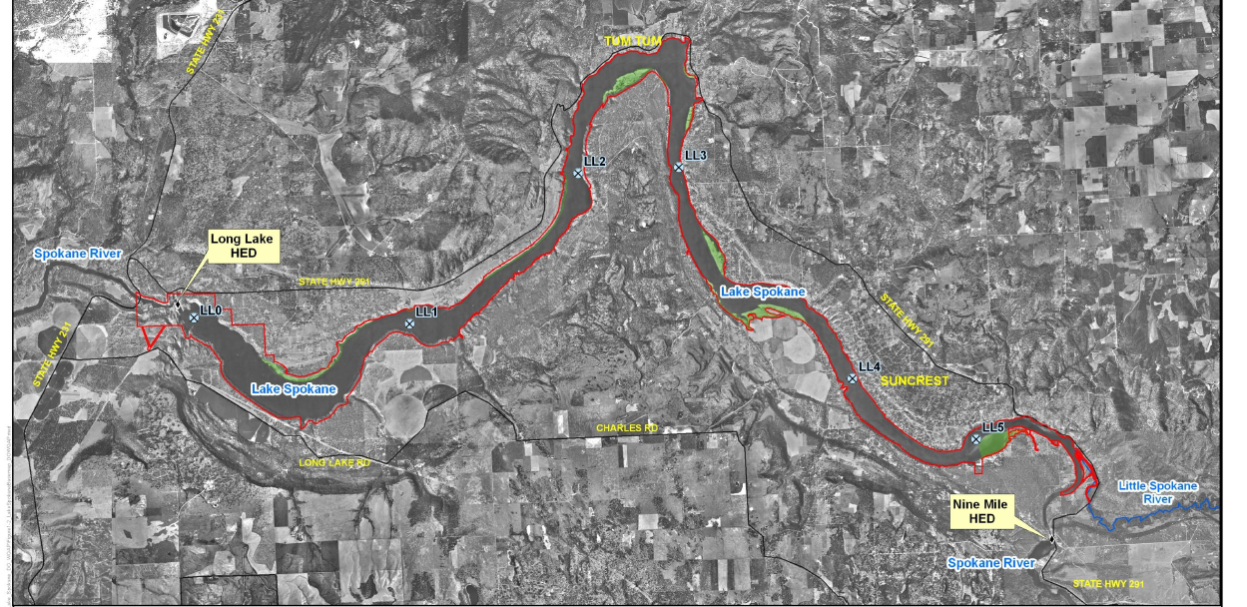
Lake Spokane Nutrient Monitoring
May – October
Stations: LL5 – LL0
Record Low Snowpack
Record Early Snowmelt
Record Hot June (and spring/summer)
Very/Record Dry June (and spring/summer)
Record amount of evaporation measure at Spokane
Water Clarity Indicators
  Chlorophyll-a
  Secchi Disk Depth
  Algae bloom?
Notes:
-Monitor at 6 stations, May - October

Slide 6

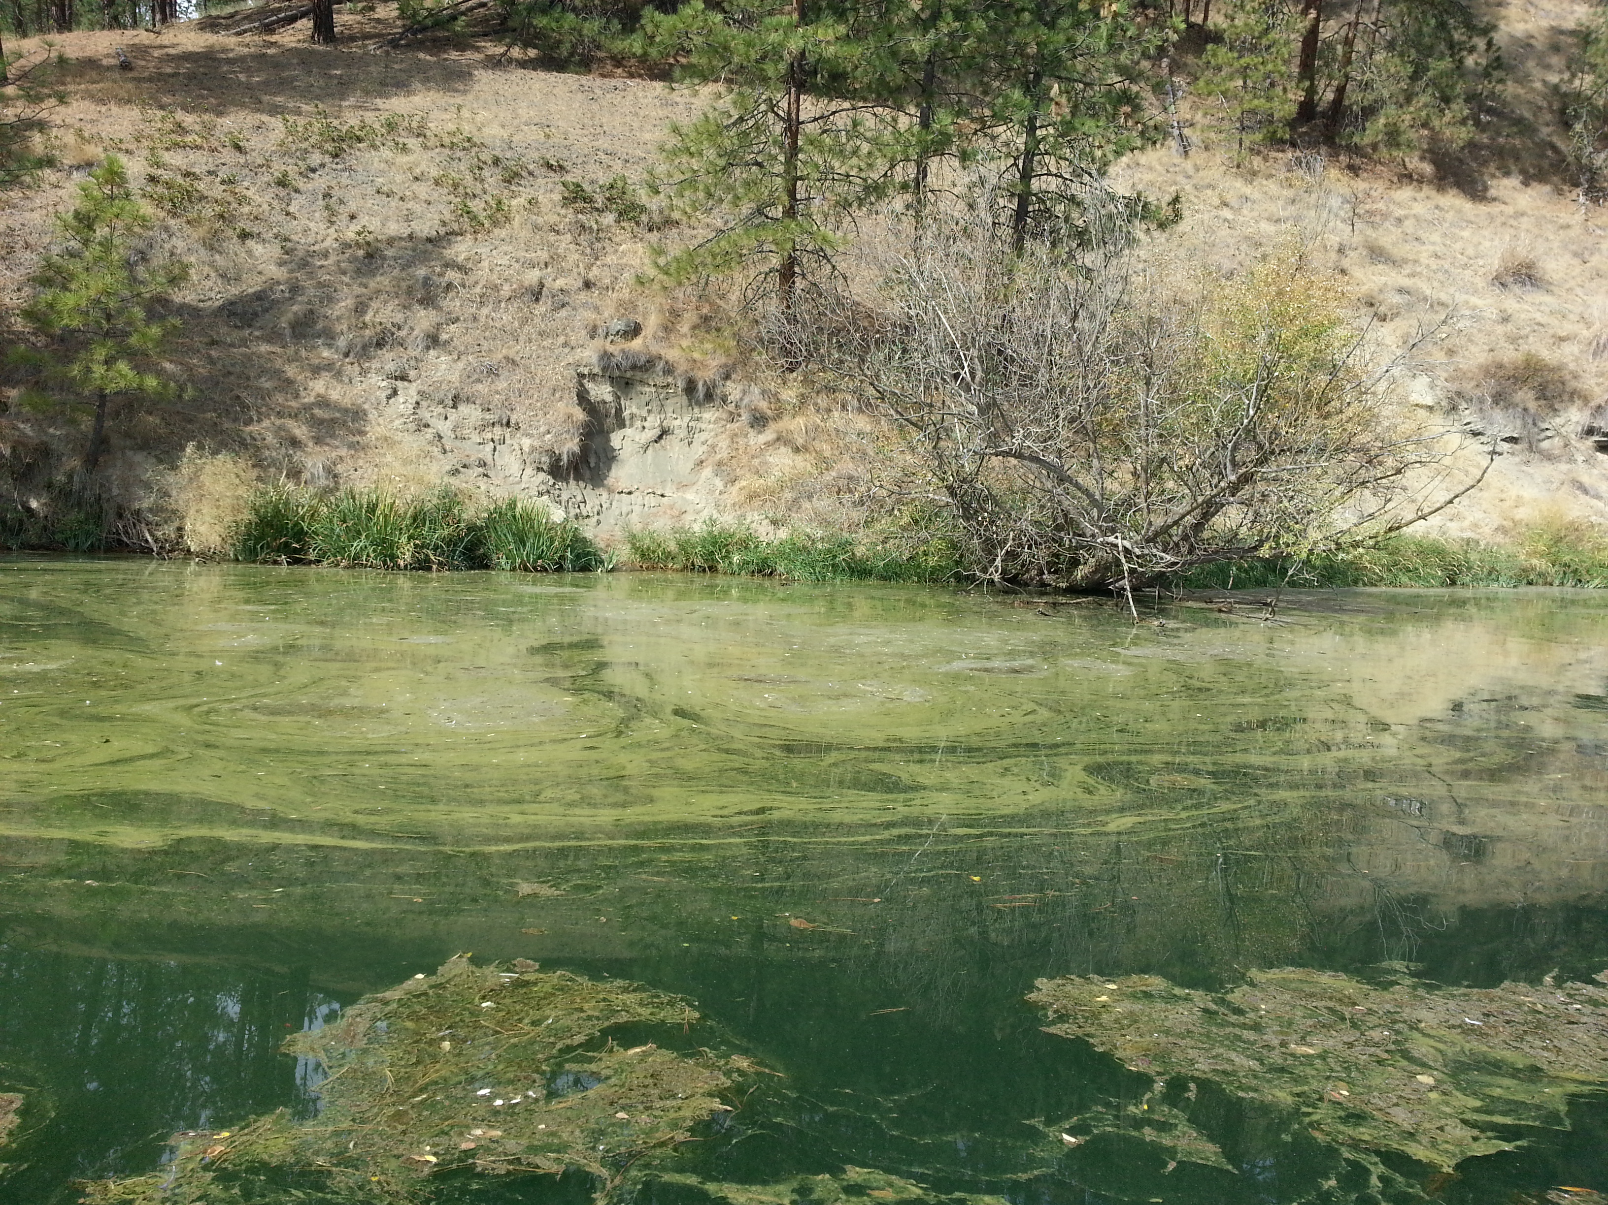
LL5
(~5 m Depth)

Slide 7
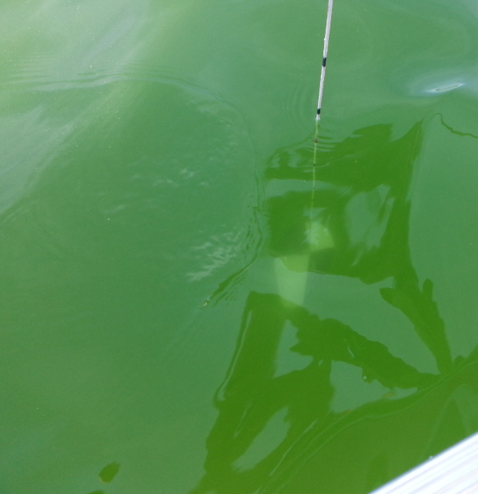
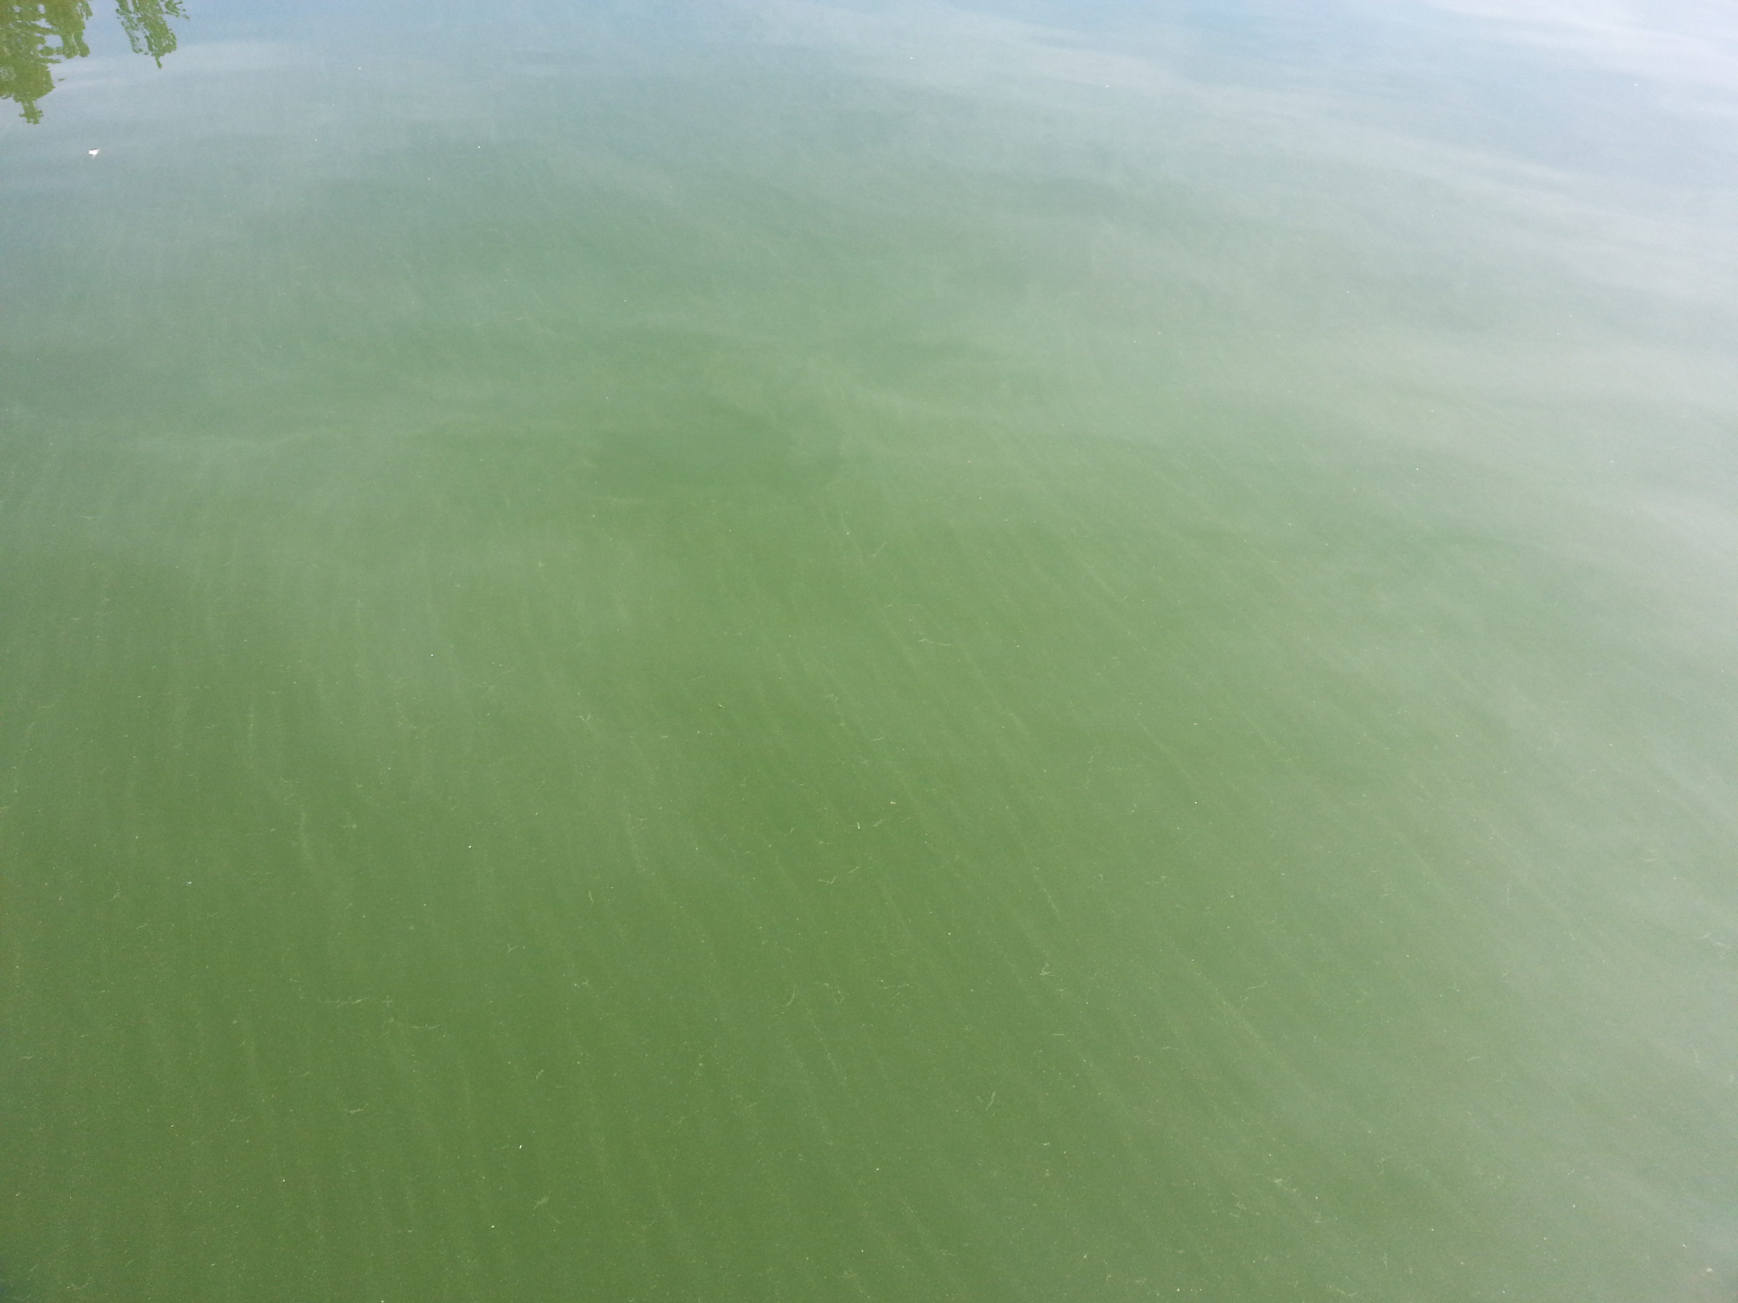
LL4
(~8 m Depth)

Slide 8
LL3
(~19 m Depth)

Slide 9
LL2
(~25 m Depth)

Slide 10
LL1
(~33 m Depth)

Slide 11
LL0
(~47 m Depth)

Slide 12
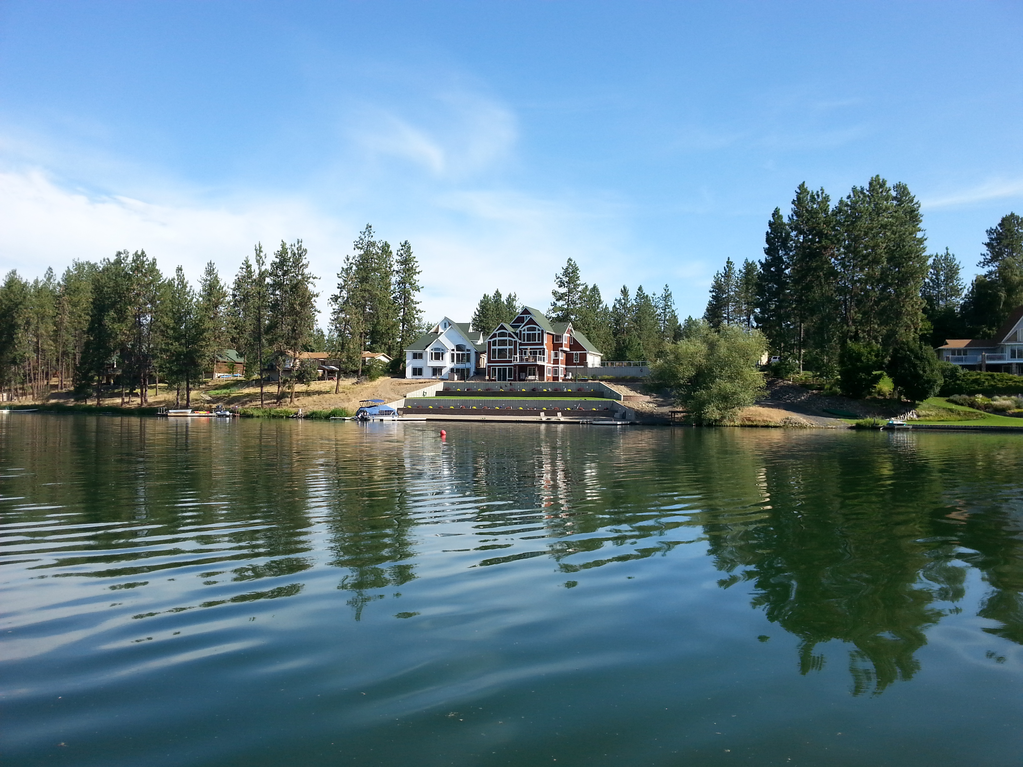
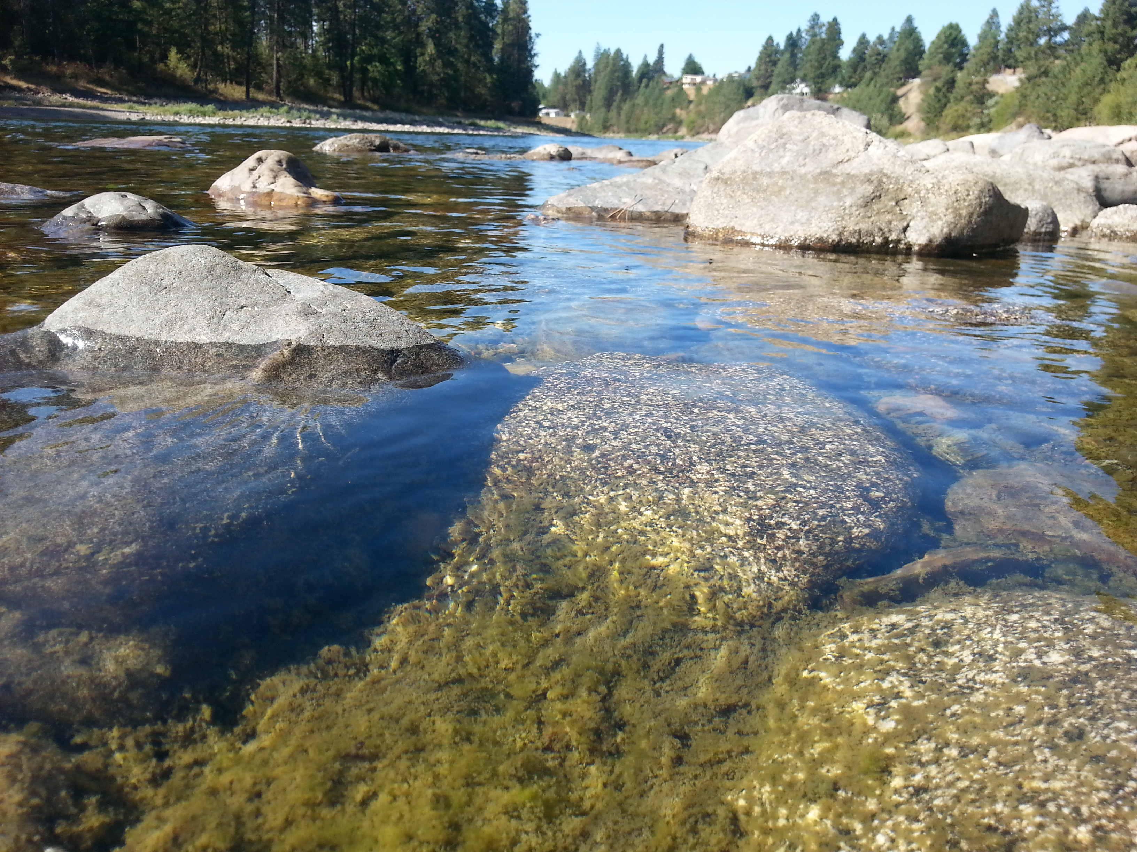
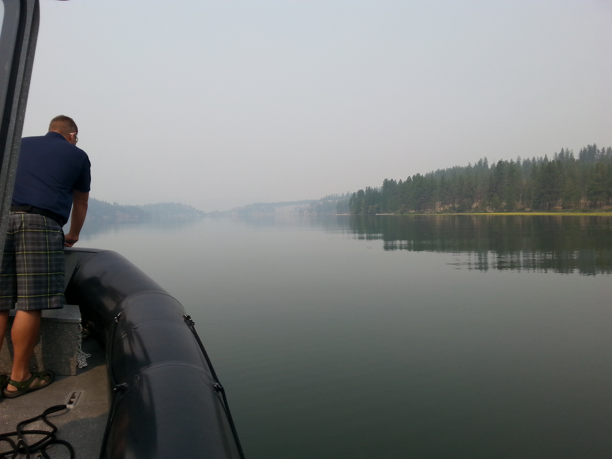
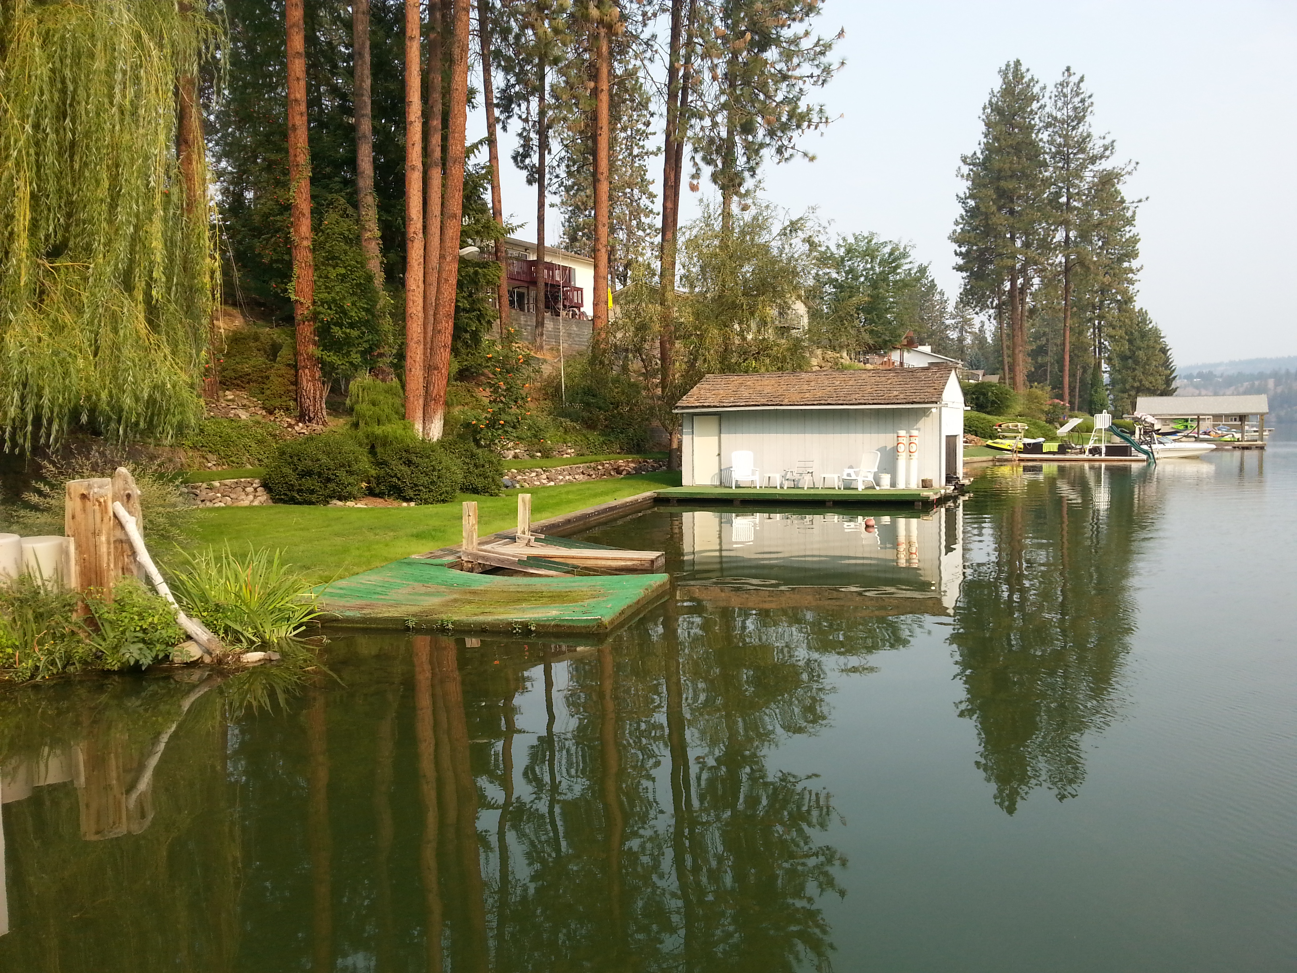

Questions?

